Slide 2
Centering Racial Equity in Neighborhood Revitalization
Monica E. Unseld, Ph.D., MPH

Slide 3
Housing
Climate justice
FIRE regimes
Crime prevention & public safety
Renters
Advocacy ideas
"The need for connection and community is primal, as fundamental as the need for air, water, and food." - Dean Ornish

Slide 4
“Housing is a human right. There can be no fairness or justice in a society in which some live in homelessness, or in the shadow of that risk, while others cannot even imagine it.”
― Jordan Flaherty, Floodlines: Community and Resistance from Katrina
"Segregation in Minneapolis, like elsewhere in the U.S., is the result of historic practices such as the issuing of racialized real estate covenants that kept non-White people from buying or occupying land." - Julian Ageyman, YES! Media, 2020
"At its inception, modern urban planning in the United States followed the European model of focusing on public health, "taking steps like separating industrial and residential uses. However, American planners quickly began using zoning as a tool for segregation." - Emi Okikawa and Tim Frank. 2021
Calls for urban highway and interstate removal
Pollution
Public transportation
Jobs
Aging infrastructure

Slide 5
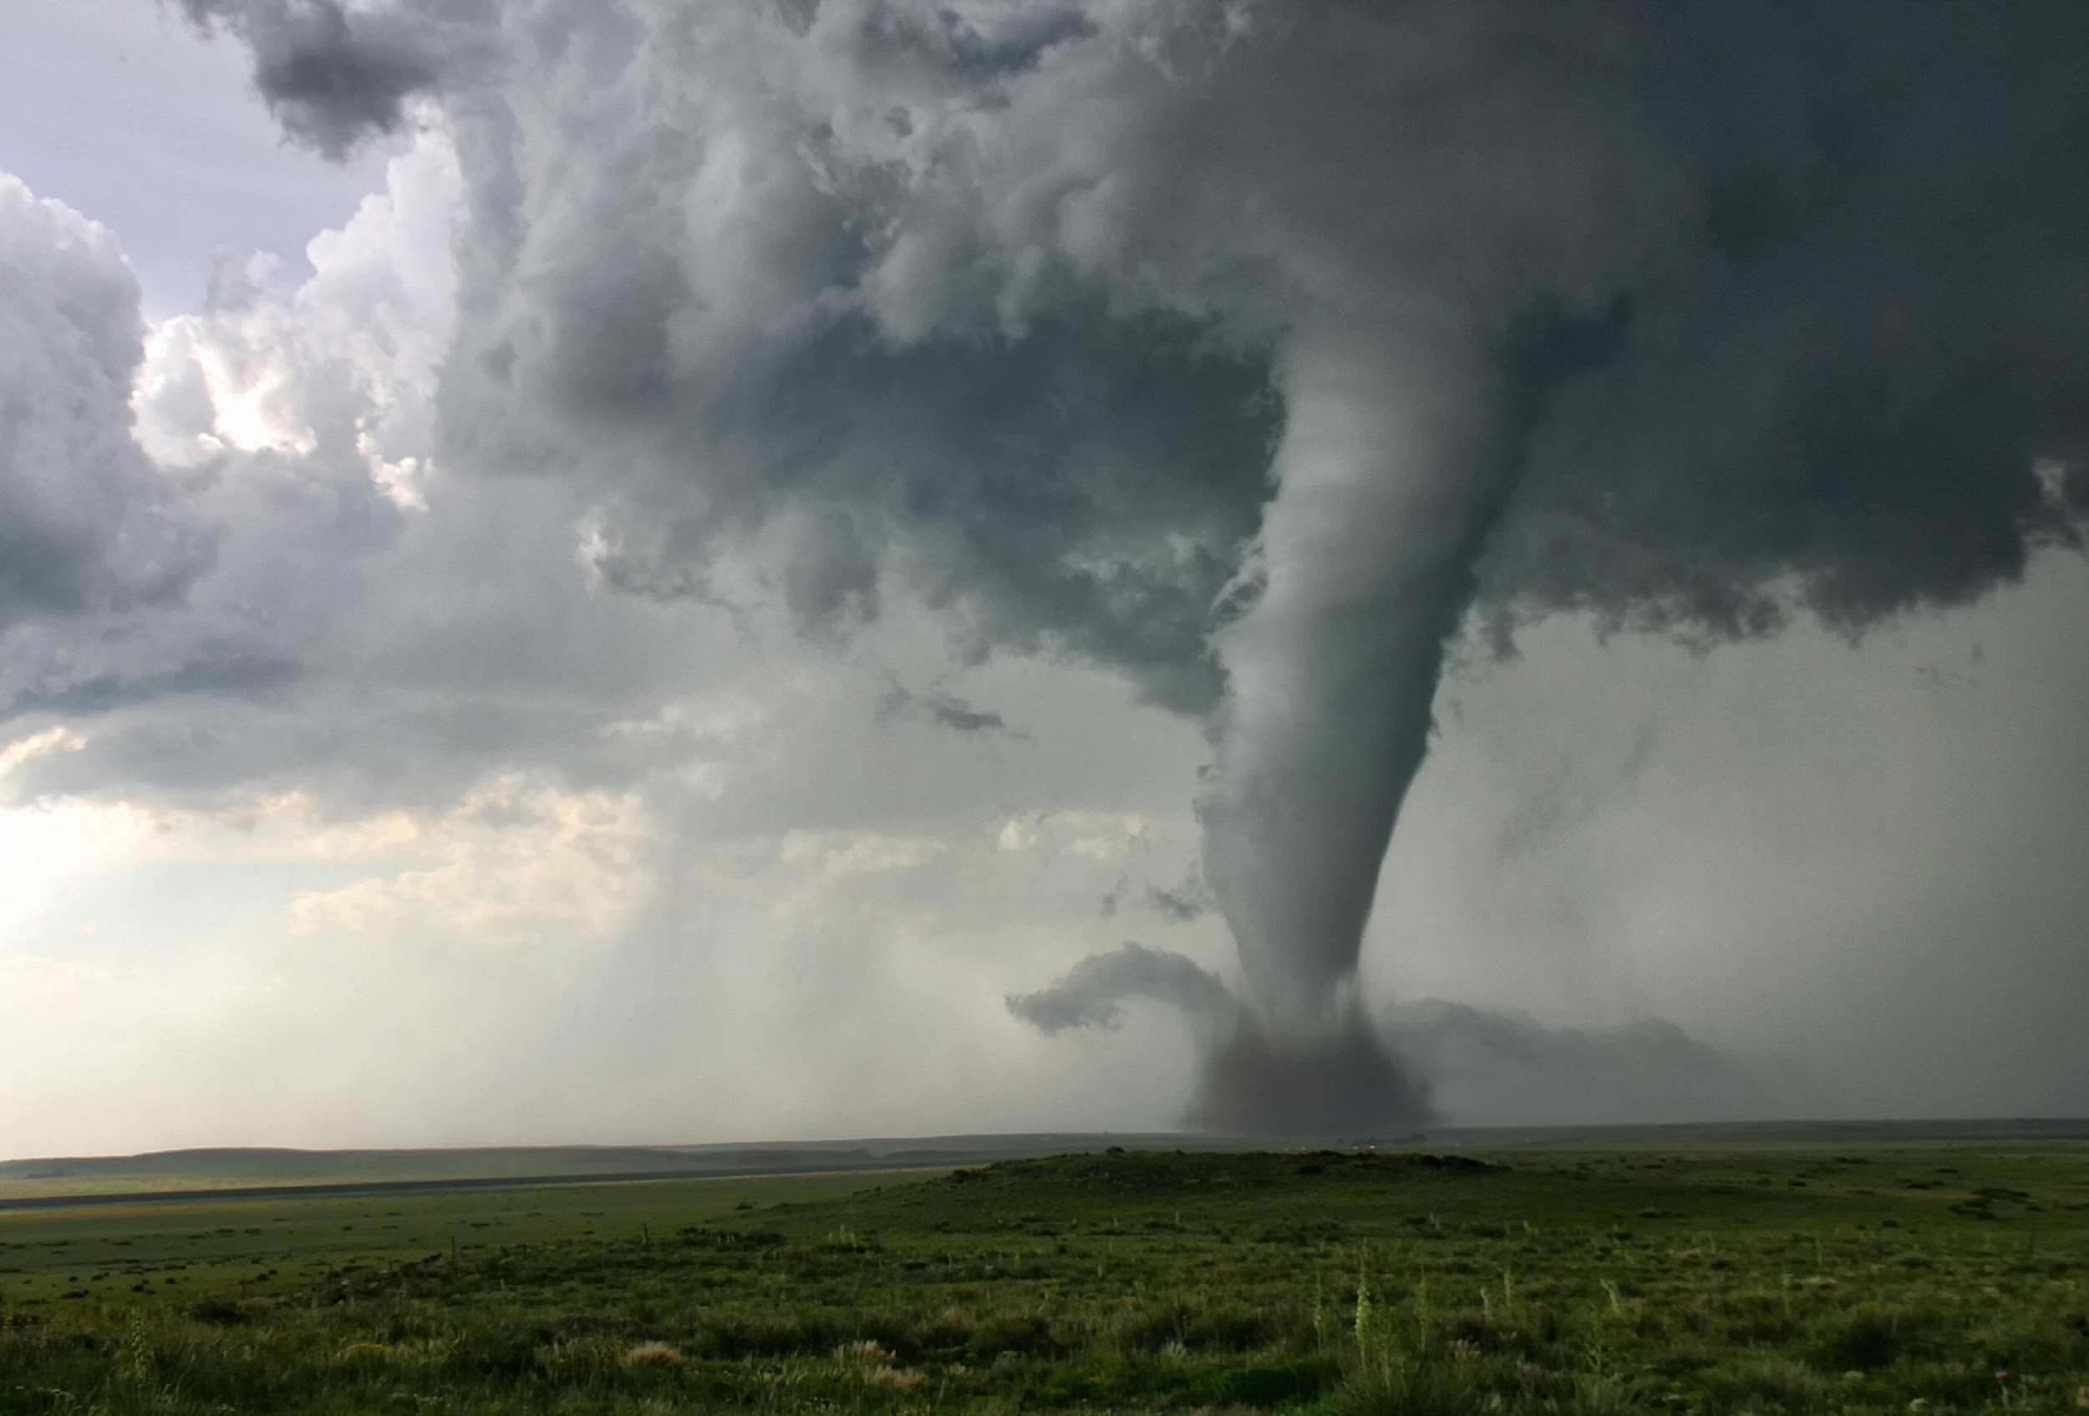
Housing justice and climate justice
Pollution
Transportation
Toxic facilities
Toxic chemicals in products dollar stores
Contaminated soil
Emergency response to extreme weather
Evacuations & rebuilding
Cost of rebuilding after extreme weather events and natural disasters
Loss of health, life, and property
Healthcare costs
Investment in infrastructure to mitigate destruction
Flood wall, pumps
Safe (nontoxic) and stable shelter options
Just and Equitable Climate Platform: https://ajustclimate.org/
"After centuries of global plunder, the profit-driven industrial economy rooted in patriarchy and white supremacy is severely undermining the life support systems of the planet. Transition is inevitable. Justice is not." - Just Transition Alliance,
climatejusticealliance.org

Slide 6
FIRE Regimes
finance, insurance, and real estate (FIRE)
Creates and sustains disproportionate impacts of climate change
Obstacles to clean energy for disproportionately impacted communities due to racist determination of financial risk
Aging infrastructure
High energy bills (less trees)
Food insecurity/food Apartheid
Cycle of poverty and fossil fuel dependence
Areas of high financial risk prepare way for private developers
"These strategies removed essential public resources—such as fire, health, and transit services—from non-white neighborhoods, pressuring residents out and making way for private investment." - Kartik Amarnath, 2021

Slide 7
FIRE Regimes Cont.
Finance, insurance, and real estate
"Climate justice is a public good, and equal treatment under the law demands truly collective climate action—a just transition—free of FIRE dogma." - Kartik Amarnath, 2021
Intergenerational Credit Scores
Redlining
Climate Redlining

Slide 8
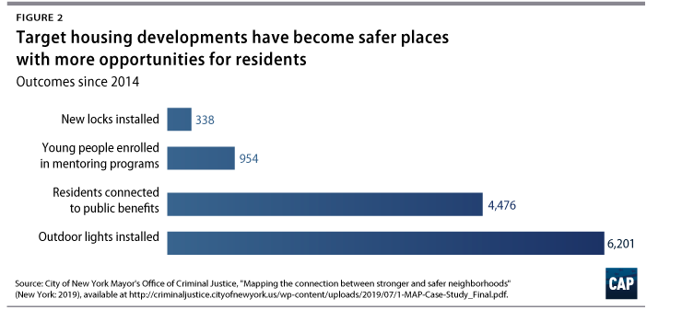
"He who does not prevent a crime when he can, encourages it. -
Lucius Annaeus Seneca
Housing and Crime Prevention
Foreclosures, evictions, and vacancies destabilize communities and are associated with an increase in violent crime (U.S. Department of Housing and Urban Development, 2016)
NYC study on housing and public safety, (Neighborhood Stat, 2019)

Slide 9
Renters
(Edelberg, et. al, Brookings Institute, 2021)
"Renters are at greater risk of housing instability compared to homeowners. " - Edelberg, et.al, 2021
Recommendations:
"Don’t subsidize homeownership over renting."
"Don’t subsidize real estate over other wealth-building mechanisms."
"All families should have access to neighborhoods that offer economic opportunity."
"Housing should not harm the health and safety of families or communities."
"Housing supply should be able to expand to meet demand."

Slide 10
Media
Community
What can we do?
Are they asking the right questions?
Are they challenging the narrative?
How can the community get the message out?
Importance of data and refernces
Move beyond social media
Narrative
Advocacy & Accountability Ideas
Corporate
Government
Philanthropy
How can local funders better advocate for housing & racial jusitce?
How can the community hold them accountable when they don't?
Charity vs justice and funding patterns
How can local business advocate for housing & racial jusitce?
How can the community hold them accountable?
Are they good "neighbors?"
Policy
Candidates
Accountability
Voting Access

Slide 11
References:
Agyeman, J. (2020, July 31). How Urban Planning Keeps Cities Segregated—and Maintains White Supremacy. YES! Magazine. https://www.yesmagazine.org/social-justice/2020/07/31/urban- planning-segregation-white-supremacy
Amarnath, K. (2021, September 29). How financial institutions engineered climate injustice and the clean energy colorline. Ehnorg. https://www-ehn-org.cdn.ampproject.org/c/s/www.ehn.org/amp/climate-injustice-2654634094
Deep Dive: Redlining, Racism and Urban Planning. (2021, July 21). Sierra Club. https://www.sierraclub.org/articles/2021/07/deep-dive-redlining-racism-and-urban-planning
Edelberg, W., Estep, S., Lu, S., & Moss, E. (2021, April). A comparison of renters and homeowners in recent decades. Brookings Institute. https://www.brookings.edu/wp-content/uploads/2021/04/A-Comparison-of-Renters-and-Homeowners-in-Recent-Decades-2.pdf
Fitzgerald, J., & Agyeman, J. (2021, September 7). Removing urban highways can improve neighborhoods blighted by decades of racist policies. The Conversation. https://theconversation.com/removing-urban-highways-can-improve-neighborhoods-blighted-by-decades-of-racist-policies-166220

Slide 12
References:
NeighborhoodStat: Strengthening Public Safety Through Community Empowerment. (2019, October 2). Center for American Progress. https://www.americanprogress.org/issues/criminal-justice/reports/2019/10/02/475220/neighborhoodstat-strengthening-public-safety-community-empowerment/
United States Department of Housing and Urban Development. (2016). Neighborhoods and Violent Crime | HUD USER. Https://Www.Huduser.Gov/Portal/Periodicals/Em/Summer16/Highlight2.Html. https://www.huduser.gov/portal/periodicals/em/summer16/highlight2.html

