Slide 1
Neighborhood Summit
Creating Inclusive Space
Tahjená Muldrow, Neighborhood Liaison
November 6, 2021

Slide 2
Creating Inclusive Space Sponsor:

Slide 3
Welcome!
Introductions & Ice Breaker
What is your name?
What neighborhood do you live in?
What brings you to the Summit?
What is a fun fact about you?
Set group agreements.

Slide 4
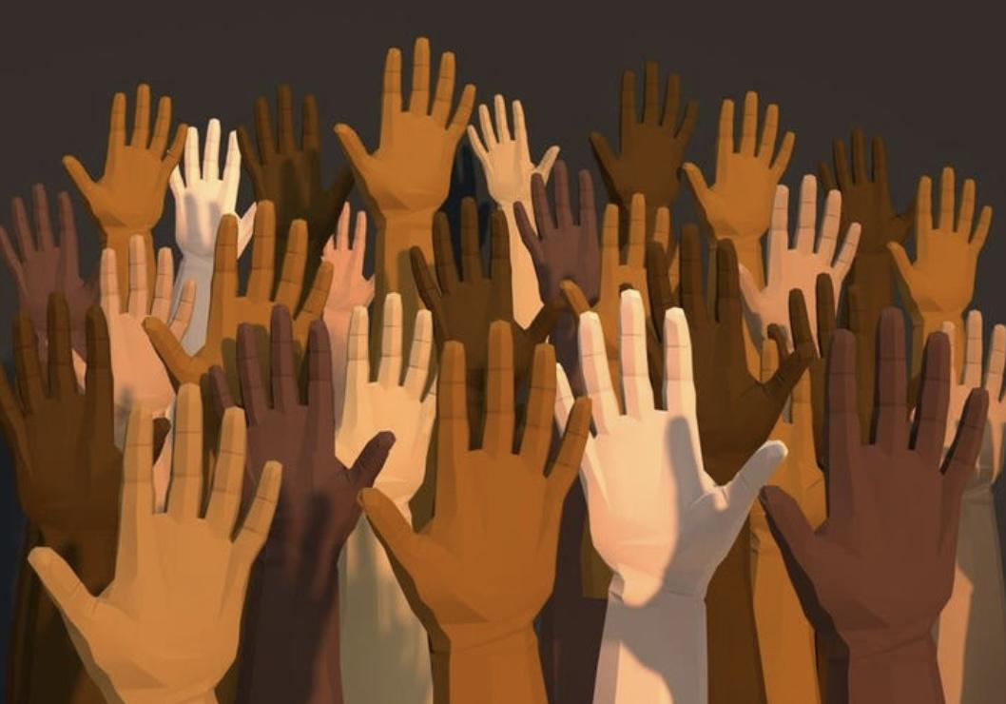
What is inclusivity to you?
The practice or policy of providing equal access to opportunities and resources for people who might otherwise be excluded or marginalized, such as those having physical or mental disabilities or belonging to other minority groups.

Slide 5
What is your definition of an inclusive space? An inclusive community?
An inclusive space is a welcoming space where all individuals feel seen, heard, safe, supported, and protected.
The inclusive public space can be defined as possessing four mutually supportive qualities of ‘access.’
Physical access
Social access
Access to activities and discussions or intercommunications
Access to information.
https://letsreimagine.org/creating-inclusive-spaces

Slide 6
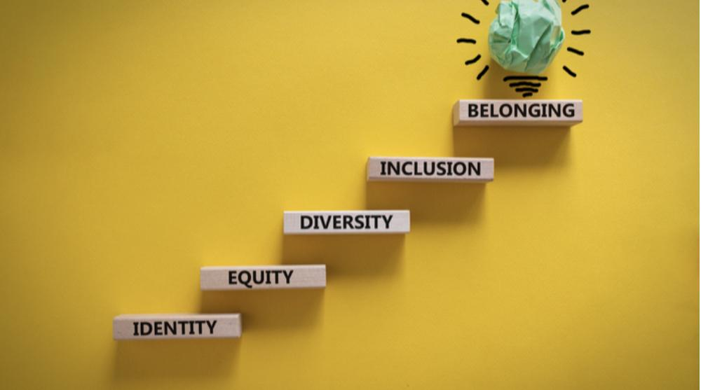
So, what’s holding us back?
What types of events and meetings are you having?
Who is showing up?
Who is missing?
How can you get those missing to be more involved? What do they need?

Slide 7
After discussion and looking over the handout, what do you think you can do differently moving forward?

Slide 8
Thank you!
]Thank you so much to our workshop’s sponsor, AIA Central Kentucky!
https://www.aia.org/resources/24301-equity-diversity-and-inclusion

Slide 9
Thank you all!
Tahjená Muldrow tahjenam@centerforneighborhoods.org
centerforneighborhoods.org

