Slide 1
Environmental Justice Panel

Slide 2
This workshop is sponsored by
Sociable Weaver Foundation

Slide 3
Yolanda Walker Eboni Neal Cochran Tom Fitzgerald

Slide 4
What are environmental justice issues?
Certain communities may be exposed to poorer environments and inequities than those of a wealthier socioeconomic status.
Air and water pollution: are major environmental justice issues. Because many lower-income or minority communities are located near industrial plants or waste disposal sites, air and water quality can suffer if not properly monitored. These communities may also contain older and unsafe homes, (homes that may be infected by lead or mold) poor public transportation and lack of access to healthy foods.

Slide 5
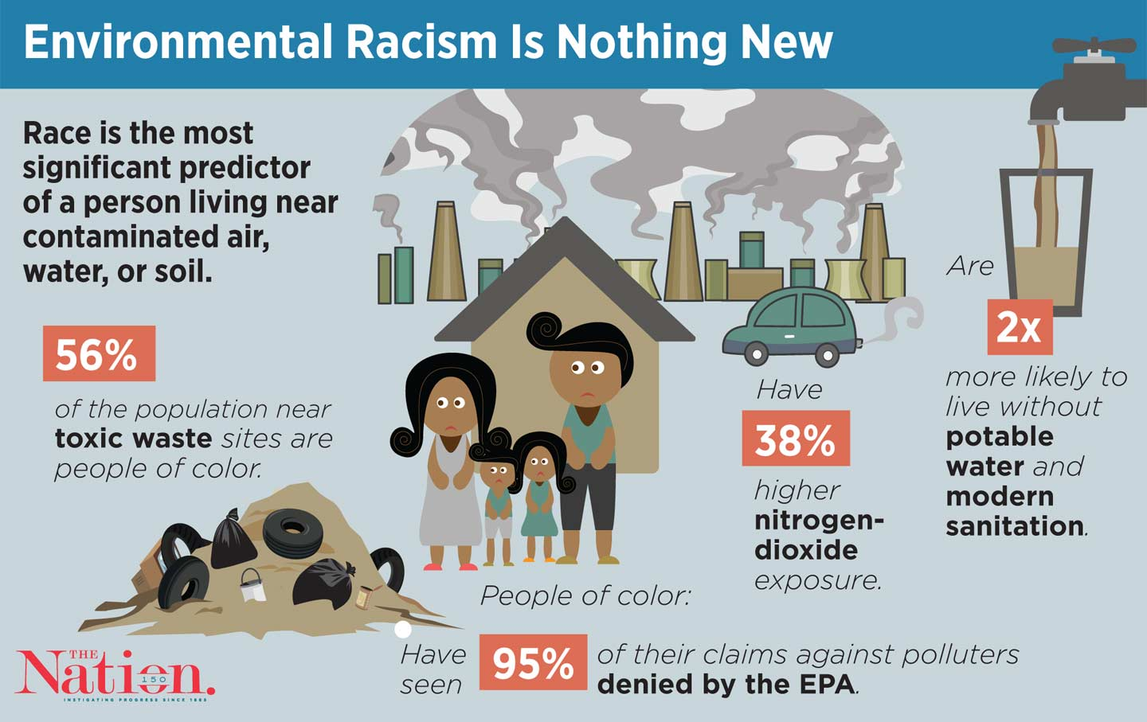

Slide 6
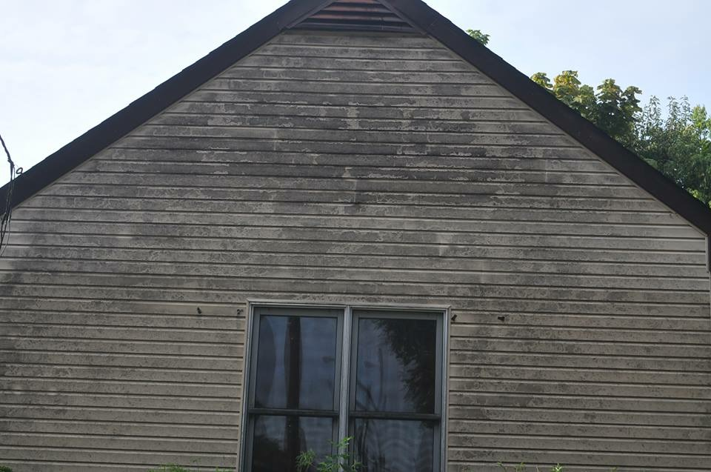

Slide 7
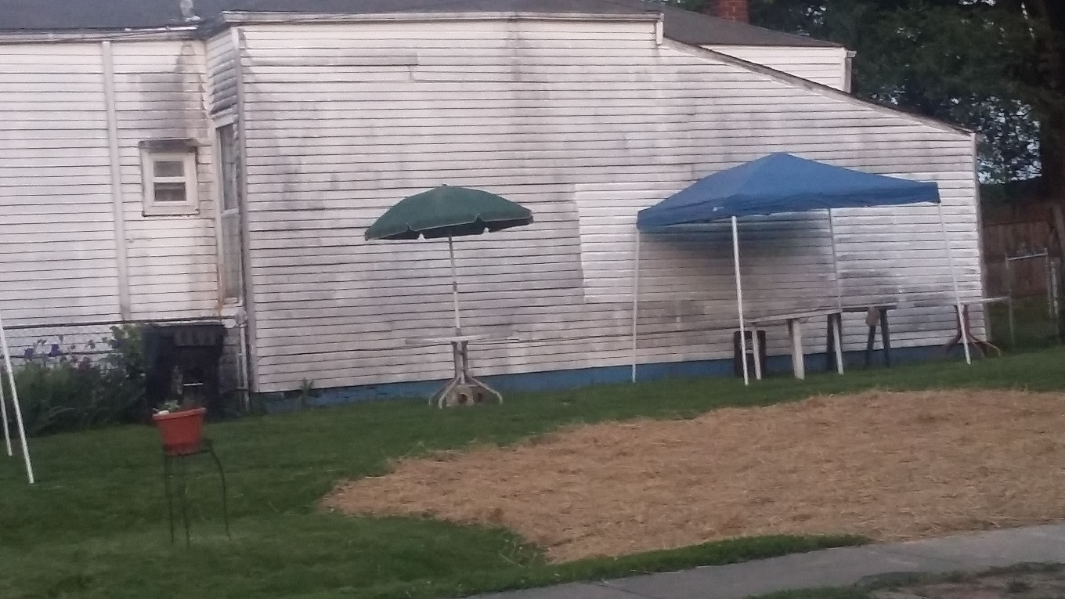

Slide 8
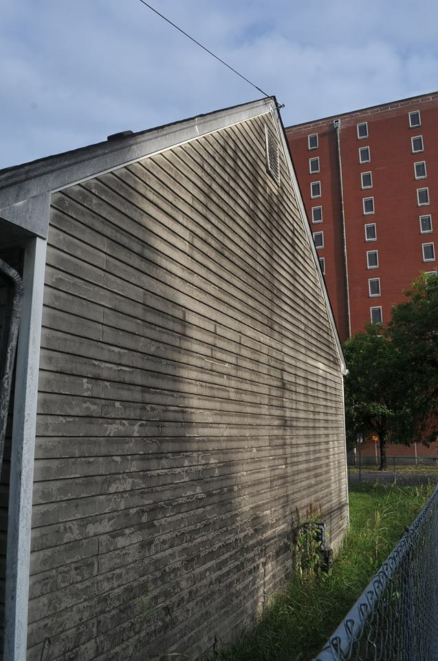
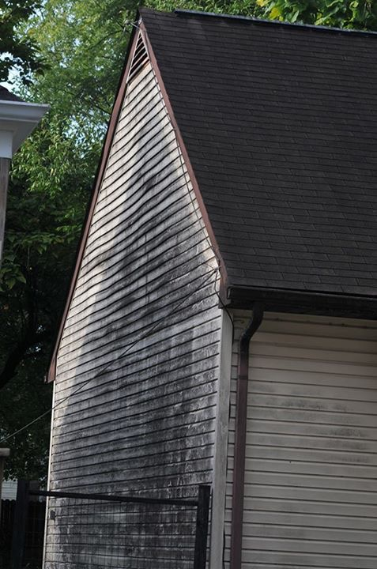

Slide 9
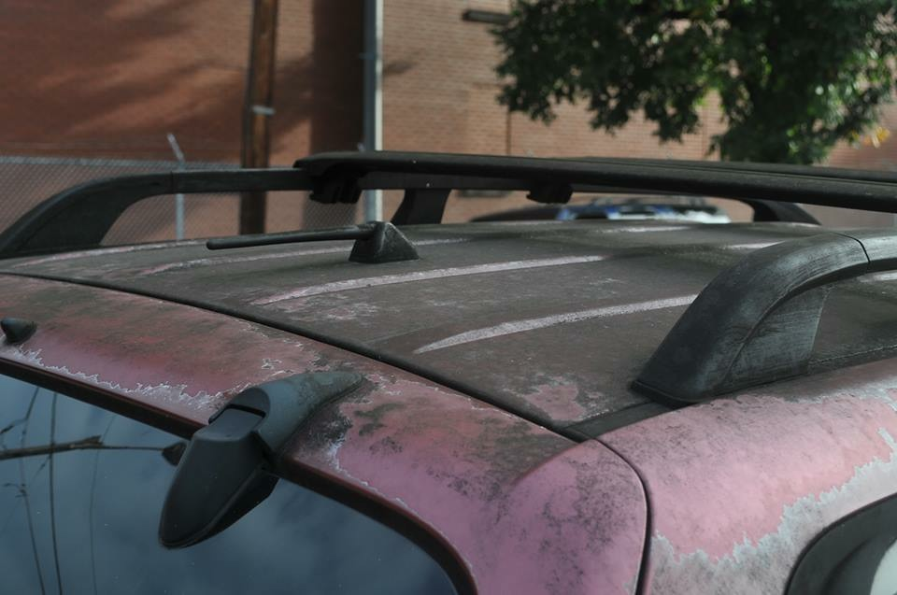

Slide 11
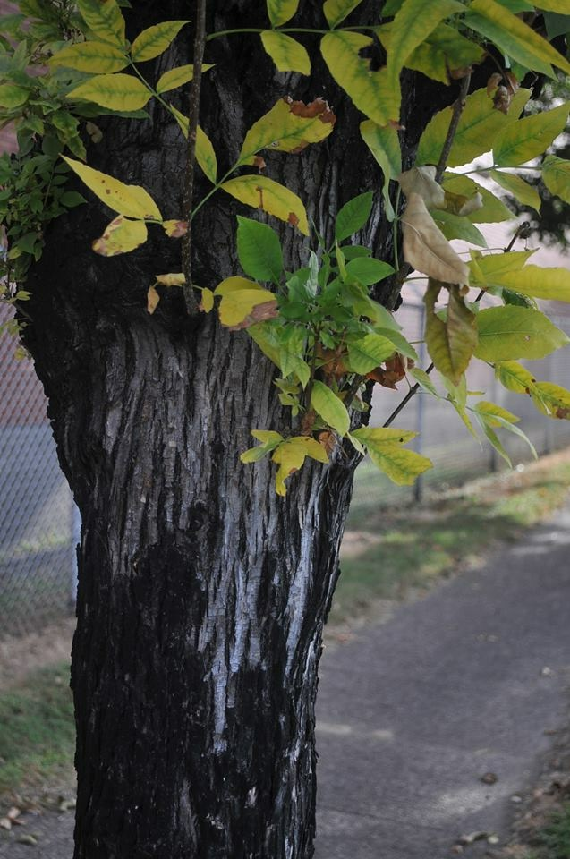

Slide 12
Baudoinia compniacensis
Whiskey Fungus Is a Real Thing, and It's Covering Kentucky – InsideHook
The Angels’ share is the romantic term for the annual rate of whisky lost during cask maturation due to evaporation. From a scientific point of view, however, it is the volume of the liquid that turns into gas and then leaves the barrel.
whiskipedia.com/fundamentals/angels-share/
But those ethanol vapors don’t fly to the angels — once they hit the air, they’ll combine with moisture and head back down to the ground, where a fungus called Baudoinia Compniacensis takes hold. And that’s becoming a far-reaching problem in the bourbon capital of Kentucky, according to a new report by Atlas Obscura.
What is alcohol made from? Ingredients, chemicals and ...
https://www.drinkaware.co.uk/facts/alcoholic-drinks-and-units/what-is-alcohol...
The type of alcohol in the alcoholic drinks we drink is a chemical called ethanol. To make alcohol, you need to put grains, fruits or vegetables through a process called fermentation (when yeast or bacteria react with the sugars in food - the by-products are ethanol and carbon dioxide)
Ethanol:
a colorless volatile flammable liquid which is produced by the natural fermentation of sugars; alcohol. "yeast used in making beer metabolizes the sugar into ethanol" ·

Slide 13
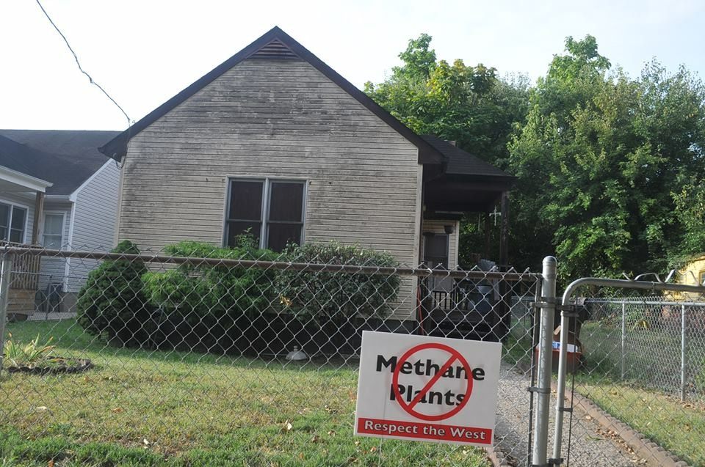

Slide 14
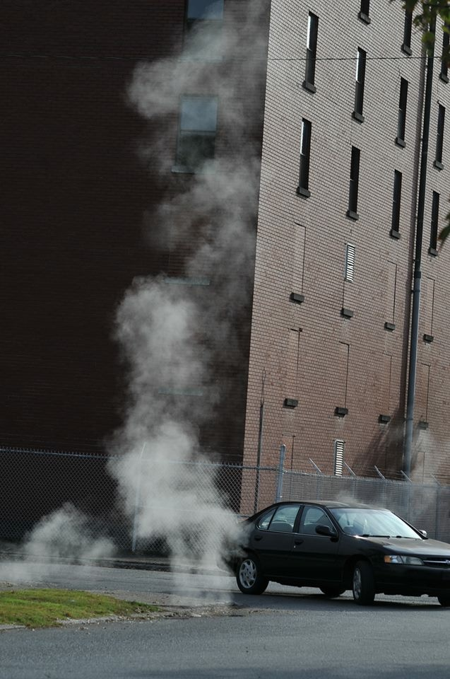
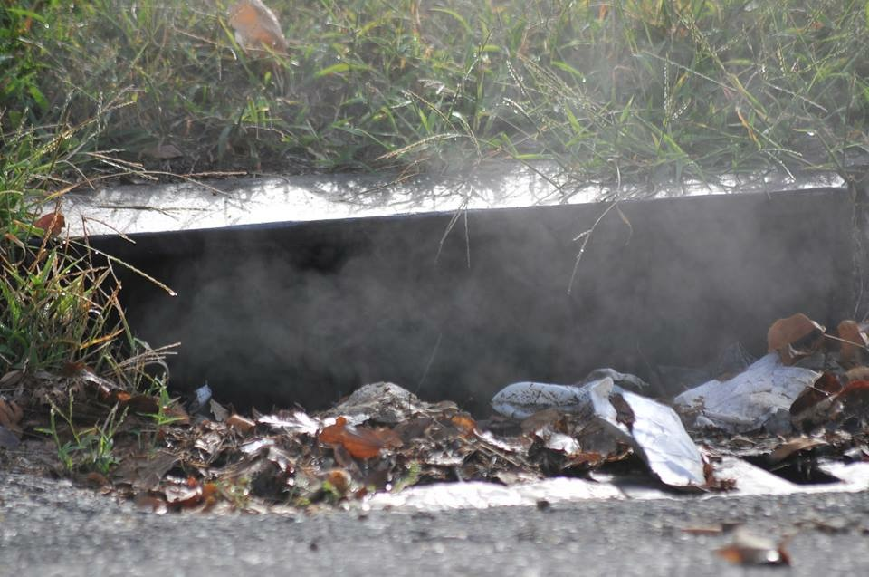
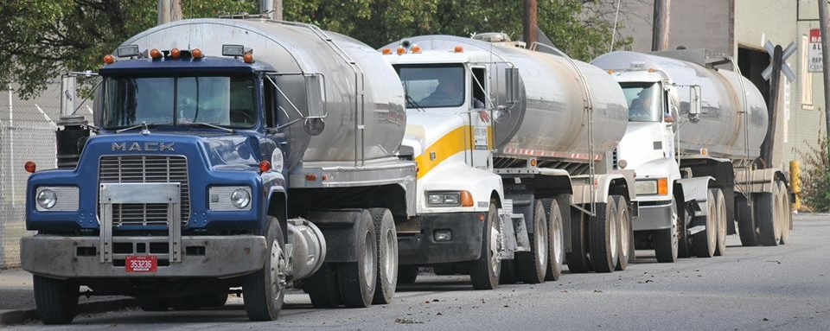
Air Pollution:
1. from dust stirred by trucks in transit
2. fumes pollution from both travelling and idling trucks.
3. from Baudoinia compniacensis (angel share)

Slide 15
“Environmental injustice exists when one segment of the population is affected adversely by the environment more so than others…” Tim Darst at Passion Earth and Spirit Center. Nov. 25, 2015 Number of residents suffering symptoms caused by outdoor air pollution in Metro West Louisville 30% East Louisville 16%
“Environmental justice problems tend to affect the poor and vulnerable first and hardest...sadly, low income people usually don’t have enough political pull to change laws or even get them enforced in the first place.”
Tim Darst, Kentucky Interfaith Power & Light

Slide 16
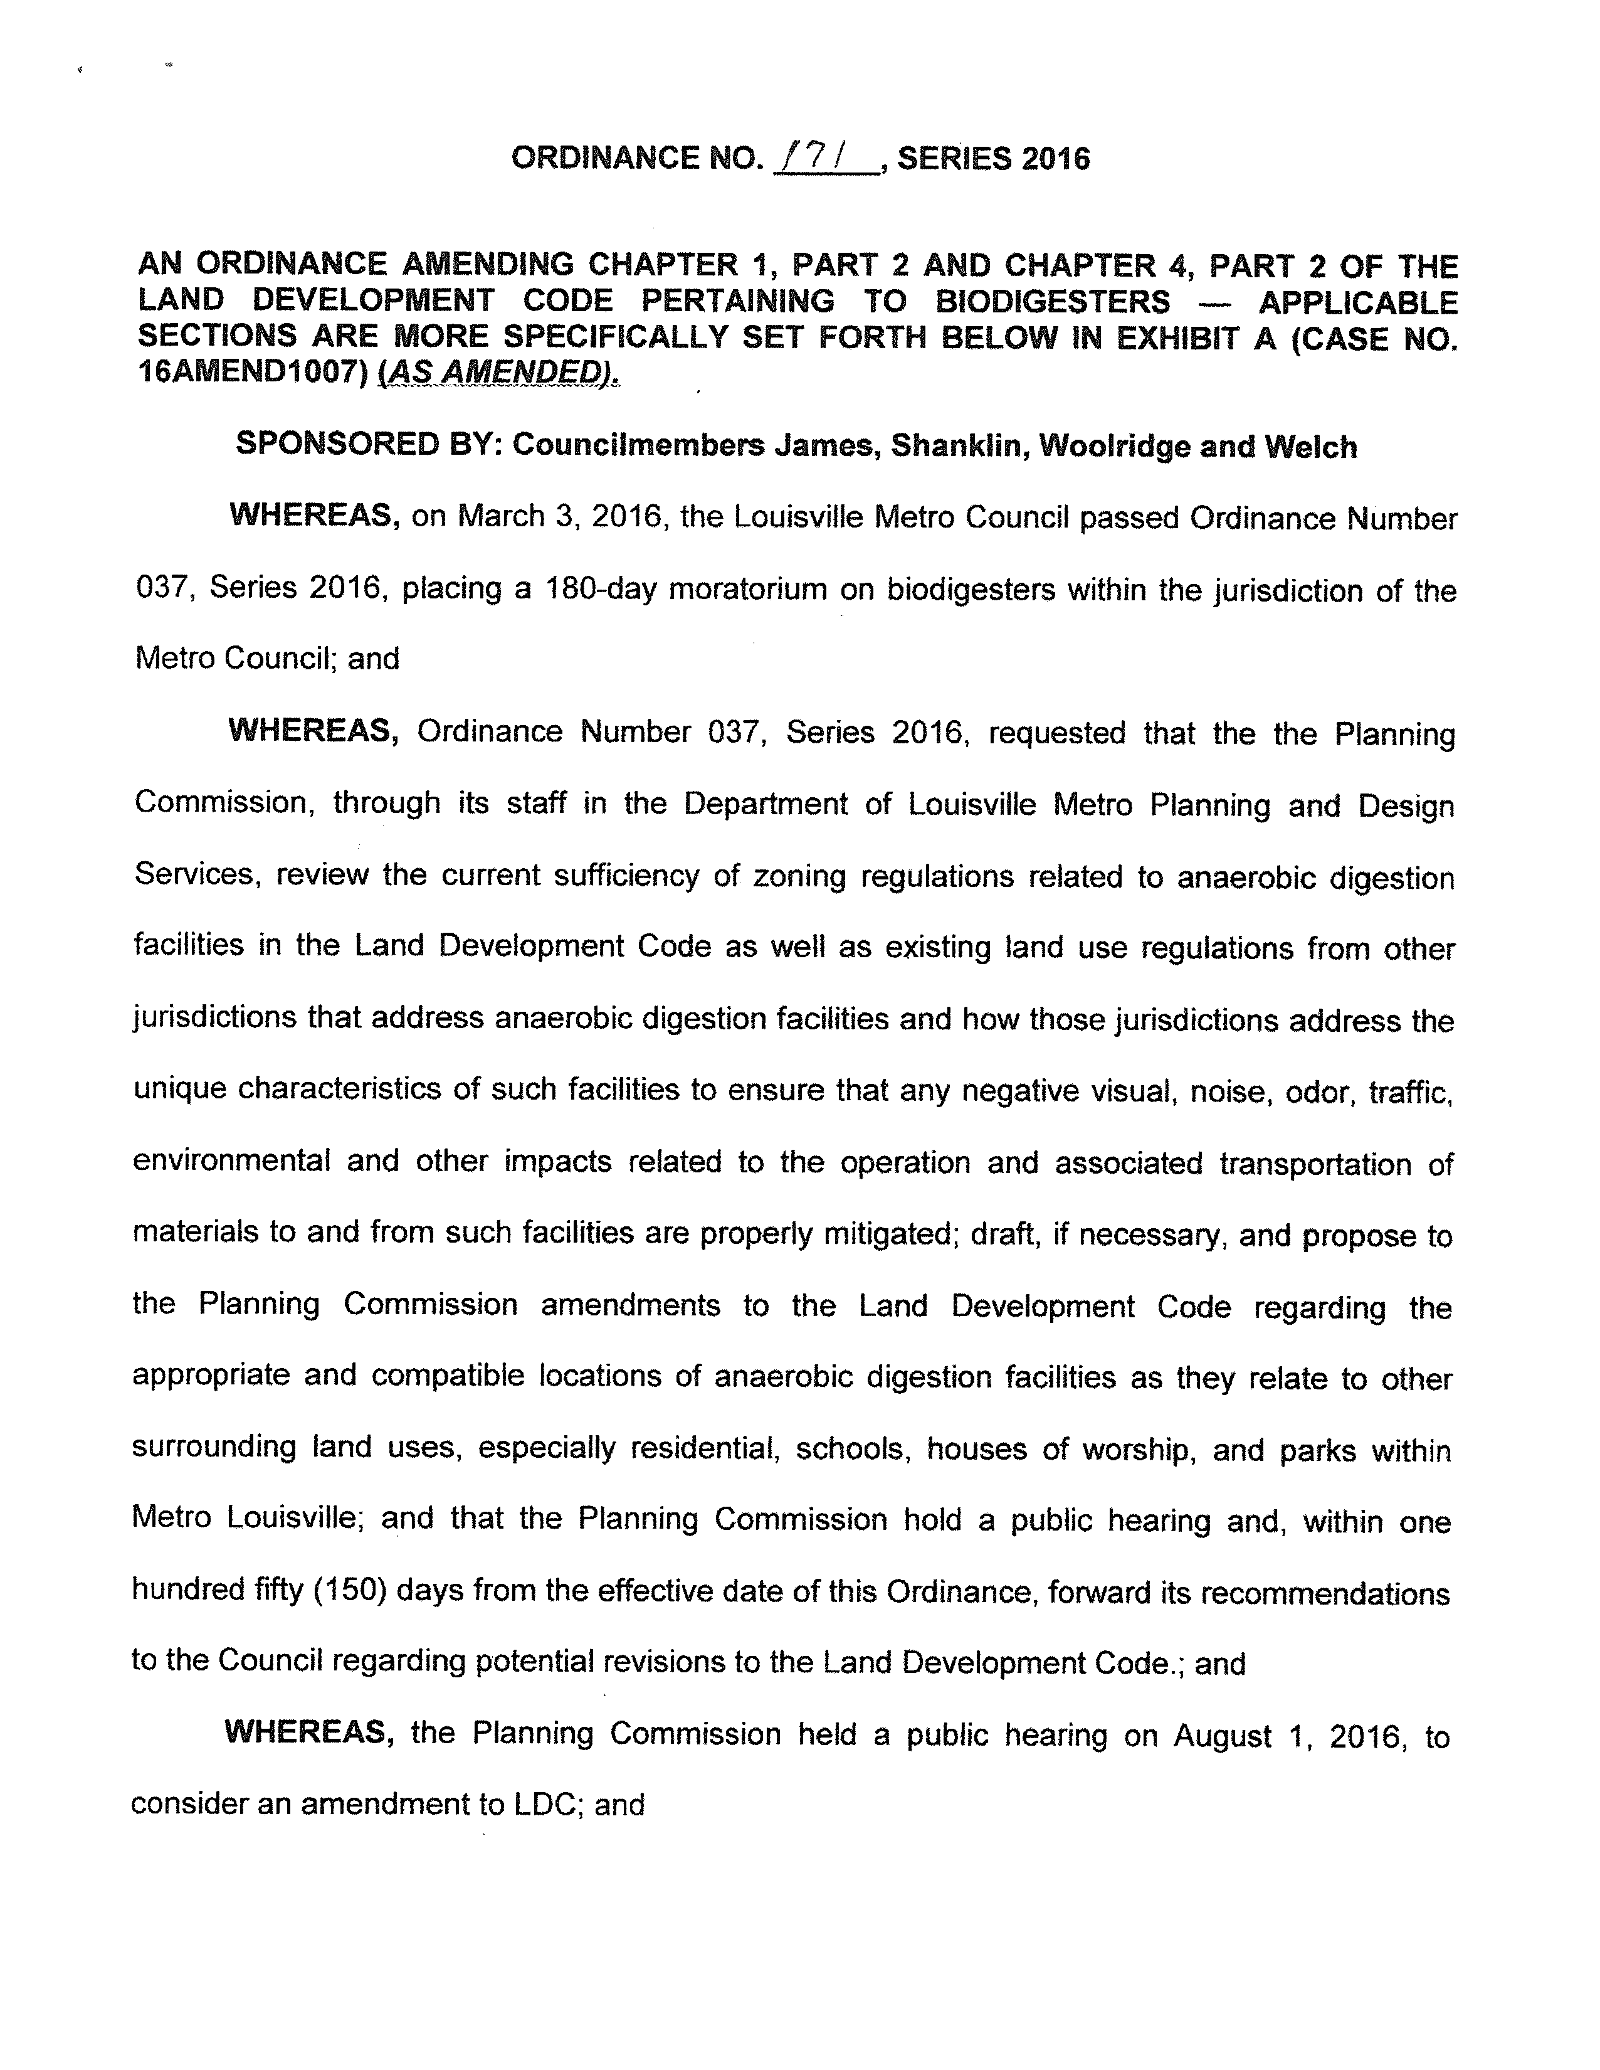
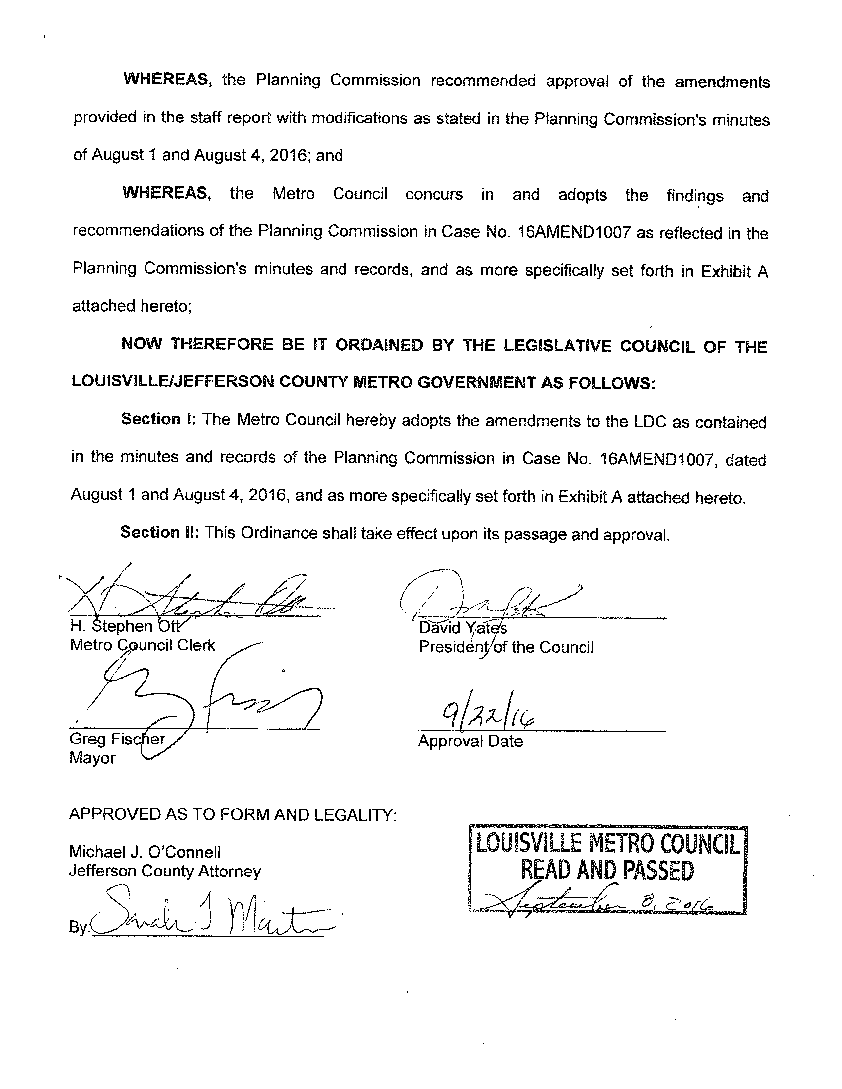

Slide 17
This is what environmental injustice looks like in the neighborhood.

Slide 18
The Dark Side of the 'Angel’s Share' - Gastro Obscura (atlasobscura.com)
Whiskey Fungus Is a Real Thing, and It's Covering Kentucky – InsideHook
What Is the Angel's Share? - The Whiskey Wash

Slide 19
Sociable Weaver Foundation
Thank you to our sponsors

