Slide 1
Neighborhood Institute Fall 2021
Week 6

Slide 2
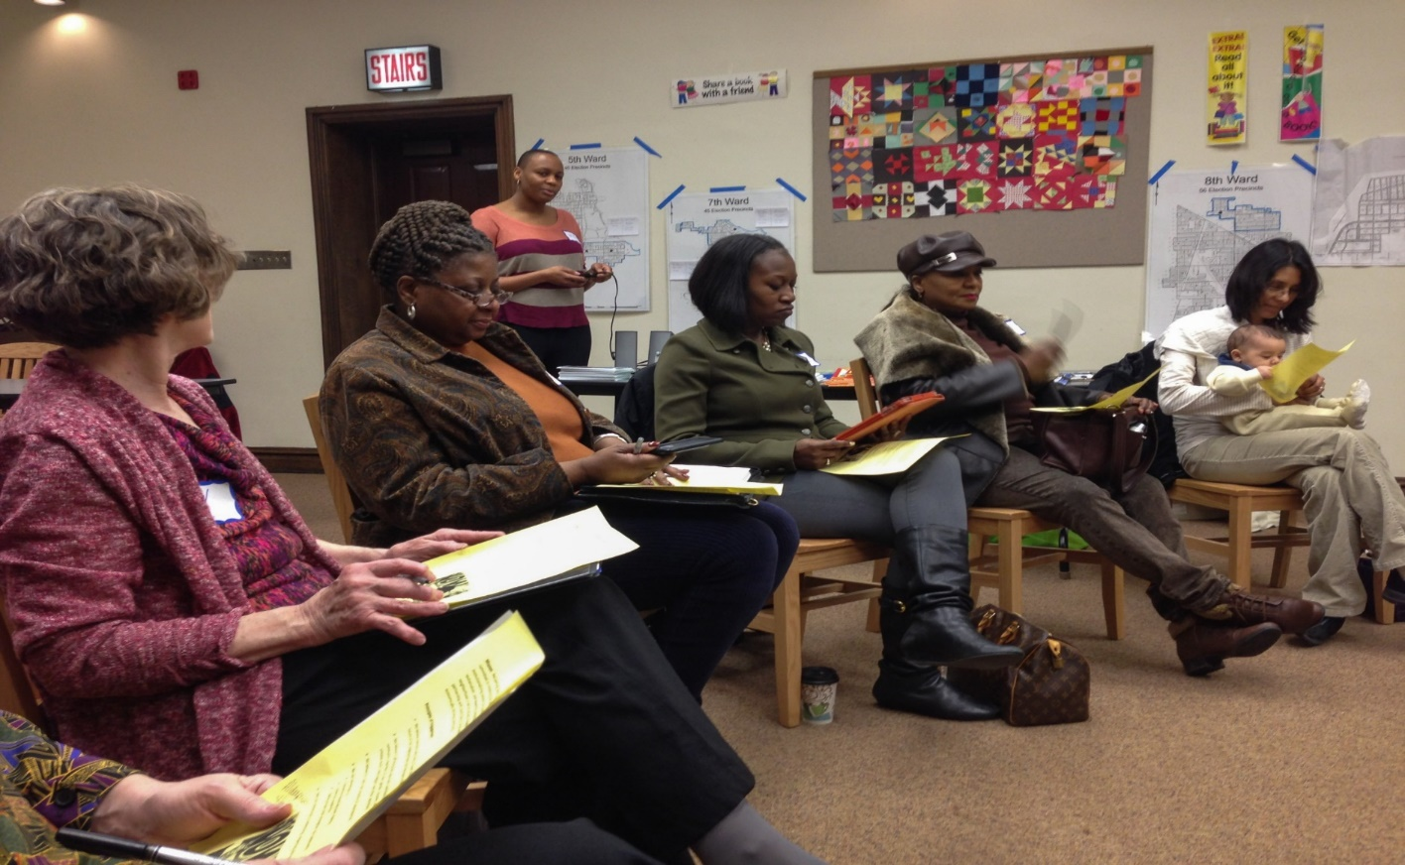
Community Engagement

Slide 3
What is Community Engagement?
A framework of guiding principles, strategies and approaches
Employs a range of tools and strategies to ensure success
Fostering and enhancing trust as a critical element in the long term, sustainable engagement and effective governance.
It shifts the focus from the individual to the collective, with the implication for inclusiveness to ensure consideration is made of the diversity that exists within any community.
Can be complex and labor intensive and requires dedicated resources such as time, funding and PEOPLE with the NECESSARY SKILLS.

Slide 4
Guiding Principles of Effective Community Engagement
Increase resident’s knowledge about a community or the issues you are seeking to address in their community.
Encourage residents to co-create additional knowledge and understanding. Then allow them the space to apply that knowledge.
Use that knowledge to improve the community and address the identified concern/issue.
Create future opportunities for residents to engage with each other.
Ensure that the opportunities and effective communication become regular and ongoing components of the process.

Slide 5
Core Principles of Community Engagement
Careful planning and preparation-Planning ensures that the design, organization, and convening of the process serve both a clearly defined purpose and needs of the participants.
Inclusion and Demographic Diversity-Equitably incorporate diverse people, voices, ideas, and information to lay the groundwork for quality outcomes and democratic legitimacy.
Collaboration and Shared Purpose-Support and encourage participants, government and community institutions, and others to work to advance the common good.
Openness and Learning-Help all involved to listen to each other, explore new ideas unconstrained by predetermined outcomes, learns and apply information in ways that generate new options and rigorously evaluate community engagement activities for effectiveness.

Slide 6
Core Principles of Community Engagement
Transparency and Trust-Be clear and open about the process, and provide a public record of the organizers, sponsors, outcomes and range of views and ideas expressed.
Impact and Action- Ensure each participatory effort has real potential to make a difference, and that participants are aware of that potential.
Sustained Engagement and Participatory Culture-Promote a culture of participation with programs and institutions that support ongoing quality community engagement.

Slide 7
What Makes Community Engagement Successful?
Capability-The members are capable of dialogue
Commitment-Mutual benefit beyond self interest
Contribution-Members volunteer and there is an environment that encourages members to have a go or take responsibility/risks
Continuity-Members share or rotate roles and as members move on there is a transition process that sustains and maintains the community’s corporate memory
Collaboration-Reliable interdepend. A clear vision with members operating in an environment of sharing and trust.
Conscience-embody or invoke guiding principles/ethics of service, trust and respect that are expressed in the action of the community.

Slide 8
Establishing Your Engagement Goals
Inform-Informing is the most elementary and simplest goal of an engagement process
Consult-The second level of engagement entails stakeholder consultation-in essence providing some mechanism to gather input on the issues, problem, or process you are concerned about.
Involve-the third potential goal of your engagement efforts is to involved stakeholders, to the degree appropriate, in the decision making.
Collaborate-Collaboration refers to the engagement of stakeholders in order to create an environment conducive for solving complex issues with plausible solutions for which they take responsibility-and catalyzing the contributions and assets of stakeholders into actions.
Empower-Empower refers to placing either the decision making authority or the responsibility for implementing a particular solution in the hands of stakeholders.

Slide 9
Things to remember when engaging residents/groups
Change is a fundamental part of the growth process and effective change must come within the individuals and/or groups. ( In other words, the residents and/or group must want the change.
Community engagement/growth starts with changing ourselves, our attitude, LANGUAGE and the way we view communities other than our own.
Communities are most successful when TRUE partnership exits and power/control is delegated and vested effectively within the community.
Engaging a community to address any issue is a long term process not a one time event.

Slide 10
BREAK

Slide 11
Body/Life map
Head How would you like to make an impact?
Heart Things we feel strongly about OR the people, relationships, things that you love and make you who you are.
Hands What you want to create or build.
Eyes What you want to see in the future, visions you have for your community.
Muscles What are your sources of inspiration, support, strength, power?

Slide 12
Institute Project Introduction
15 Min.

Slide 13
Participatory Process
What is a Participatory Process
CHE Participatory Budget
Plan & Produce an Event or Project
Mural, Festival, Community garden, Clean up
Start a Program or Service
Help seniors with yard work, create a newsletter, start an email list or phone tree

Slide 14
Institute Project Introduction
Issues and Problems
Embrace work to solve specific problems: Traffic, Crime, Code and Zoning, Absentee Landlords
Physical Improvement
Streetscape rehab & improvement, Park projects, Signage, Beautification
Grant writing
For neighborhood improvement projects

Slide 15
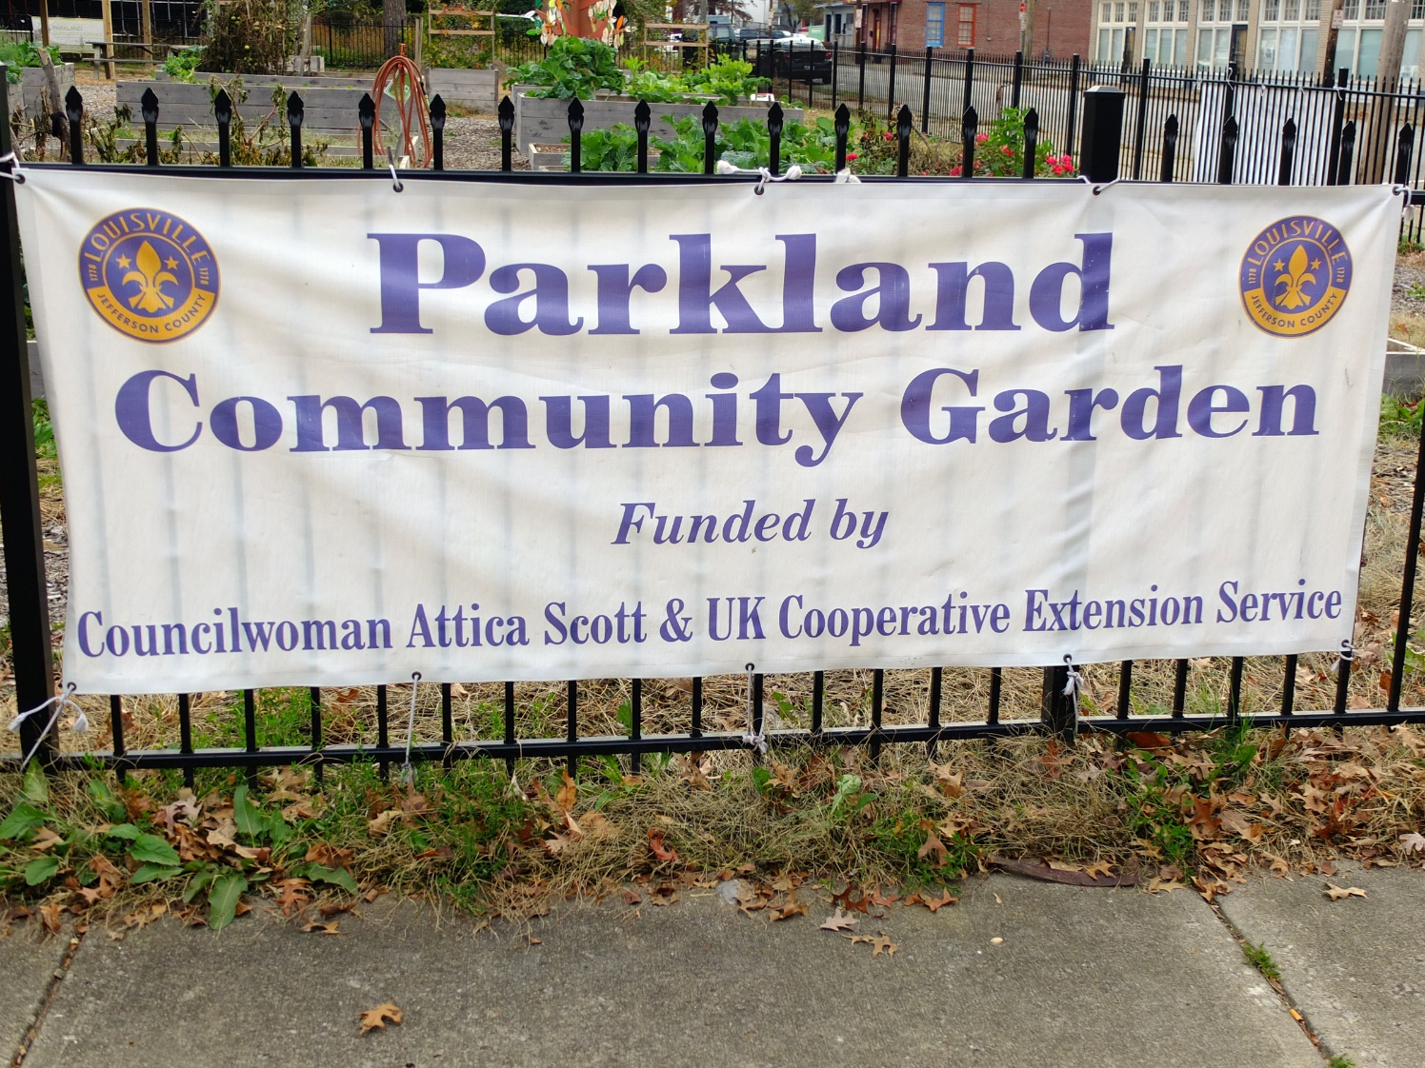
Institute Project Introduction

Slide 16
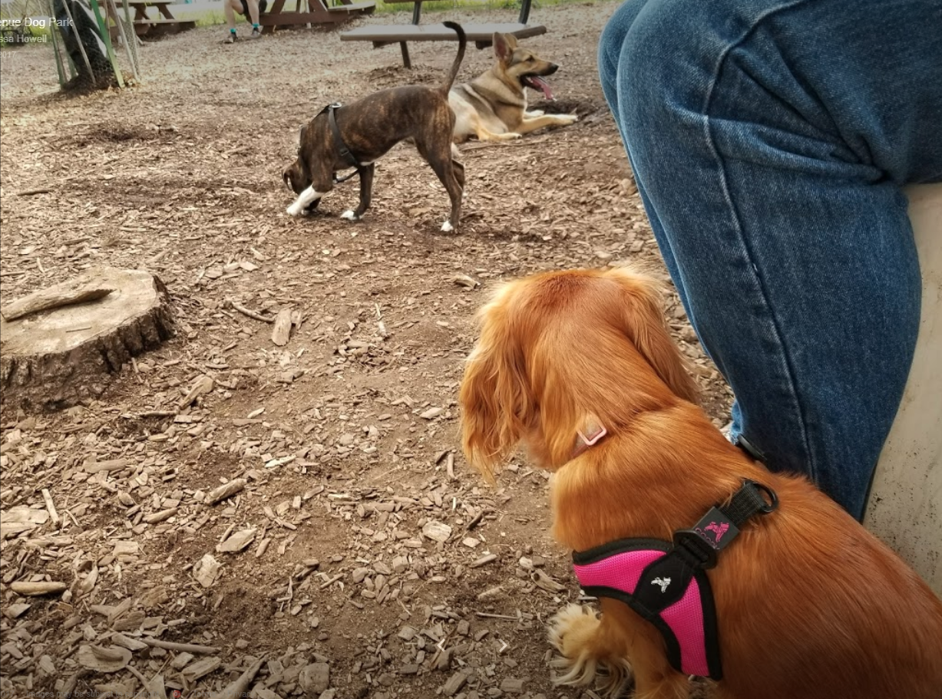
Institute Project Introduction

Slide 17
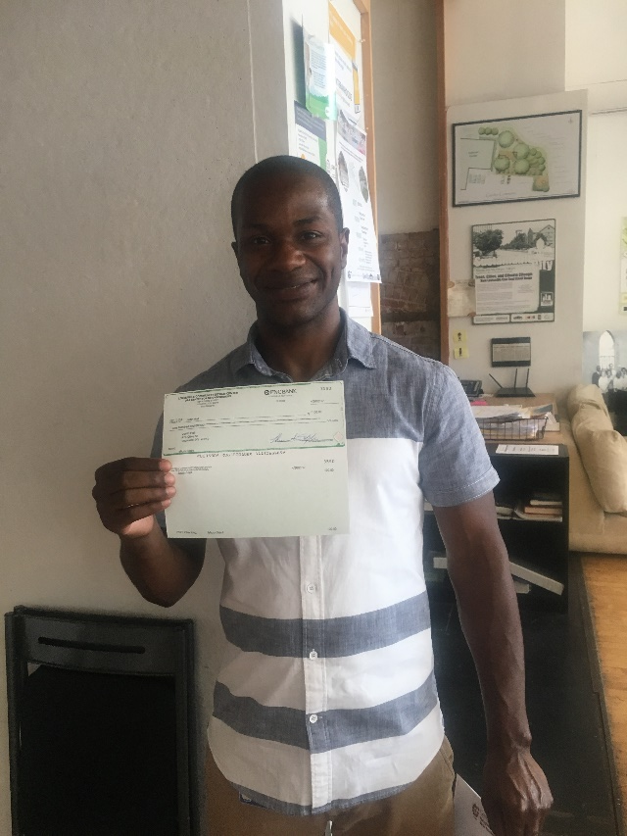
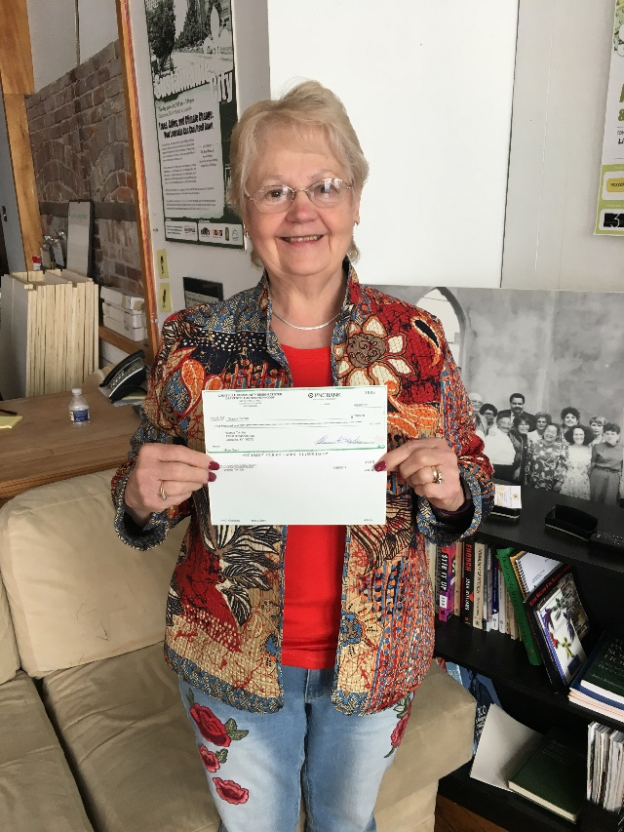
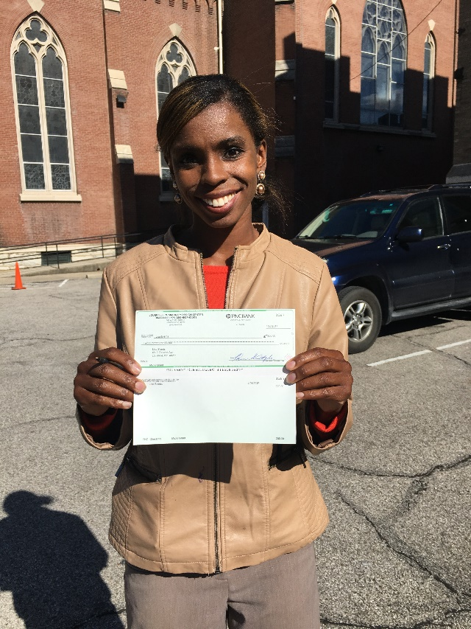
Micro Grant Program

Slide 29
Project Planning Worksheet
Purpose/Goals
Details
What to do
How it will help
Questions?

Slide 30
Project Planning Practice

