Slide 1
Asset Based Community Development
(ABCD)

Slide 2
Our Agenda
Center for Neighborhoods
Asset Based Community Development

Slide 3
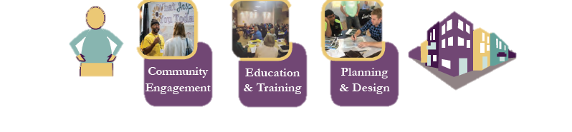
Our Mission:
Engaging with neighbors to build great neighborhoods.
Our Vision:
We envision a Louisville community of great neighborhoods led by engaged neighbors who are creating unique places that provide a high quality of life and equitable access to opportunity for all.
Begins with People
Build great neighborhoods

Slide 4

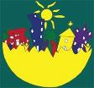
Asset Based Community Development
(ABCD)

Slide 5
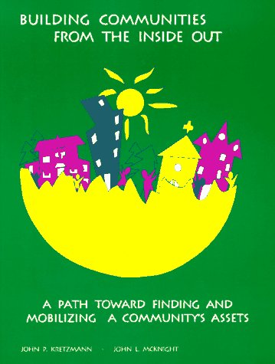
"Building Communities from the Inside Out:
A Path Toward Finding and Mobilizing a Community's Assets"
John P. Kretzmann and John L. McKnight (1993)

Slide 6
The Dilemma…
People and Communities
have deficiencies & needs
Individuals and Communities have assets and capacities
Notes:
All of us are like this glass – half full and half empty. We each have our gifts, talents and capacities as well as our problems, deficits and needs. The same thing is true of neighborhoods,. They have assets and deficits.

Slide 7
Neighborhood Needs Map
Unemployment
Truancy
Broken Families
Slum Housing
Graffiti
Child Abuse
Gangs
Crime
Illiteracy
Mental Disability
Welfare Recipients
Lead Poisoning
Dropouts
Notes:
If you look at a neighborhood in terms of needs, this is how it looks.

Slide 8









Community Assets Map
Local INSTITUTIONS
Churches/ Houses of Worship
Business
Youth
Schools
Citizens’ Associations
Gifts of INDIVIDUALS
Income
Artists
Parks
Labeled People
Older Adults
Hospitals
Community Colleges
Notes:
This is the same neighborhood if you look at its assets.

Slide 9
Consequences of the Needs Map for Local Residents
“We are deficient”
Our local relationships are damaged
Most money comes into our community for programs – often narrowly defined
Money can get misdirected towards professional helpers, not residents
We place focus on leaders who magnify deficiencies
We reward failure and foster dependency on systems
Our community has a poor self-image
We experience hopelessness
Notes:
While many institutions and funders focus neighborhoods on their needs, this approach to neighborhood development has many negative consequences.

Slide 10
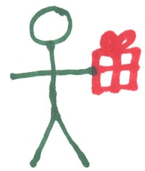
Individuals
Notes:
The first asset is the gifts of local residents. This is the only asset that appears in every story. It is, therefore, the most important.

Slide 11
Sample Personal Capacity Inventory
Gifts I Can Give To My Community
Gifts of the Head (Things I know something about and would enjoy talking about with others, e.g., art, history, movies, birds).
Gifts of the Hands (Things or skills I know how to do and would like to share with others, e.g., carpentry, sports, gardening, cooking).
Gifts of the Heart (Things I care deeply about, e.g., protection of the environment, civic life, children).
Notes:
One simple method of finding the gifts of neighbors is to ask about their gifts of the head, hand and heart. Some people also add “Gift of Human Connection”

Slide 12

Associations
Notes:
The second asset is local clubs, groups and associations. Many associations are unnamed. Pooling the gifts of individuals in associations makes those gifts more powerful. People give their gifts when they are in association

Slide 13
What are Local Voluntary Associations?
Groups of two or more residents joined together around a common activity or interest, often sharing a common passion, care and interest.
Might have a small paid staff, but
Members always create the vision and engage in the work to achieve the goal.
Notes:
The key to this definition is that the basic work is done by unpaid members who create the vision and produce the outcomes.

Slide 14
Institutions
Notes:
The third asset is local institutions. There are 3 kinds: profit, not-for-profit and governmental. Unlike associations, their members are paid to do the work.

Slide 15
Local Institutions
Schools
Libraries
Parks
Law Enforcement
Colleges, Universities, Trade Schools
Health and Human Services Agencies
Non-Profits
Private Business
Notes:
This is a list of the kinds of institutions that are in many neighborhoods. Institutions can have a positive influence in a neighborhood by opening up their resources to the community.

Slide 16
Institutions Don’t Care.
People Care.
Notes:
This is a list of the kinds of institutions that are in many neighborhoods. Institutions can have a positive influence in a neighborhood by opening up their resources to the community.

Slide 17

“Service systems can never be reformed so that they will produce care. Care is the consenting commitment of citizens to one another. Care cannot be produced, provided, managed, organized, administered, or commodified. Care is the only thing a system cannot produce. Every institutional effort to replace the real thing is a counterfeit.”

Slide 18
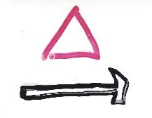

CONTROL | CHOICE
PRODUCTION GOODS SERVICES | CARE
CLIENTS CONSUMER | CITIZEN
NEEDS | CAPACITY
Notes:
In order to have an effective relationship between local neighborhoods and large outside institutions it is important to clearly understand the functions that each is uniquely designed to fulfill.
Institutions and neighborhood associations are like two tools. Each is useful and important, but neither can do the work of the other.
The unique characteristics of large institutions is that:
They are designed so that a few people can control many other people.
They are able to produce lots of standardized goods and services.
They need clients and consumers.
Their basic raw material is needs and deficits.
The unique characteristics of local neighborhood associations is that:
The members are participating by choice. This is why they are called voluntary associations. Their members are held together by trust whereas institutions are held together by money.
Associations are groups that care about each other and/or the same thing. They are the site of care in a community. Institutions are the site of services. Care is the free given commitment of one person to another. Service is the paid benefit of one person provides another.
The critical person in associational life is a citizen (not meant legally) – a person with the power to create a vision and to make it come through. On the other hand, institutions need clients not citizens. Client comes from the root word “cli” as in “recline,” which means a person on their back. A citizen stands tall at the center of democracy.
Associational life is powerful because it uses capacities of citizens and does not need their deficits.

Slide 19
Physical Space
Not For Profit
NFP
NFP
G
$
Governmental
G
$
For Profit
Notes:
The fourth asset is the land, indicated by the line surrounding the first 3 human assets. The land and everything on it and below it is a valuable neighborhood asset.
The climate can also be an asset, i.e. the ability to have community gardens year round.

Slide 20
Physical Assets of the Community
What are the assets?
Land
Property
Buildings
Businesses
Transportation
Organizations
Institutions
Churches
Parks
Notes:
This is a list of the kinds of institutions that are in many neighborhoods. Institutions can have a positive influence in a neighborhood by opening up their resources to the community.

Slide 21
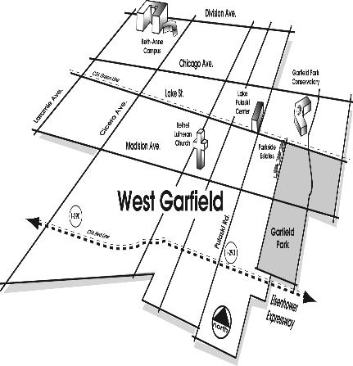
Assets - Community
(physical, social capital, economy)
Recognize your physical assets & economic ones
Look with new eyes
Bethel - abandoned school, closed down hospital, transit stop, conservatory
Look at the assets of the economy of the community-businesses, etc.
Build partnerships
Keep evolving

Slide 22
Exchange
Not For Profit
NFP
NFP
G
$
Governmental
G
$
For Profit
Notes:
The fifth asset is all kinds of exchanges. It is indicated by the two arrows at the bottom of the slide. These exchanges, among people in the neighborhood, include giving, sharing, trading, bartering, exchanging, buying and selling, time banking, babysitting co-ops.

Slide 23
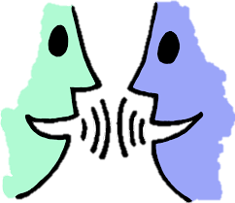
Culture, Stories and History
Notes:
The sixth asset is culture, stories and history These remind neighbors of how they have done things successfully in the past. They also strengthen the culture of the neighborhood by creating a common history, culture and identity. Use of stories through video, and photos bears witness to how assets are making change.

Slide 24
Six Community Assets
Individuals
Associations
Institutions
Physical Space
Exchange
Culture/Stories/History
Notes:
Here is a list of all 6 assets. Every story of neighbors making things better involves using one or more of these 6 basic building blocks

Slide 25
Basic ABCD Findings
In every story, neighbors know about
the local assets.
Successful neighborhood action is the result of assets that were not connected being connected.
To connect assets there must be a connector, i.e. individuals, associations or local institutions.
Notes:
These are the three basic findings about how assets build powerful neighborhoods. They indicate the importance of people or groups that initiate a connecting process.

Slide 26
Connecting Assets
Asset maps are a guide to relationship building
We organize and re-organize assets through relationships
Connector-Leaders are the most powerful assets
Learning Conversations are the most effective tool for building asset-based relationships.

Slide 27
Connector’s Skills
Gift centered
Well connected
Trusted
Believes community is welcoming
Notes:
ABCD has done research regarding effective connectors. These are their basic characteristics. People with these characteristics exist on every block. Therefore, you don’t train a connector, you find them in a neighborhood.

Slide 28
Three Planning Questions
As neighbors, what can we achieve by using our own assets?
What can we achieve with our own assets if we get some outside help?
What can’t we do with our assets that must be done by outsiders?
Notes:
We have found that powerful neighborhood associations follow 3 steps in doing their work. It is the asset-based neighborhood development process. This process does not start by asking, “What are our problems and what outside institutions can fix them?” Instead, the ABCD process always begins by asking. “What is our vision and what asset do we have to make that vision come true?”

Slide 29
Cautions Regarding ABCD
Not every community is ready
Need to be serious about involving everyone
Need to be serious about TIME

Slide 30

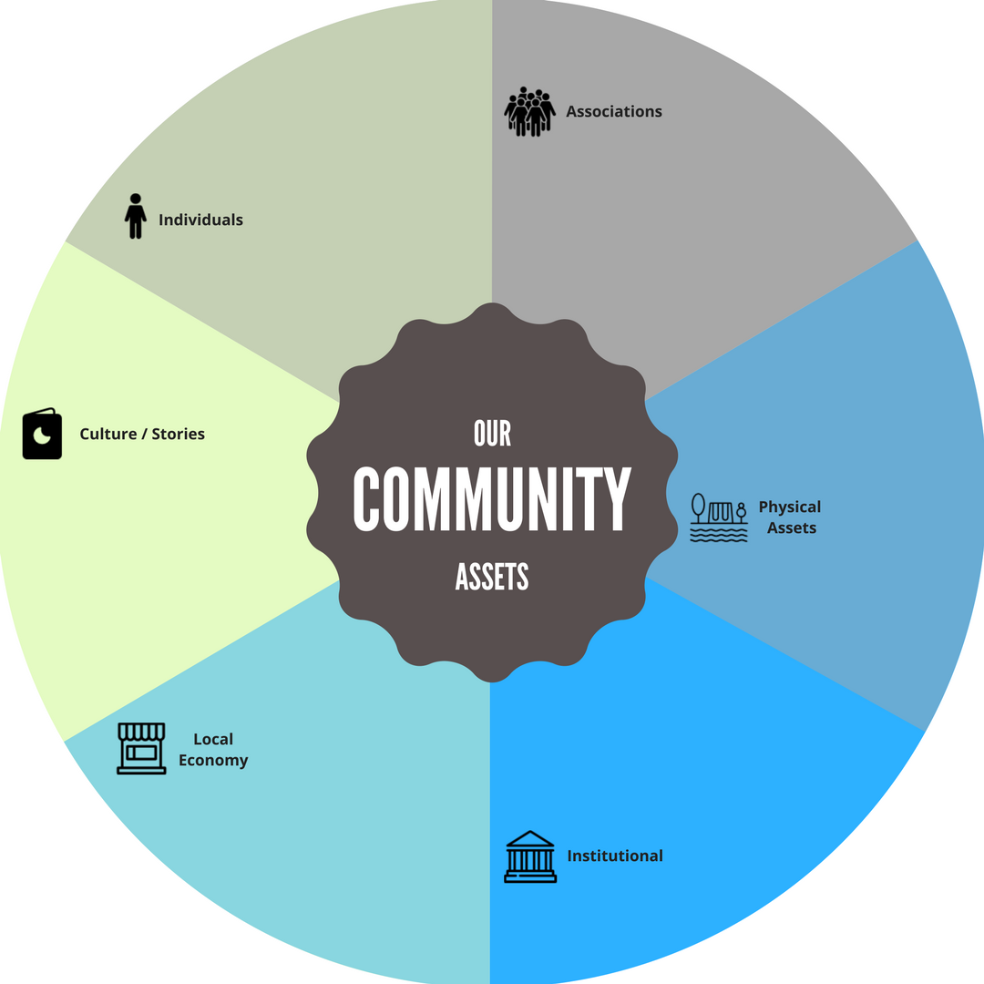
Notes:
Here is a list of all 6 assets. Every story of neighbors making things better involves using one or more of these 6 basic building blocks

Slide 31
Asset Mapping
We have to be very purposeful in implementing the three steps of resident engagement.
  Use learning conversations to discover the gifts and passions of the residents
  Ask people to get involved, and share their gifts around the issues they care about.
  Connect people with the same passions to act collectively for the common good.
The goal is to have more residents become involved by sharing their gifts, based on their passions. Not to just attend meetings.

Slide 32
ABCD INTO ACTION
FIND AND MOBILIZE ASSETS OF THE COMMUNITY:
● RESIDENTS
● ASSOCIATIONS AND CONGREGATIONS
● BUSINESS, NON PROFITS, GOVERNMENT
● LOCAL ECONOMY
● PHYSICAL WORLD

Slide 33
ABCD INTO ACTION
1) WHAT DO WE WANT TO DO?
2) WHAT DO WE HAVE TO DO IT WITH?
● Find assets
● Connect assets
3) HOW DO WE GET THEM TO DO IT?
● Relationships
● Discover self interest “motivation to act”
● Self interest to common interest
4) HOW ARE WE DOING?
● Evaluation
● Celebration

Slide 34
Questions?

Slide 35
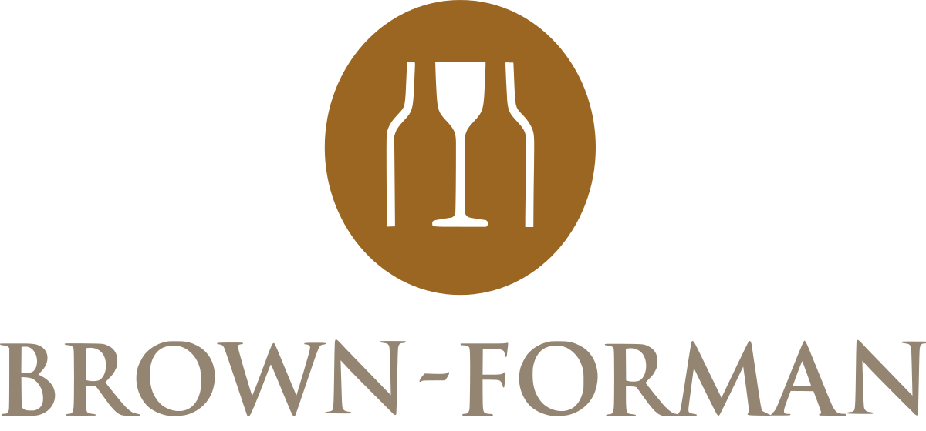
Thank You To Our Workshop Sponsor,
Brown Forman

