Slide 2
Unconscious Bias: Who, Me?
Notes:
Hello and welcome. My name is Rochelle Armstrong. Thank you for choosing to participate in this workshop on Unconscious Bias. What is an unconscious bias? Simply stated, “it’s unintended people preferences. They are formed by socialization, our personal experiences, and the representation of different groups in the media.” During this session, we’ll dig deeper into what an implicit or unconscious bias is and how it impacts our attitude and behavior personally and professionally.

Slide 3
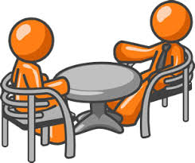
Exposure
Awareness
Notes:
Today is about exposure & awareness. Interactive activities are built into this course, but more importantly, allow yourself to absorb & reflect.
*You will need paper and pencil.
Next slide: riddle

Slide 4
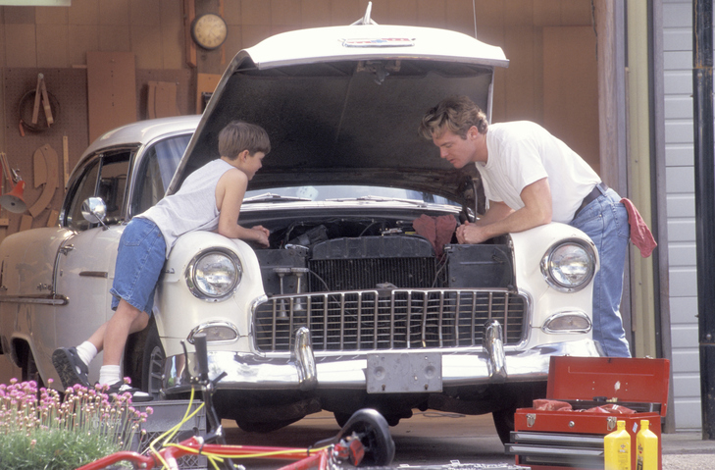
riddle
A FATHER AND HIS SON ARE IN A CAR ACCIDENT. THE FATHER DIES at the scene and the son, badly injured, is rushed to the hospital. In the operating room, the surgeon looks at the boy and says, “I can’t operate on this boy. He is my son.”
Notes:
Ask the audience: How can this be?
Answer: The surgeon is his mother. (Describe mindbug on next slide…)

Slide 5
riddle
How can this be?
Notes:
Answer: The surgeon is his mother. How can this be? (Describe mindbug on next slide…)

Slide 6
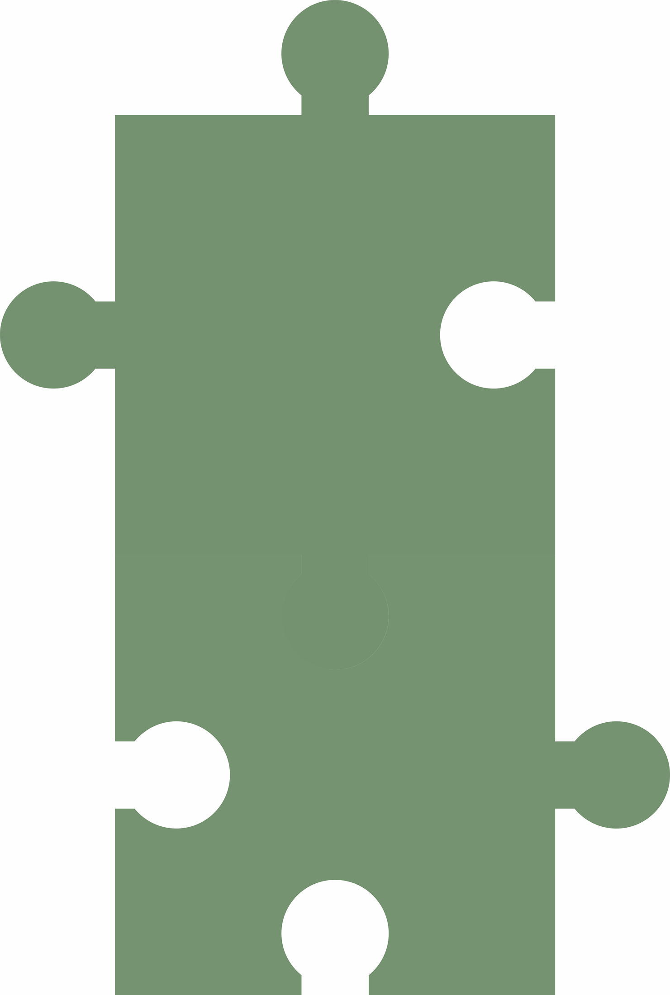
Mindbug
surgeon
male
Notes:
Riddle…How can this be? The association surgeon = male. In this riddle, that stereotype works as the first piece of a mindbug The second piece is error in judgment-in this case a failure or delay in figuring out that the surgeon must be the boy’s mother. Both are minor examples of one’s automatic mind. If you got this riddle, great but as we get deeper into the session, you’ll discover how these mindbugs and stereotypes impact our blindspots or unconscious mind.
*Ground Rules (next slide)

Slide 7
Ground Rules
Acknowledge one another as equals
Stay curious about each other and the content
Recognize that we need each other to become better listeners
Slow down so we have time to think and reflect

Slide 8
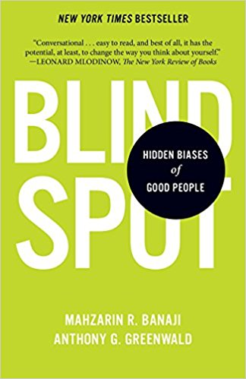
Purpose
“The primary use of the IAT and purpose of this course is to bring dissonance between reflective and automatic preferences into conscious awareness. From there, it is at least partly up to each individual to use knowledge to move beyond dismay and to find ways to understand hidden biases and if desired, to neutralize them before they translate into behaviors.”
—Mahzarin R. Banaji and Anthony Greenwald
Notes:
Most of the research came from a book called Blind Spot: Hidden Biases of Good People written by two scientist Mahzarin Banaji and Anthony Greenwald. “In this book they aim to make clear why scientists, including themselves, now recognize hidden-biases (blind spots) as fully believable because of their sheer weight of scientific evidence that demands this conclusion. As many scientist, they’re both brilliant enough to know that convincing people of this, is no simple challenge. Of course, there’s always critics and naysayers who challenge the validity of their research and the implicit association test (IAT), so when you do take the IAT, keep in mind, it’s not exhaustive.
I chose to use it because Banjai & Greenwald, as well as many others, started studying the Implicit Association Test (IAT) as far back as 1955. This test has enabled them to reveal to the contents of hidden-biases (blindspots). According to the authors, hidden biases are bits of knowledge about social groups. Once lodged in our minds, hidden biases can influence our behavior toward members of particular social groups, but can remain oblivious to their influence.
(Purpose on slide): The primary use of the IAT and purpose of this course is to bring dissonance between reflective and automatic preferences into conscious awareness. From there, it is at least partly up to each individual to use knowledge to move beyond dismay and to find ways to understand hidden biases and if desired, to neutralize them before they translate into behaviors. Note: I’ll go deeper into what is meant by dissonance, reflective and automatic preferences, here shortly.
But for now, Why is this especially important for people in our neighborhoods?

Slide 9
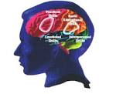
Topics of Discussion
MINDBUGS
Visual
Memory
Social
REFLECTIVE and AUTOMATIC MIND
STEREOTYPES
IMPLICIT ASSOCIATION TEST (IAT)
Notes:
As we go deeper into these topics of discussion, I’ll share examples of how they can impact attitudes, behavior and decision making, but I challenge you to think about how these mindbugs, mindsets and stereotypes may influence your attitude and behavior towards certain groups within and outside of our neighborhoods. Who we will socialize with, work on projects with or hire.

Slide 10
Visual/Memory Mindbugs
Are ingrained habits of thought that lead to errors in how we perceive, remember, reason, and make decisions.
Notes:
The first two mindbugs we’re going to talk about are visual and memory. Have some read this slide.
Next slide: Activity place marker

Slide 11
Notes:
Let’s gain some self-awareness.
*Note to Self: Insect Activity on the next two slides.

Slide 12
Ant Bee
Spider Wing
Feelers Bug
Web Small
Fly Bite
Poison Fright
Slimy Wasp
Crawl Creepy
Notes:
Instructions: Read the following sixteen words with sufficiently close attention so that you can expect to be able to remember them when I show them to again in a different arrangement. *30 secs

Slide 13
Maple Wing
Ant Leaves
Poison Tree
Roots Insect
Stem Bite
Creepy Spider
Fly Willow
Berry Web
Feelers Bug
Slimy Small
Birch Oak
Crawl Fright
Acorn Branch
Wasp Pine
Bee
Notes:
Instructions: Think back to the words you just saw, as you examine this list. As you review each word, try to recall whether each word you see here also appeared in the list you read earlier. Write them down. *To avoid any doubt about your answers, copy all the words you recall seeing on the previous list and leave out any word that, by your recollection, did not appear on the previous list.
Answer: To be correct, you should have left out all twelve tree-related words, starting with maple, ending with pine. You should have also written down all the insect-related words, except one: insect itself.
It’s quite likely that you included insect as a word you seen before. If so, you have demonstrated a powerful but ordinary mindbug that create false memories.
The mind is an automatic association making machine. When it encounters any information; words, pictures, or even complex ideas, related information automatically comes to mind. In this case, the words in the original list had an insect theme. Unthinkingly, we use shared themes as we try to remember the past and, in so doing, stumble easily when we come across the word insect itself. Such a memory error is called a false alarm, we mistakenly remember something that actually did not occur.
*Survey results on the next slide

Slide 14
Survey Results
82% of students remembered seeing words that shared a theme (like insect), but were not on the original list
Students had 75% correct memory for words that were actually on the list
Notes:
*What does the results of this study conducted at Washington University tell us?
Facilitator: Mindbugs can be powerful enough to produce greater recollection of things that didn’t occur than of things that did occur.
Example of memory error…false alarm. Eye witness memory next slide.

Slide 15
Eye witness memory
Notes:
Imagine being interrogated about a potential suspect in a crime or car accident? In one famous study, Researcher (Elizabeth Loftus is among psychology’s most creative experimentalists at University of California at Irvine) showed witnesses scenes from an automobile accident in which two cars had collided with no personal injury. Later she asked half the witnesses, “How fast was the car going when it hit the other car?” Those who were asked the “smashed” question gave higher estimates of the speed of the vehicle, compared to those who were asked the “hit” question, in addition to which they were more likely to mistakenly insert a memory of broken glass at the accident scene even though there was none in what they saw.
Psychologists call this mindbug retroactive interference –an influence of after-the experience information on memory. Loftus gave her’s a more memorable name: the misinformation effect. Her point is that a small change in language can produce a consequential change in what is remembered, often resulting in mistaken testimony by eyewitnesses who relied on mistaken information.
*Ask audience: Have you ever had to be a witness to a car accident or crime? If not, share my story.
*Transition to Social Bugs

Slide 16
Social Mindbugs
Can give us both false feelings of faith in people we perhaps shouldn’t trust and the opposite feelings of distrust of people we should trust.
Notes:
Now that we’ve talked about visual and memory mindbugs, let's take a look at the social mindbug. Have someone Read the slide first. Next: Take as an example Bernard (Bernie) Madoff, perpetrator of the largest investment fraud in U.S. history. While Madoff’s victims were quite ethnically diverse, Jewish organizations were particularly numerous among them, suggesting that they were more unwisely trusting of Madoff, with whom they shared a group identity based on religion. Bernard Madoff p. 16
Another example: A symmetric but opposite outcome involves the evocation of inappropriate distrust that is also in error. As the story goes, when Omar Edwards left his home on the morning of May 28, 2009, he had a little reason to predict that he would never return home. But, Edwards, a Black police officer, was fatally shot in Harlem when fellow detective mistook him for a suspect.
Now let’s explore social mindbugs for ourselves.

Slide 17
Notes:
Gain some self-awareness on next slides. .

Slide 18
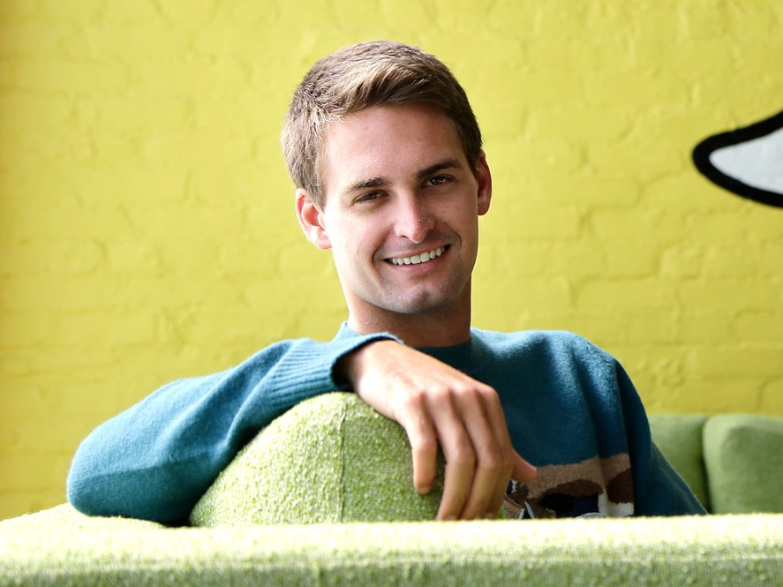
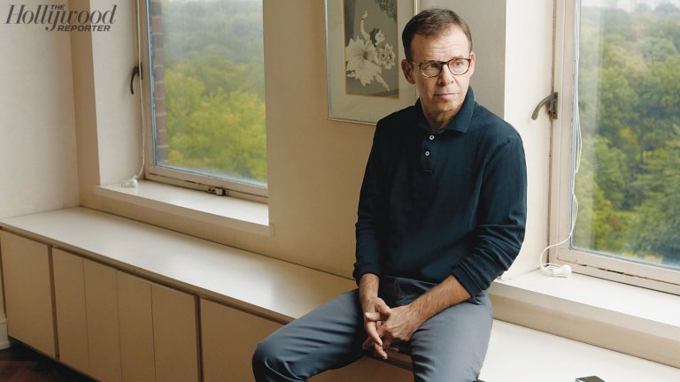
Billionaire
Stay at Home Dad
Notes:
ASK: Which one do you think is the stay at home dad and which one do you think is the billionaire? Click enter: for professions to appear (1st: Evan Spiegel, 2nd Rick Moranis)
Evan Spiegel, CEO of Snap (social media) net worth is around $10.2 billion, making the 31 year old one of the youngest billionaire in the world.
Rick Moranis was a huge star best known for comedies Ghostbusters, Little Shop of Horrors, as well as Honey I Shrunk the Kids, to name a few. But following the death of his wife, he stopped acting to take care of his kids. With the exception off doing a voice over on the Brother Bear movies.
It turns out that it’s easy (not accurate) to make assessments based on nothing more than a static picture. In fact, trying to avoid making such judgments may be far more effortful than making them. The problem is that these judgments may be not just a little wrong but quite wrong.
When judging people’s character, we hardly even recognize just how “right” our assessment feels, even when it’s based on only a smattering of information. Look at these two photos and ask yourself:
A face whose features are similar to our own may evoke a feeling of trust when we are deciding to hire a job applicant or choosing a candidate to vote for. And particular facial configurations can lead us all to believe that a person is trustworthy, such as those who have more of a baby face.

Slide 19
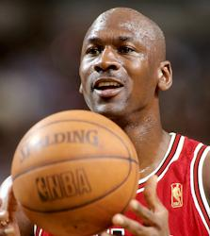
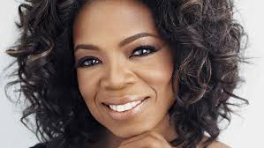
Notes:
This time is a little different because most of us have at least limited information on these two individuals.
Without given a second thought, ask yourself:
1. Which one of these two people seems more trustworthy?
2. Which one will be more competent on the job?
3. Which one is more likely to dominate others?
Economists, sociologists, and psychologists have confirmed time and again that the social group to which a person belongs can be isolated as a definitive cause of treatment he or she receives.
*Now, lets talk about Shades of Truth…next slide

Slide 20
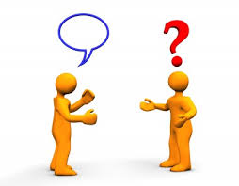
Shades of Truth
How often do you give answers that you know are untrue?
Notes:
If your answer is “rarely” or “never” the hope is to convince you that this itself is something you know to be untrue. We are not questioning your integrity. It’s perfectly understandable that you would believe that you rarely answer questions in ways you know to be untrue. Almost certainly you see yourself as an honest person…most people do. You would probably assume that we were asking about times when you were consciously and deliberately lying, perhaps even in ways that might benefit you at the expense of others.
What we’re interested in are the untruths that are somewhere between totally unconscious and partly conscious, untruths that people tell not only to others but at times to themselves as well.
Consider the questions that is probably most asked:
How are you? How often do you answer fine even if the question interrupted your mental review of how much your back hurts, how upset you are about criticism just received from a friend, or how little sleep you’ve been getting? Note: this may or mayn’t be true for you depending on the person asking and your relationship with them, including if they’re positive or always upbeat can impact your answer.
Do I look fat in these jeans? Is another question you might have heard or said.
You may defend yourself by pointing out that the untruths you tell in response to these questions are nobly motivated. They reveal your desire to avoid boring, burdening, or hurting the person who asked the question. You may add to your defense by pointing out that your less-than true answers to these questions cannot possibly harm anyone. And even the person who asks these questions may have little expectation of receiving a truthful answer. Typically, we refer to these as White Lies.
Maybe you’re saying, yes, it’s true. I do engage in the occasional white lie, but what about when the homeless person ask, Can you spare a dollar and you respond, “Sorry I don’t have any cash.” or Is Ms X or Mr Y @ home when the solicitor calls and you respond, “No, he isn’t or no she isn’t.”
These untruths are a bit darker than white lies so we color them gray. Like white lies, gray lies are motivated to spare feelings. However, these answers are shaped more by the desire to spare one’s own feelings than by the intention to spare someone else’s.
Next slide: what the different shades of truth mean.

Slide 21
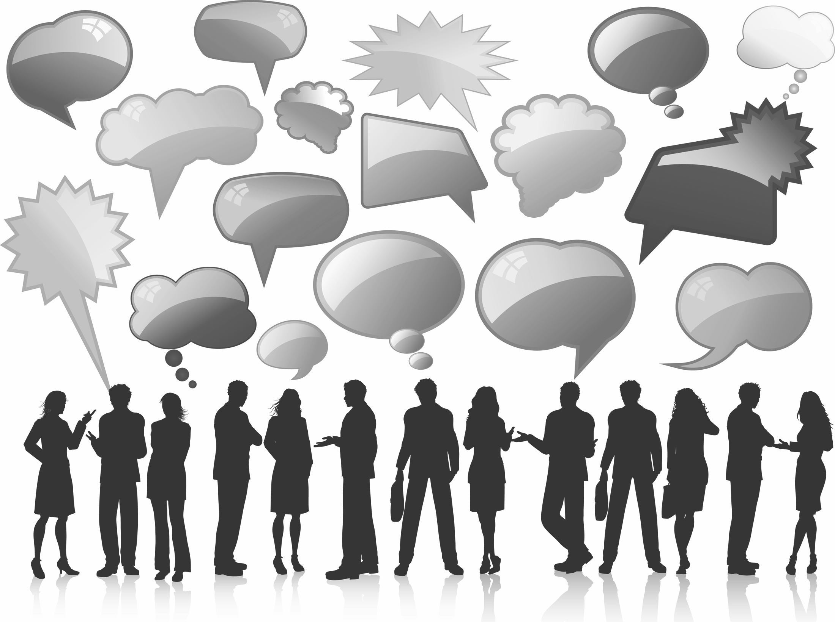
What does these shades of truth mean?
Gray lies
Untruths
Colorless lies
White lies
Notes:
Our daily social lives demand, and generally receive, repeated lubrication with a certain amount of untruthfulness, which keeps gears of social interaction meshing smoothly. Unfortunately, what works so well in daily life does not serve the interests of science. If answers to questions as matter-of-fact as those about “how are you doing” or “do I look fat in these jeans”, what should we assume about the limits of what can be learned from question-asking research on topics as highly charged as a person’s racial attitudes or other forms of bias? P 31
*Revisiting the open question: When you are asked questions, how often do you give answers that you know are untrue? If you responded “rarely” or “never”, perhaps you are now ready to grant that it might be more often than that. Which leads us to ask: Do you think you are biased against people of other races or ethnicities? Given what you’ve learned about the limits of honesty, in thinking about your answer you might want to ask yourself: How truthful will I be in responding to questions about racial beliefs and attitudes?
*Next slide: Colorless Lies

Slide 22
Colorless Lies
“Every man has reminiscences which he would not tell to everyone but only his friends. He has other matters in his mind which he would not reveal even to his friends, but only to himself, and that in secret. But there are other things which a man is afraid to tell even to himself, and every decent man has a number of such things stored away in his mind.”
-Fyoder Dostoyevsky

Slide 23
Notes:
Let’s gain some self-awareness.
*Next slide: “Not that anything is wrong with that”

Slide 24
“Not that anything is wrong with that.”
Notes:
Have you ever said this phrase on the slide? *Share Seinfield ep. 57 about Jerry & George pretending to be lovers for the benefit of a woman eavesdropping, only to find out that she’s actually a reporter who believes them and intends to “out” Jerry in her newspaper. Trying to clear up the mistake, Jerry & George repeatedly try to persuade her that they’re not really gay, while repeatedly adding the qualification: “Not that anything is wrong with that.
Ask: has anyone ever said this? If so, what was it in reference to? *Share personal story at the Mexican restaurant with Nikki.
Even if you’re not familiar with the sitcom or its characters, it’s easy to recognize that the humor in that oft-repeated line derives from a contradiction: While contemporary attitudes toward homosexuality may have come so far that in many of our minds there’s everything right with being gay (Jerry and George can even pretend to be gay), the very need for the denial signals that at some level, many of us must believe that there’s something wrong with it.
Next slide: introduce reflective & automatic mind

Slide 25
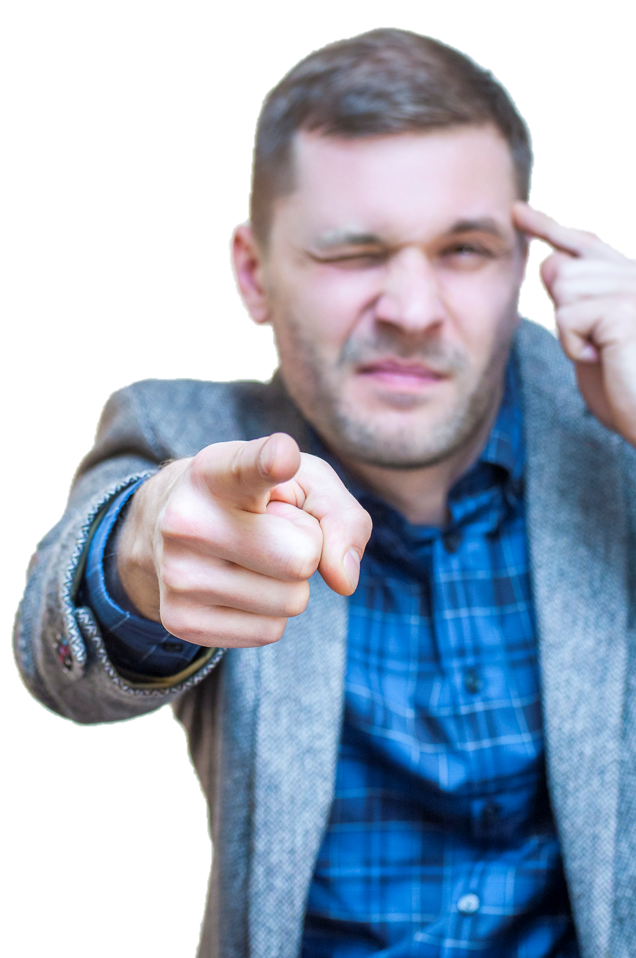
Reflective Mind
Automatic Mind
Notes:
Our preferences, what and whom we favor or reject, nurture or thwart, approach or avoid, can take different forms. For the purpose of building theories and conducting research, psychologists routinely speak about two systems that characterize the mind: reflective and automatic.
Reflective or conscious side of Jerry’s mind is indeed gay-friendly, and he can honestly say that he believes there’s nothing wrong with being gay. But Jerry is also the product of a culture that has for centuries treated homosexuality to be at best an unfortunate psychological disorder, and more likely an abomination. If Jerry’s automatic, less conscious mind makes this simple yet culturally potent association (gay = sinful), surely this will influence his own thoughts and behavior.
*Breakdown Reflective and Automatic mind on next slides…

Slide 26
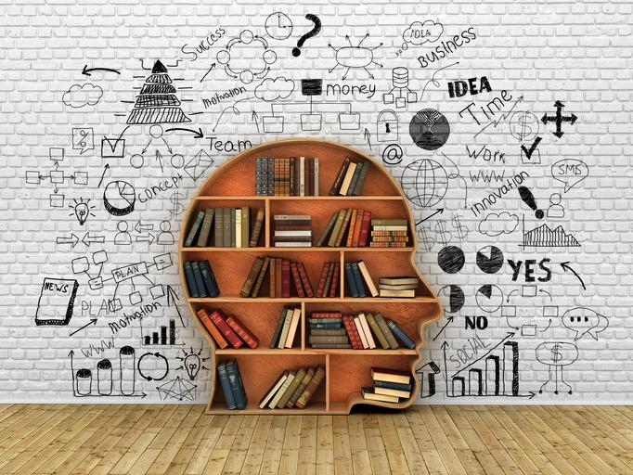
Reflective Mind
“The power of conscious thoughts and feelings is to create a particular type of fuel for action.”
-William James
Notes:
We know our reflective preferences quite well, especially when they concern matters important to us. For example, we can voice our religious beliefs or the lack thereof. We can articulate why a particular candidate for political office is the right or wrong choice.
Consciously, we can even make statements that are cognitively and emotionally complex such as “Although I would probably gain by the election of candidate X , I will vote for candidate Y, whom I regard to be better for the country as a whole.” Sometimes such beliefs and preferences are also mirrored in actions. “Thinking is for doing” says psychologist William James (reference quote on slide).

Slide 27
Automatic Mind
‘Automatic preferences serve as navigational devices.”
-William James
Notes:
Contrary to the “reflective” side of our mind, the “automatic” side is “a stranger to us.” We implicitly know something or feel a certain way, and often these thoughts and feelings are reflected in our actions too, the difference being that we can’t always explain these actions, and they are at times completely at odds with our conscious intentions.
*Next slide: share the professor buying the Porsche instead of the Volvo station wagon

Slide 28
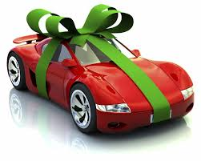
Notes:
Share an example to show the difference between an automatic and reflective mind…
Story from book: I learned about a business school professor, a savvy teacher of negotiation no less, who went to a dealership to purchase a new car. A person with a growing family, he left the house intending to buy a sensible family car, good for transporting the dog, the groceries, and the kids. Ask audience: what type of car do you think he should get? Then say, lets go with a Volvo station wagon, perhaps? A few hours later, he found himself pulling into his driveway in a sporty red Porsche! What caused the gap between the professor’s reflective intention and his actual behavior? Even more, why didn’t he know all along what his final choice was going to be?
This is a common experience: We often find ourselves attracted to things (and people too) on the basis of color, and shape and style, features that appeal to preferences that lie below the surface, while we are indifferent to the more sensible features that are more rational. For example, we choose a car because it’s sleek rather than for its repair record or a house for its French-lilac color rather than its energy efficiency.
Every day, “automatic” preferences steer us toward less conscious decisions, but they are hard to explain because they remain impervious to the probes of conscious motivation. Thus we may expound at great length on the virtues of the things we think we ought to prefer (the tanklike safety of a Volvo), but when it comes to making a choice, our rationality (which tells us buy the Volvo) is often no match for our automatic preference (which says, Nope, I want that red-hot sporty Porsche).
Another theory used to describe this phenomenon is Dissonance (next slide)

Slide 29
Theory of Cognitive Dissonance
“tells us that becoming aware of conflicts between our beliefs and our actions, or between two simultaneously coexisting beliefs, violates the natural human striving for mental harmony, or consonance.”
-Leon Festinger
Notes:
Quote on the slide was formulated in the mid-1950’s by Leon Festinger, a brilliant social psychologist (example of the Reflective and Automatic mind).
Next slide: transition to stereotypes

Slide 30
Stereotype
Judging the characteristics of strangers about whom we know nothing other than that they belong to some group.
Notes:
Next slide: examples of sterotypes.

Slide 31
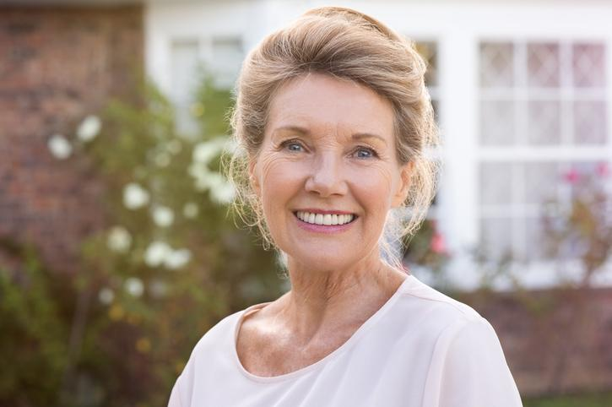
Old people are forgetful
Koreans are shy
Asians are good at math
Boston drivers are aggressive
Women are nurturing
Disabled employees have higher absenteeism
Notes:
Ask: Have you ever heard of these stereotypes? Do YOU believe them to be true? Each of these captures an association that connects a group with an attribute. The thing I want to point out is that almost any stereotype is true in “some” way. Pp. 76-77, 87
Boston drivers/The coast

Slide 32
Trait
Groups
Leadership Men more than women?
Musical talent African Americans more than Native Americans?
Legal expertise Jewish more than Christians?
Math ability Asians more than Whites?
Criminality Italians more than Dutch?
Notes:
Here is another illustration of the tendency to think in stereotypes. For each of the five traits listed on the left, do you see that trait as a better description of the first or second group named to the right?
Any yes answer suggests that you posses a stereotype that, undoubtedly, many others also have. It’s true that possessing these stereotypes doesn’t mean that you will use them when you are making judgments about individual people, or that you will make important decisions based on them. For ex. A corporate manager may believe that the leader=male stereotype is generally valid but may still be able to recognize that a specific woman who has outstanding leadership potential would be a great candidate for an executive position. At the same time, the bar she would have to clear might be higher than for men competing for the same position.

Slide 33
Does Stereotyping Have a Useful Purpose?
“The human mind must think with aid of categories…Once formed, categories are basis for normal prejudgment. We cannot avoid this process. Orderly living depends on it.”
-Gordon Allport
Notes:
Ask: Why do we stereotype? According to Gordon Allport’s 1954 book The Nature of Prejudice. Allport wrote: “The human mind must think with aid of categories…Once formed, categories are basis for normal prejudgment. We cannot possibly avoid this process. Orderly living depends on it.
*Share Malcom Gladwell’s quote after taking the IAT on the next slide

Slide 34
Theory for Stereotyping
Presently Adaptive
Notes:
Presently adaptive: people derive a useful self-esteem boost because stereotypes allow them to see their own group as superior to other groups. Having unfavorable stereotypes of many other groups makes this fairly easy to do. This theory is less compelling, in part because humans have so many other ways to boost self-esteem.
A new speculative theory of stereotyping that is also presently adaptive is that stereotyping allows us to perceive strangers as distinctive individuals . For ex. Take in consideration a Black, Muslim, Sixtyish, French, lesbian professor. Each of her six identifies carries its own set of stereotypic traits. Using one identifier at a time would mean seeing her only with the Black stereotype or only the Muslim stereotype, or only the stereotype for one of her other four category labels. But processing her six identifiers together, all at once, let us conceive of a person who is distinctly different from anyone else we know.
This explanation is no different then “thin slices” or “sizing someone up. Imagine a person who walks past you while you wait to board an airplane. Five identifiers will almost be immediately available: sex, age, race, height and weight. *Clothing may permit us to add multiple other identifiers, perhaps including income, social class, religion, ethnicity, and occupation.
When our minds automatically activate all these stereotypes at once, we get a rich, complex perception of the person, even though the passerby we are contemplating is a total stranger. After no more than a brief glance we should be able to distinguish this passerby from just about everyone else in sight, quite possibly distinct from everyone else in the airport. This is why we conclude that the mental virtuosity allows us to use stereotypes to perceive strangers as distinctive individuals.
Now that I’ve shared less harmful uses of stereotypes, lets explore when stereotypes are unfavorable, as many are, the forces that cause people to act in ways that conform to the stereotype applied to different groups can have damaging effects.
This is a great Segway to the implicit association test (IAT) – intro next slide

Slide 35
Implicit Association Test (IAT)
IAT is a self-administered test that has enabled scientist to reveal the contents of hidden-biases blindspots
Notes:
*hidden biases are bits of knowledge about social groups. Once lodged in our minds, hidden biases CAN influence our behavior toward members of particular social groups, but can remain oblivious to their influence.
*Share Malcom Gladwell’s response on the next slide

Slide 36
Response to “Race” IAT
“I took it the first time, and it told me that I had a moderate preference for White people. I was biased-slightly biased-against black people, toward White people, which horrified me because my mom’s Jamaican. The person in my life who I love more than almost anyone else is Black, and here I was taking a test, which said, frankly, I wasn’t too crazy about Black people, you know? So, I did what anyone else would do: I took it again! Maybe it was an error, right? Same result. Again, same result, and it was creepy, dispiriting, devastating moment.”
-Malcom Gladwell
Notes:
Malcolm Gladwell’s response after taking the IAT that he shared with Oprah.

Slide 37
Notes:
Now, it’s time to gain some self-awareness. Are you ready to take your IAT?
*IAT’s on next slides

Slide 38
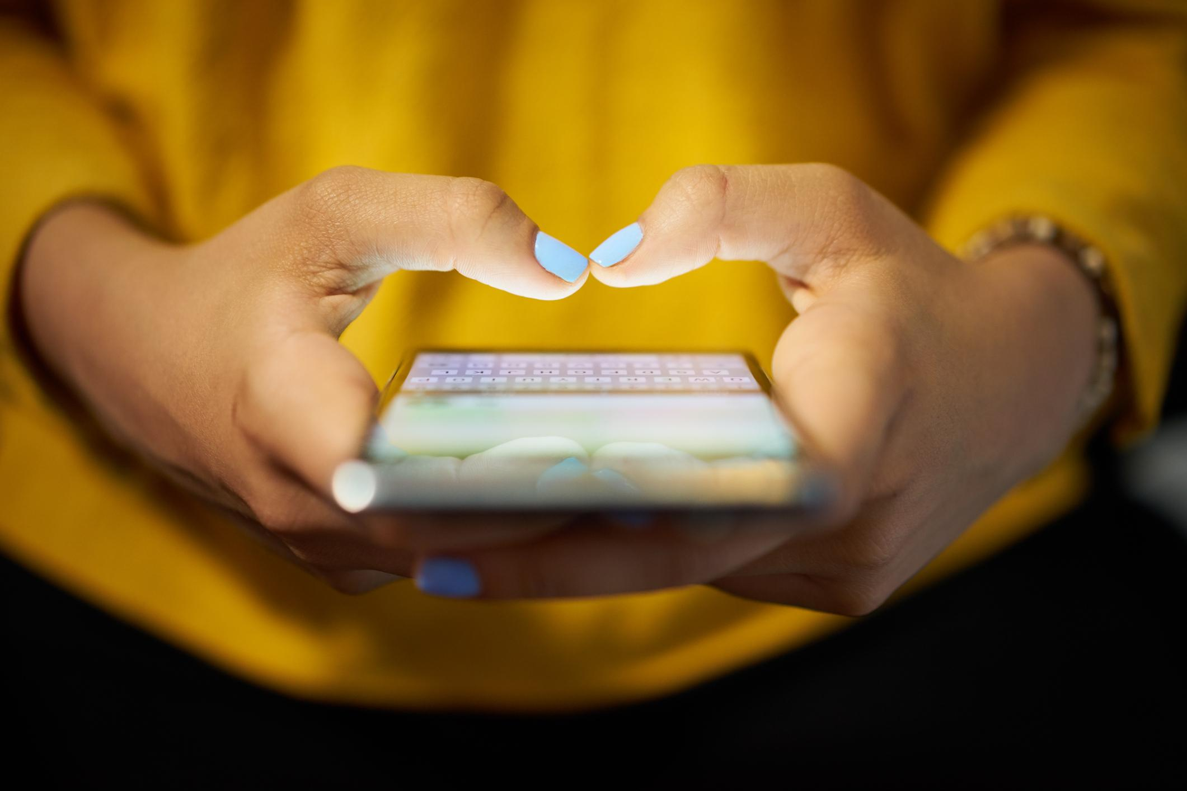
Please go to: bit.ly/T8h6uD
Notes:
Everyone please pull out your cellphones or electronic devices. It’s time to take your first IAT, the flower-insect test.
Instructions: Speed is important; work as quickly as you can with the automatic side of your mind. Your results will not be accurate if you go to slow. If you make a mistake, you will see a red X and should rapidly make the other response to correct the error. Be sure to capture or write down your results at the end.
*This is not a test of intellect, but of associations. It can take between 3-5 mins (although the results will provide your preference, write down how long it took you). Be sure to touch in the “red” and “blue” space of the word you want to select and keep swiping after each section until results are given. *Don’t pause to overthink it.
Once they’re finished say: You have just completed the first version of what it called the Implicit Association Test (IAT). It’s effectiveness relies on the fact that your brain has stored years of past experiences that you cannot set aside when you do the IAT’s sorting tasks. For flowers and insects, this stored mental content is most likely to help you put flowers together with pleasant words while interfering with your pairing flowers with unpleasant words. Similarly, it will likely be easier for you to connect insects with unpleasant words and harder to connect them with pleasant words.
Now, lets move on to the Race IAT

Slide 39
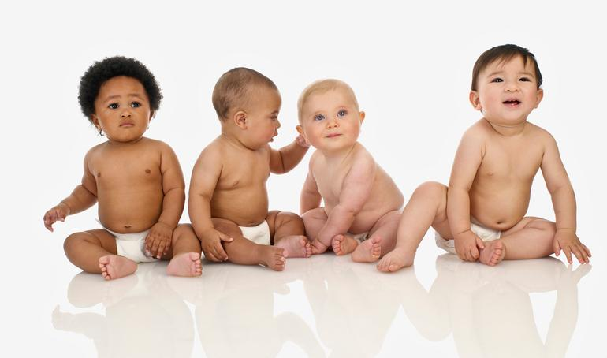
Please go to: bit.ly/TtkoCZ
Notes:
Now it’s time to take the Race IAT. It’ll show “moderate”, strong, no preference, etc.
*percentages of test results after each slide

Slide 40
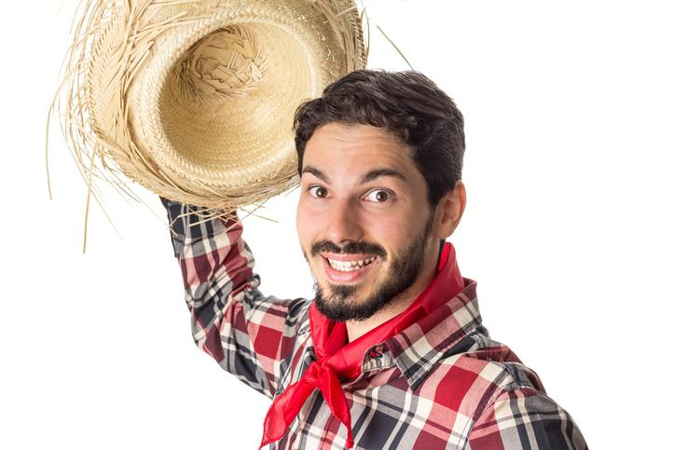
Race IAT Revealed
75% automatic White preference in American society
Notes:
The automatic White preference expressed on the Race IAT is now established as signaling discriminatory behavior, even among research participants who earnestly have egalitarian beliefs, believed to be true by the scientist also.
Earlier, we read Malcom Gladwell’s response. Without telling us your results (not unless you choose), what was your reaction? What you thought. Surprised! Relieved!

Slide 41
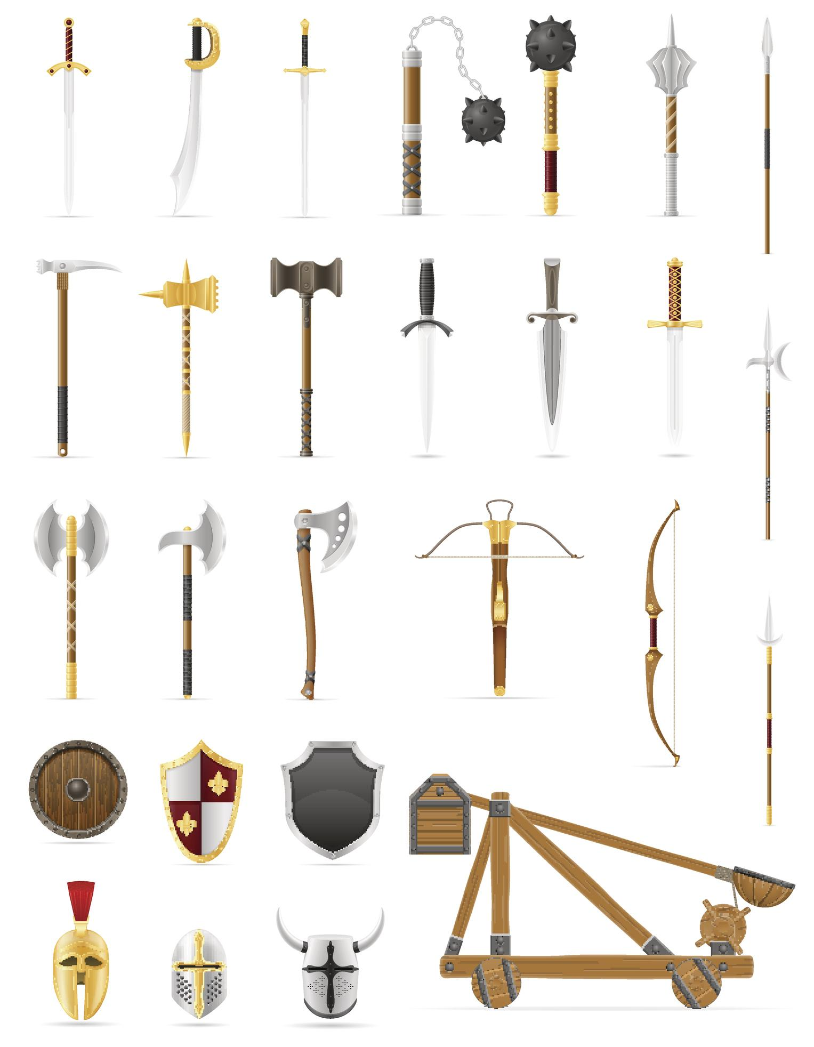
Please go to: bit.ly/P7byzi
Notes:
Race=Harmful stereotype
It’ll show “moderate”, strong, no preference, etc.

Slide 42
Race and Weapons IAT Revealed
The automatic Black=weapons association is much stronger among all groups.
The size of this automatic stereotype varies noticeably by groups. It’s largest by Whites and Asians, next largest Hispanics, and smallest African Americans.
The higher the education level, the lower the endorsement of the association between Blacks and weapons on the reflective self-report answers.
Notes:
One thing to note is you may have noticed that, rather than using images of modern weapons, this race-weapons IAT used pictures of weapons from past centuries: axes, swords, cannons and pistols. This was done deliberately , so as to undermine the race stereotype by setting aside the kinds of weapons that are stereotypically associated with present-day urban crime. The weapons chosen for this test actually have strong historical associations with European cultures, meaning that their use in the test might favor White=weapons association.
*Discuss article sent for pre-work. “Two sisters stabbed, one died (Nia Wilson), one survived and media showed a pic of the deceased holding a gun or cellphone case that looked like a gun.

Slide 43
Please go to: bit.ly/SY5lF4
Notes:
The Gender-Career test
It’ll show “moderate”, strong, no preference, etc.

Slide 44
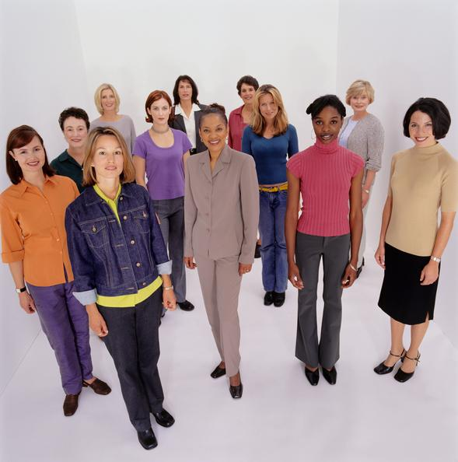
Gender-Career IAT Revealed
75% of male respondents display the automatic gender stereotype of male=work and female=family
80% of women show the same automatic stereotype
Notes:
The Gender-Career test. For those looking for the silver lining to this rather discouraging news, there’s optimism in the data from various age groups of test takers. Decade by decade, the younger the test takers are, the weaker this automatic gender bias.
Next slide: Why does hidden biases of good people matter

Slide 45
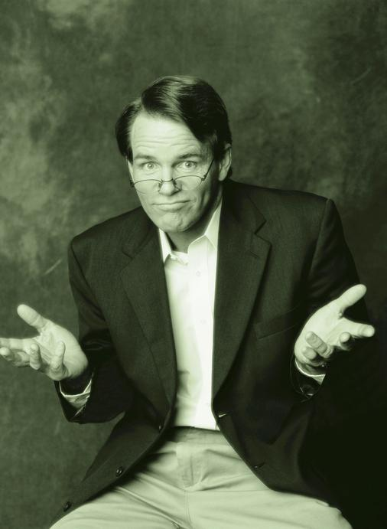
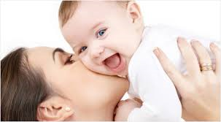
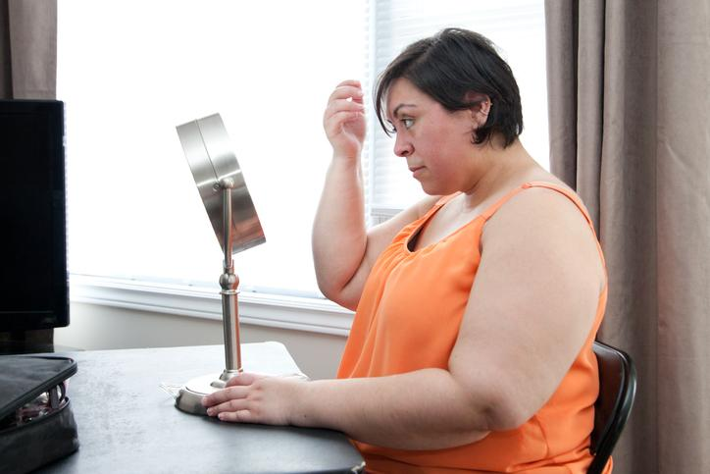
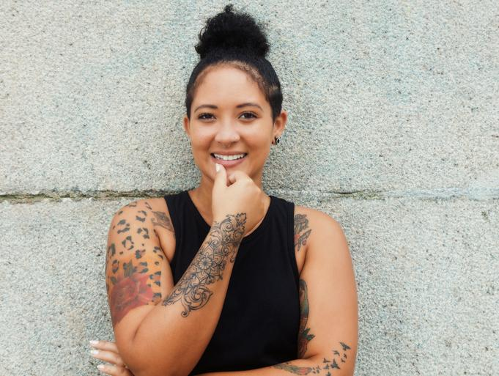
Why Does Hidden Biases of Good People Matter?
Notes:
Ask audience the question on the slide first.
Follow-up response:
Short answer: it effects our attitude and behavior towards certain groups. It’s easy to see that our racial identity goes deep, just as our gender identity does. Without awareness of our biases, the mindbugs & stereotypes we talked about today, can produce discrimination, unintentionally.
Claude Steele, a psychologist at Standford Univeristy has spoken about the “burden of suspicion” that certain individuals in every society carry around because they belong to a group whose status in society is suspect.
*Next slide: So What?

Slide 46
sO wHat?
How might unconscious bias affect working with people of different races and ethnicities?
How does this relate to how you view your neighborhood?
How does this apply to you as a member of society?
Notes:
So what! What’s the point, right? Good stuff, but what am I supposed to do with it? Maybe you’re asking yourself: How does this apply to my church or How does this apply to me as a Christian? If you lead people: can it impact who we hire, assign projects to, promote, and overall who we deem as trustworthy and competent?

Slide 47
Goals and Action Plan
Now What?
Set short-term goals
S
M
A
R
T
Specific
Examples
Seek opportunities to understand hidden biases
Identify your top 1-2 biases
Intentionally learn more/ask questions about the social group(s) you have an unconscious bias (i.e., race, age, gender, orientation, etc.)
Discover ways to neutralize biases before they turn into behaviors
Measurable
Ambitious
Realistic
Time-Based
Notes:
Homework:
Seek opportunities to understand hidden biases (i.e., attend discussions like TableTalk, get books, listen to TedTalks and videos on the topic)
Identify your top 1-2 biases and share them with someone at your table as an accountability partner
Learn more about the social group(s) that you’ve identified as being biased towards
Discover ways to neutralize biases before they turn into behaviors. Once you’ve identified when you’re in a situation where you feel them kicking in, CHOOSE to set them aside and make a decision based on “the right thing to do” “the right person to choose” not based on your preference.

Slide 48
“Practiced in life we all are, and it is such practice that readily provides the “pictures in our heads” that spur us on to the mistaken actions we take, all the while believing that we are the good ones.”
-Banaji & Greenwald

Slide 49
Thank You!

