Slide 2
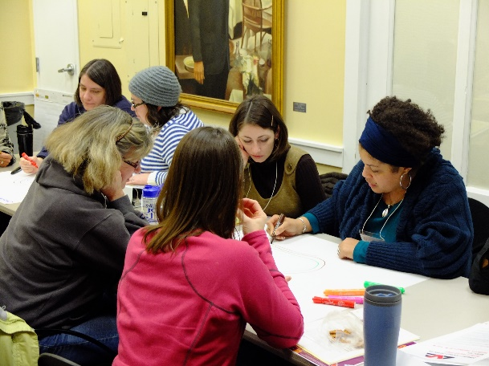
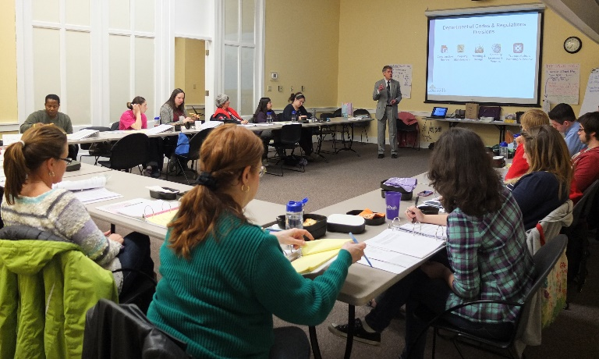
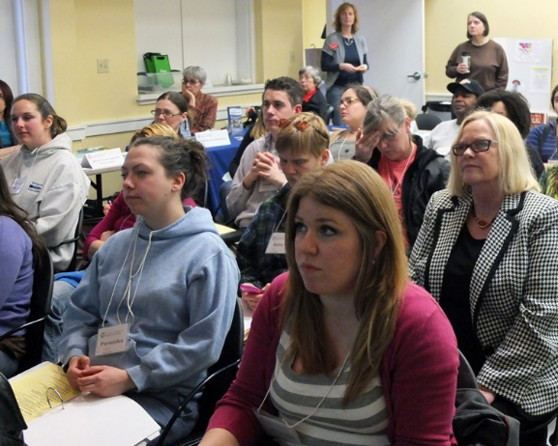

Slide 3
Intro to Neighborhood Institute Fall 2021
Syllabus
Learning Agreements
Weather Policy
Housekeeping

Slide 4
#louisvilleneighbors

Slide 5
Getting to know us

Slide 6
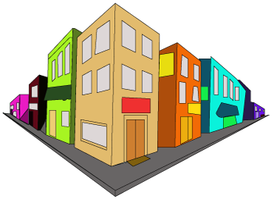
Our Mission
Engaging with neighbors to build great neighborhoods.
Community Engagement
Education & Training
Planning & Design Assistance
Begin With People
Build Great Neighborhoods
Collaborative Relationships
Informed Decision Making
Tangible Impacts

Slide 7
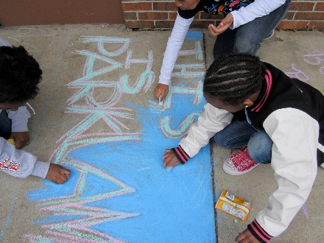
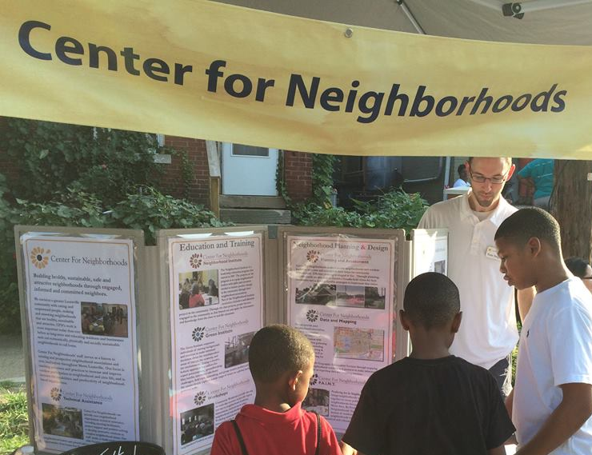
Community Engagement

Slide 8
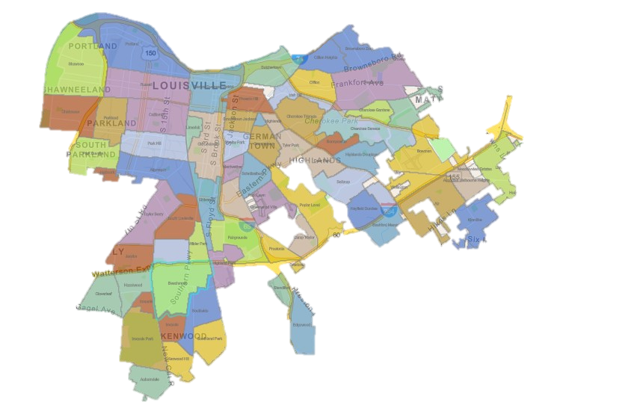
Neighborhood Liaisons
Neighborhood Outreach
Build relationships with Neighborhood Associations and neighborhood leaders; Present information about programs and project opportunities.
Technical Assistance
Meeting facilitation, project support and problem solving to develop innovative solutions to complex neighborhood issues. Help establish newly organizing associations or strengthen existing ones.
Tahjena Muldrow
Johnique Ison
Ja’mel Armstrong
Mikal Forbush
Notes:
Neighborhoods Liaisons are the lead in CFN’s outreach and assistance.
Sign up for weekly Neighborhood News or send newsletter info (community events, projects, etc.) to John Hawkins

Slide 9
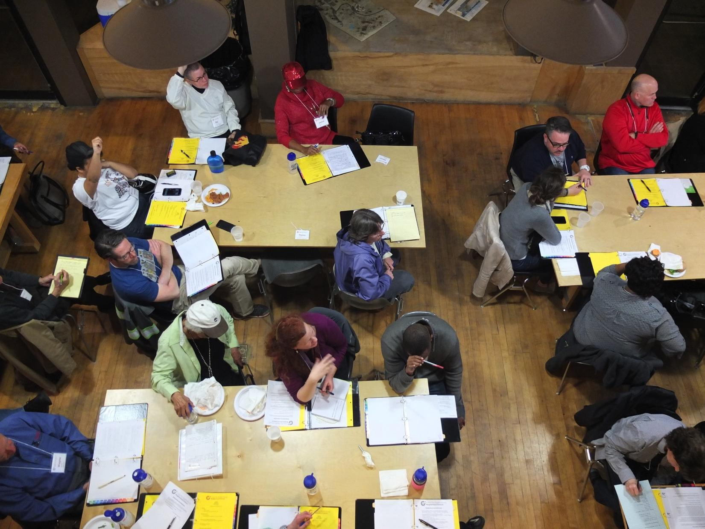
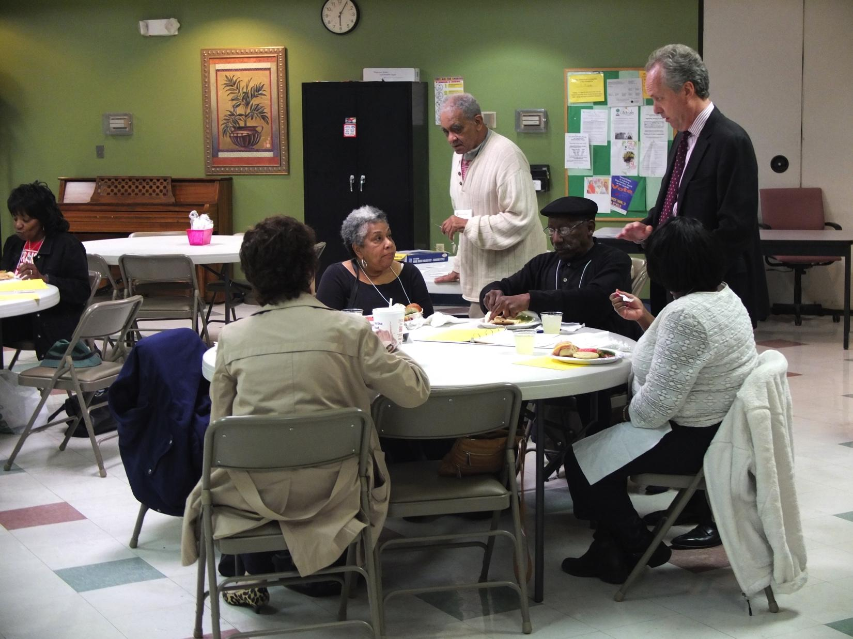
Education & Training

Slide 10
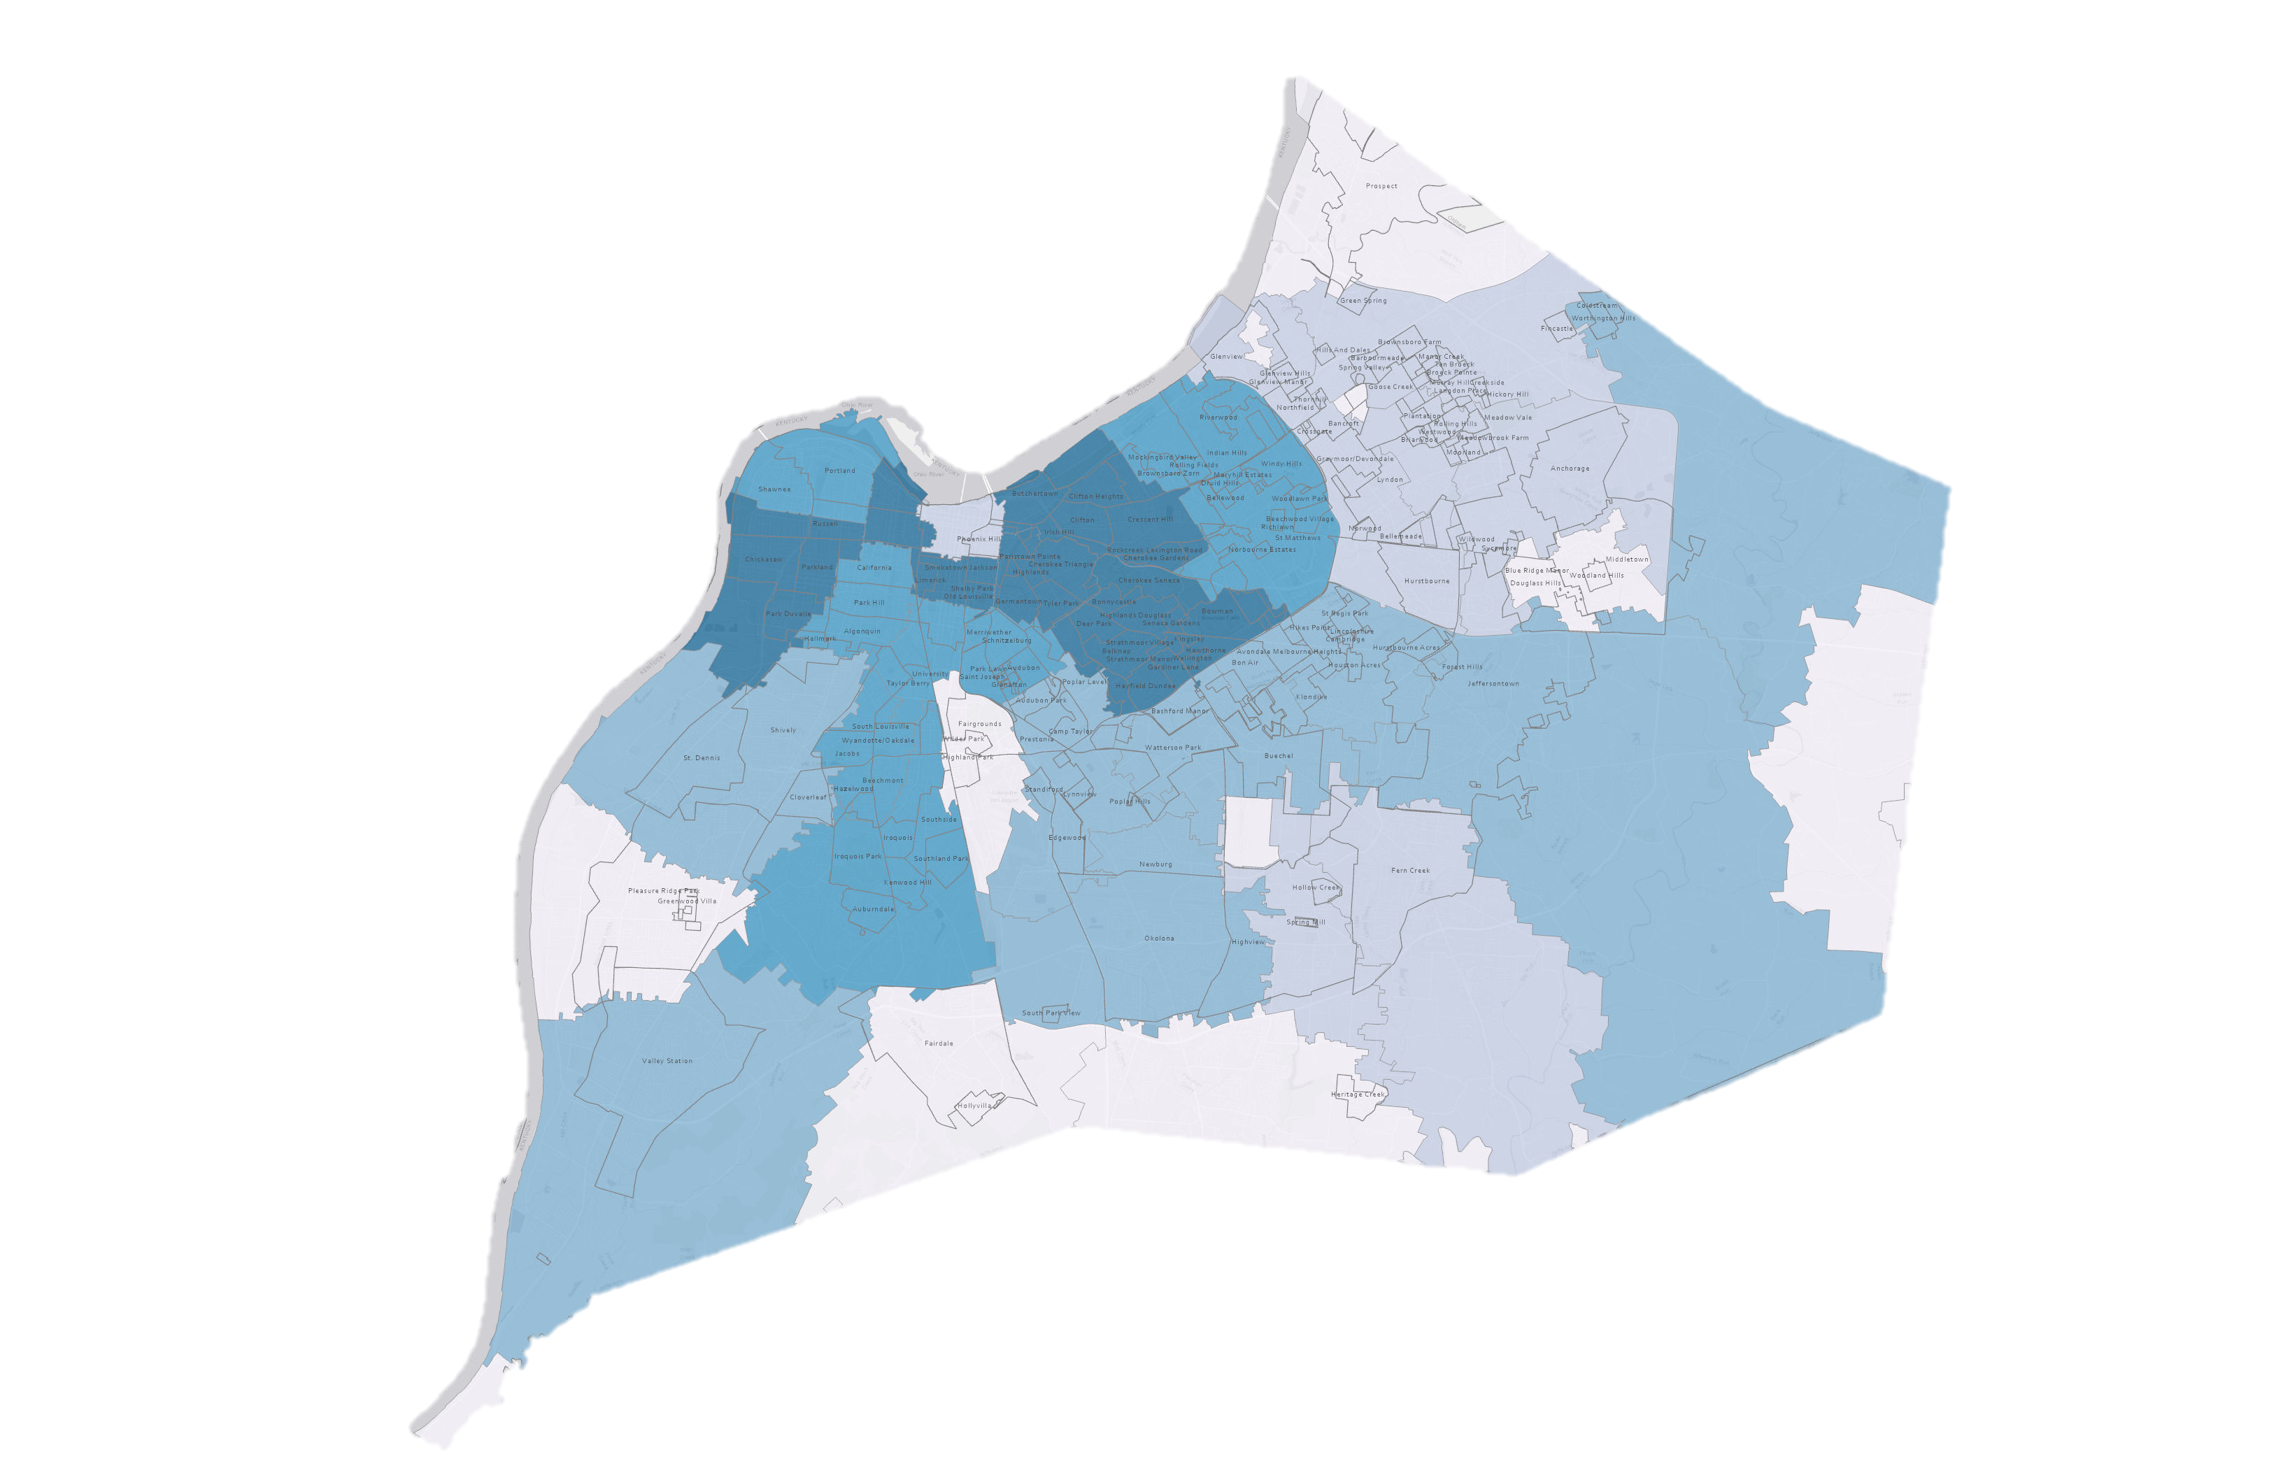
Neighborhood Institute – 30 Years of Participation
<68
<30
<20
<12
<4
Notes:
Neighborhoods Liaisons are the lead in CFN’s outreach and assistance.
Sign up for weekly Neighborhood News or send newsletter info (community events, projects, etc.) to John Hawkins

Slide 11
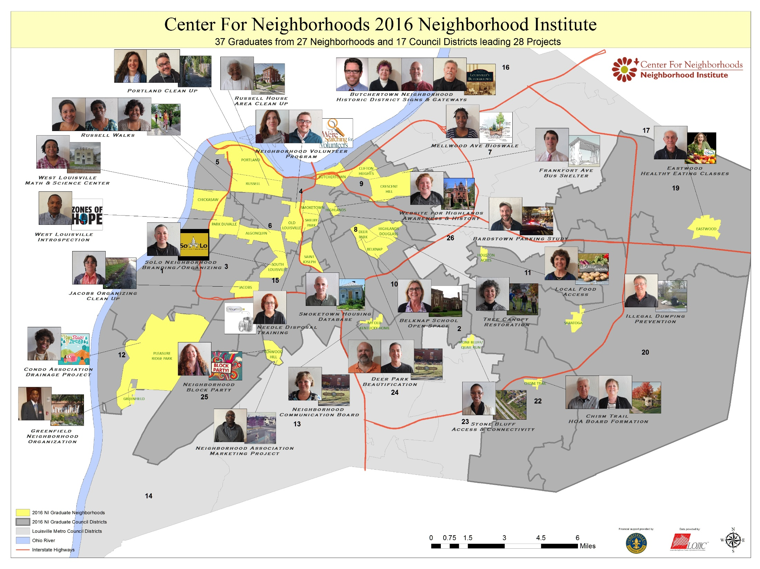
Insert NI Map

Slide 12
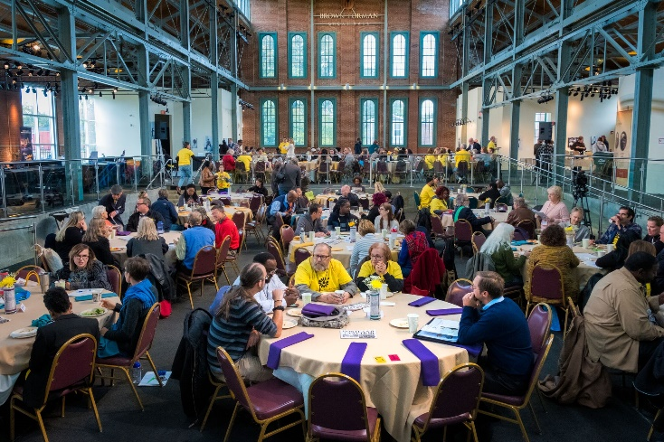
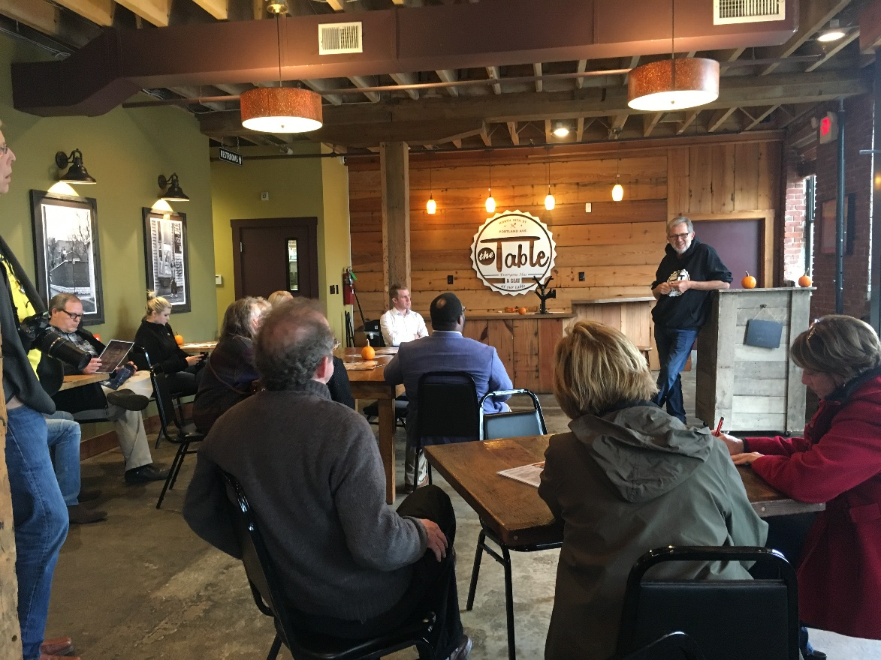
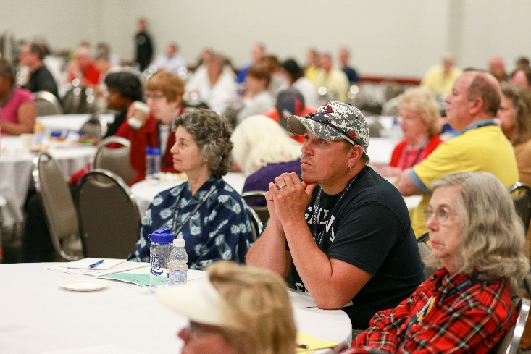
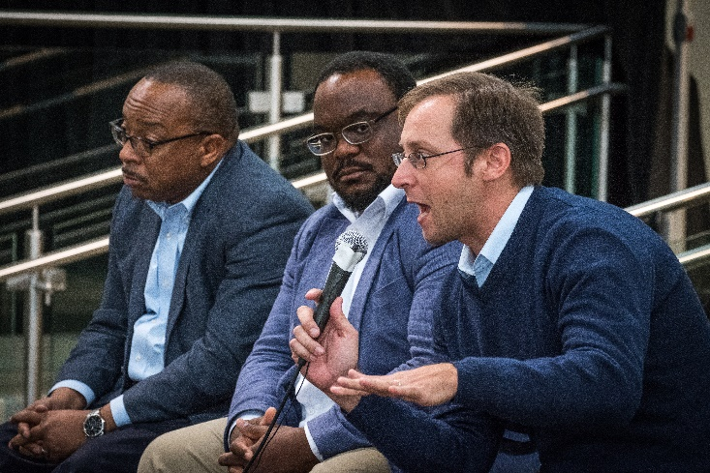
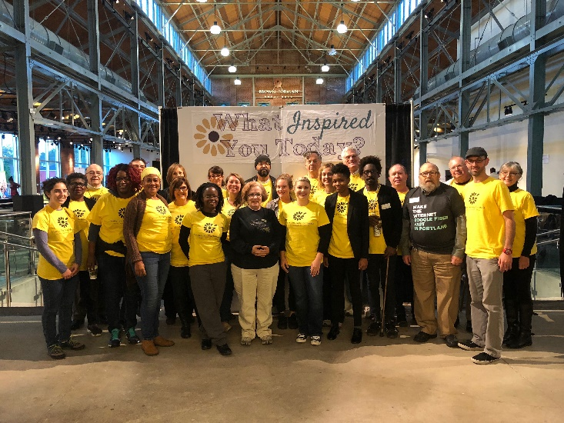
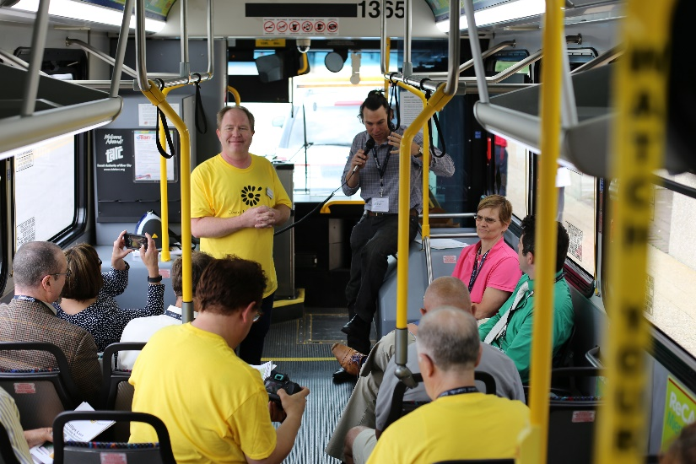
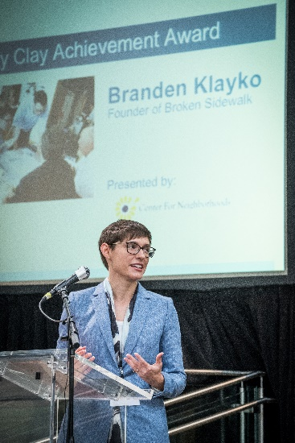
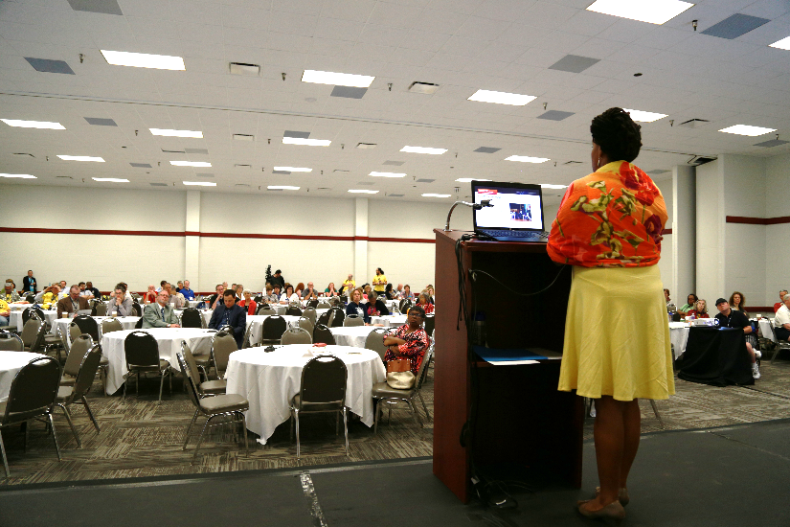
Neighborhood Summit

Slide 13
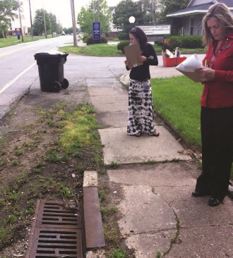
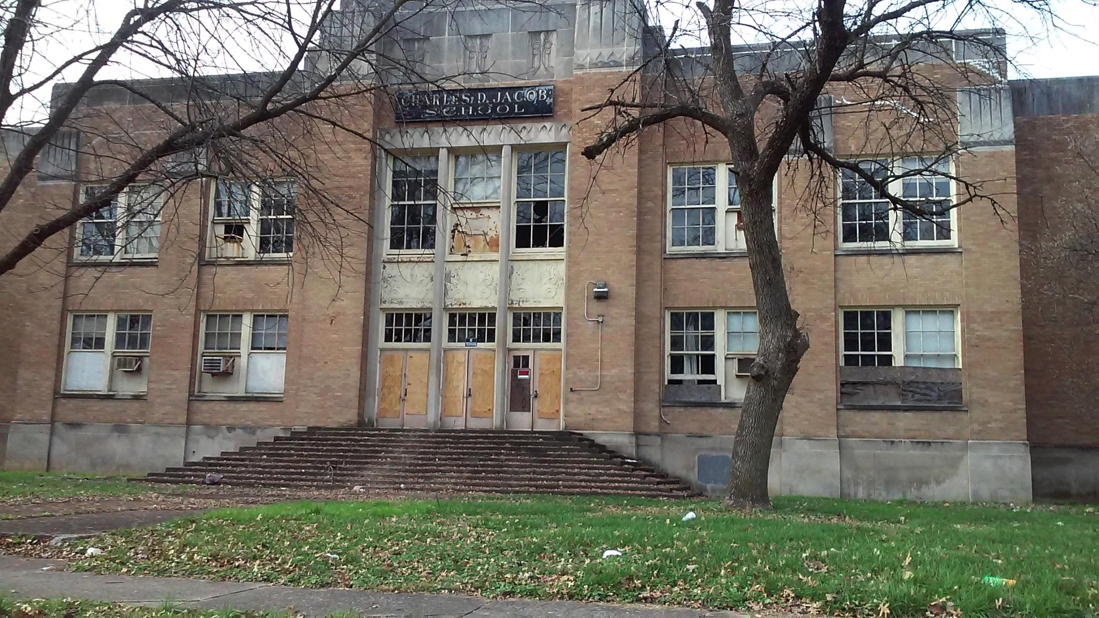
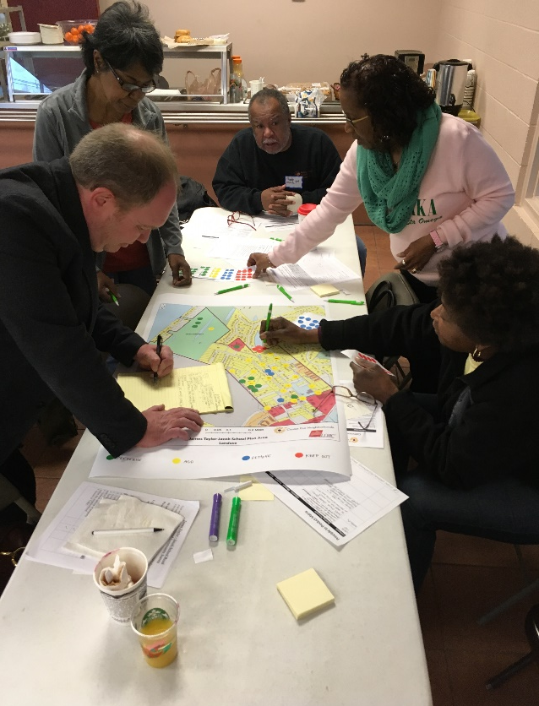
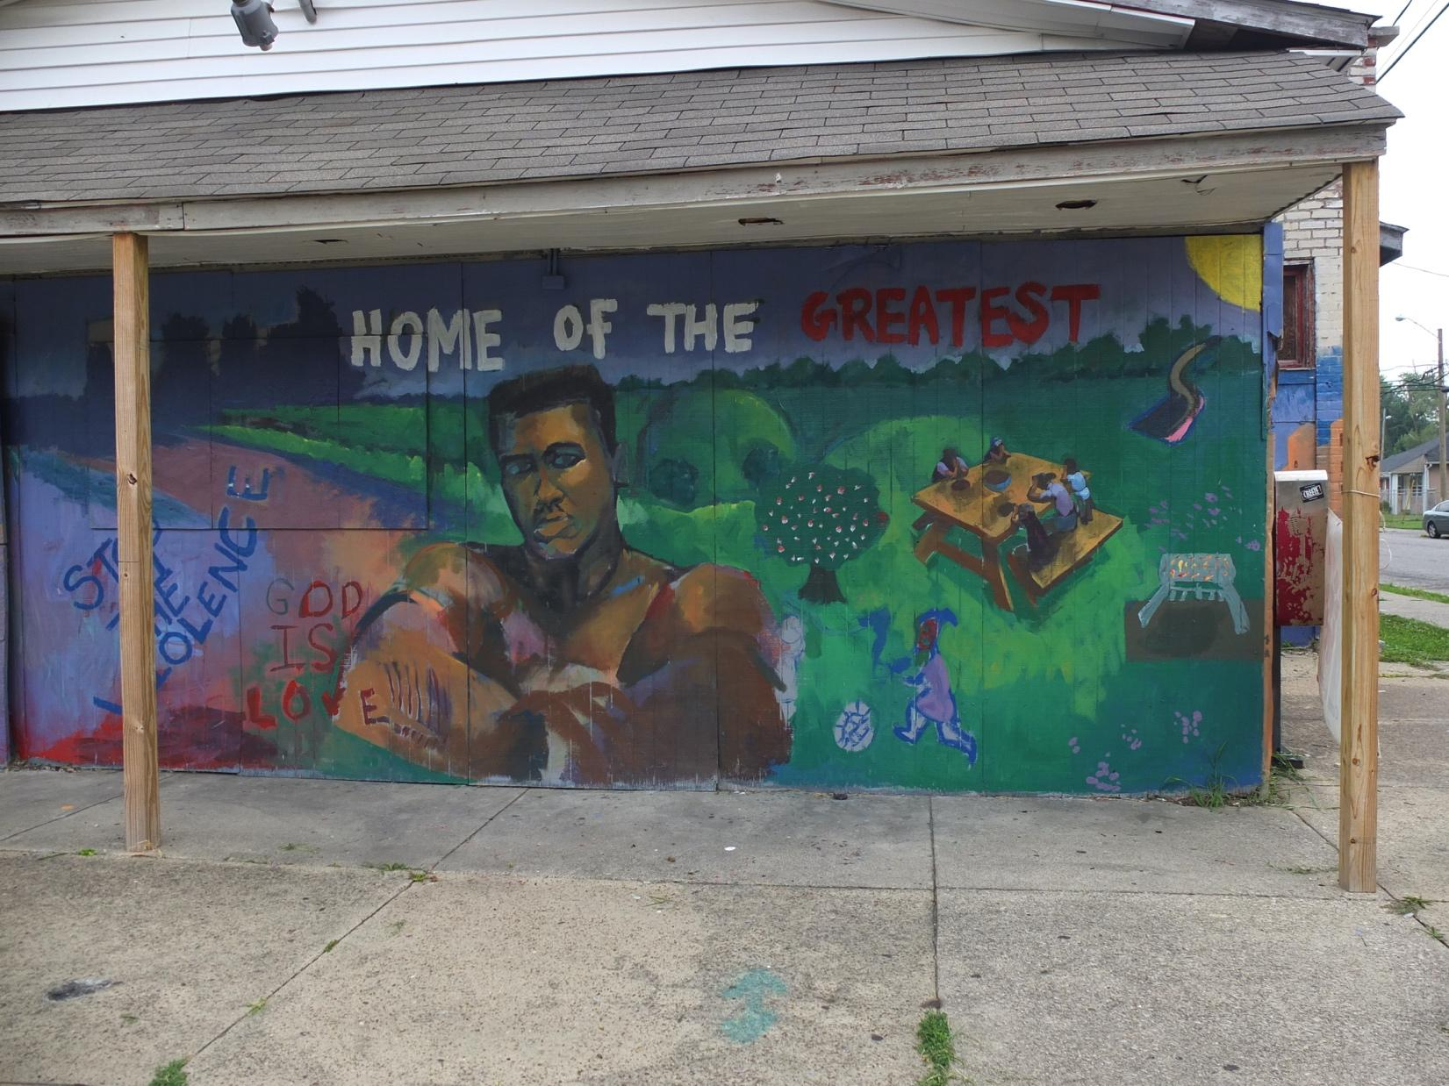
Planning & Design Assistance

Slide 14
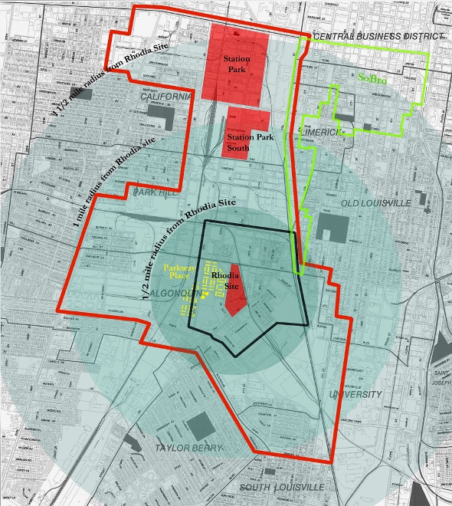
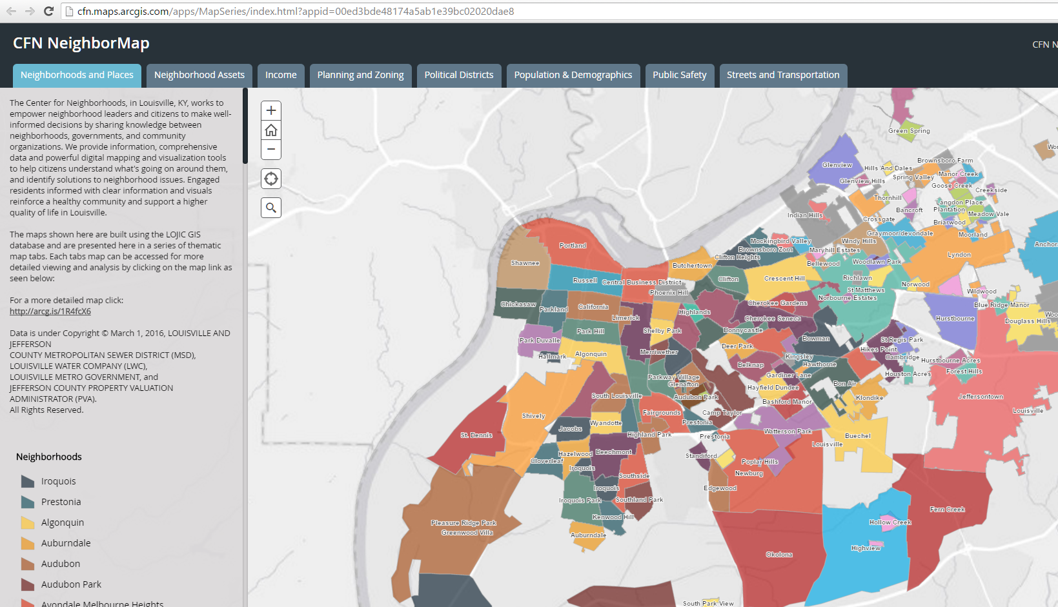
Data & Mapping

Slide 15
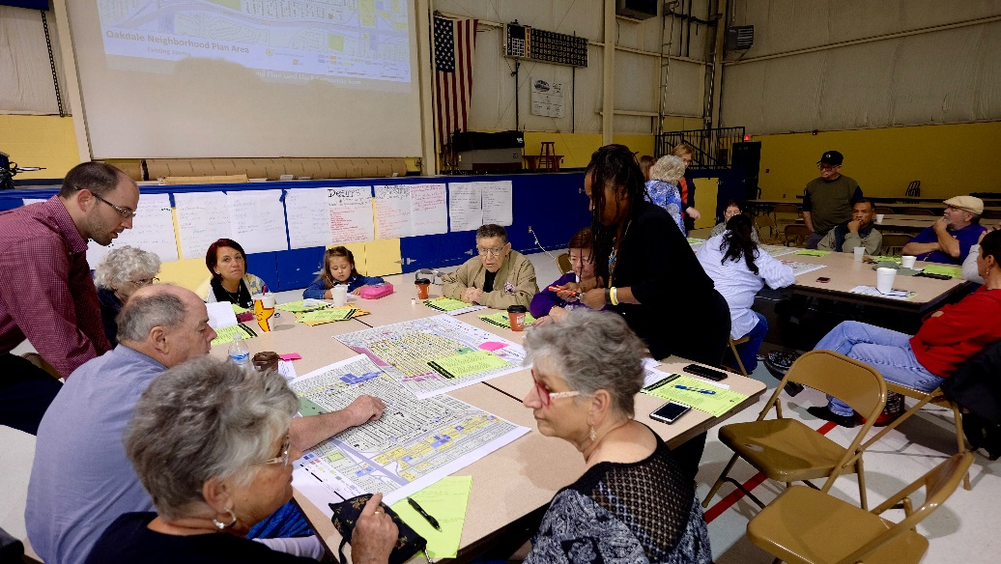
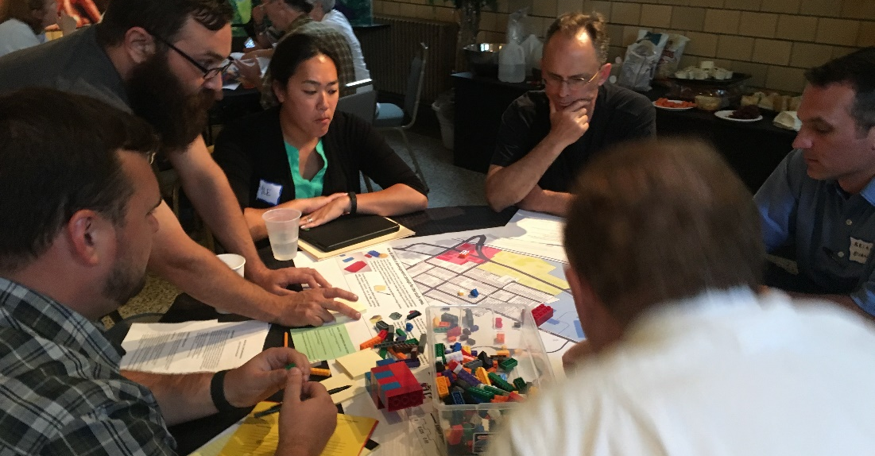
Neighborhood Planning & Assessment
Neighborhood Planning:
Irish Hill-Lexington Road Corridor
Neighborhood Planning:
Oakdale

Slide 16
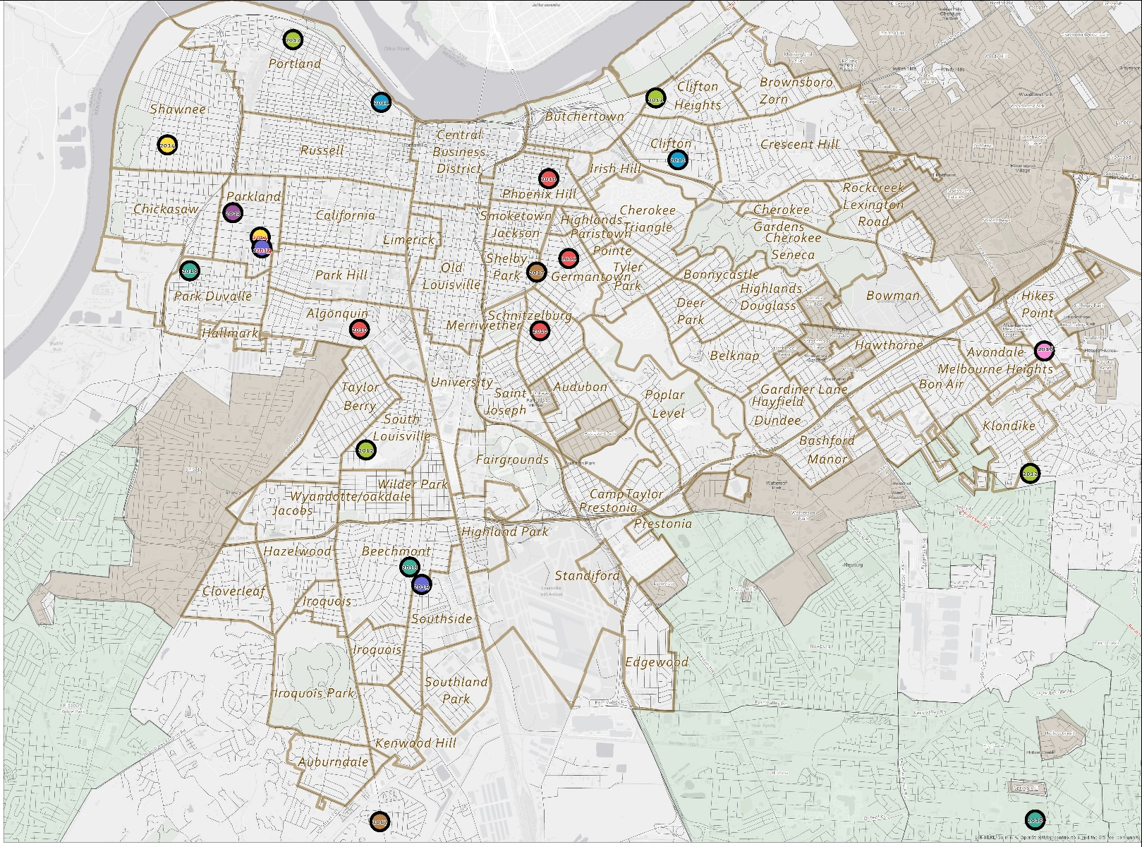
P.A.I.N.T.

Slide 17
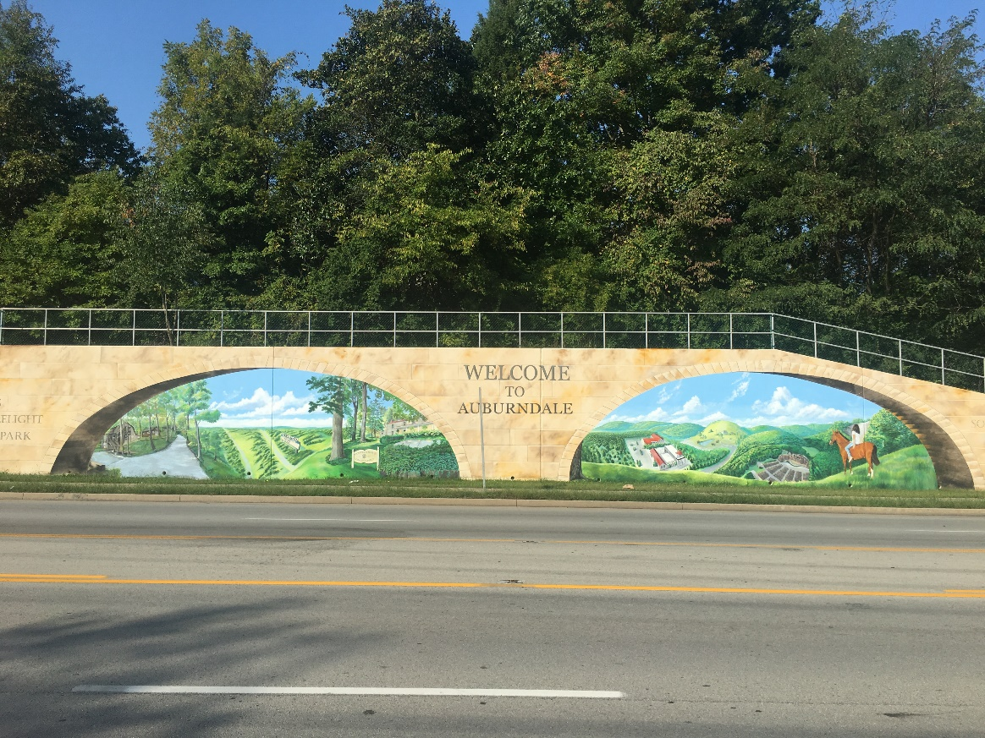
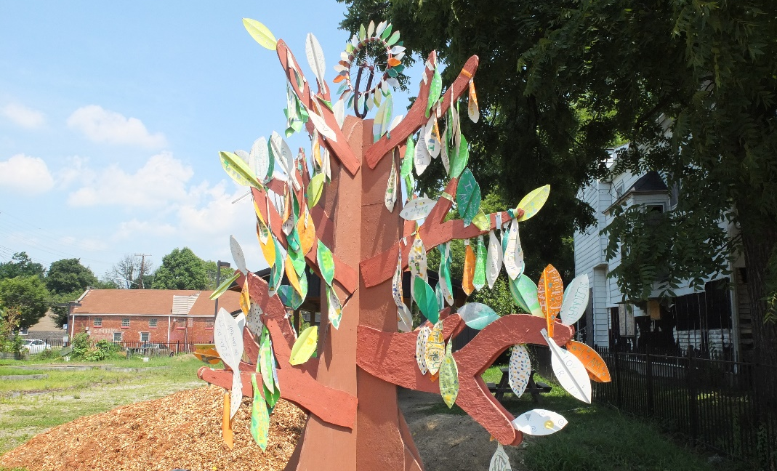
P.A.I.N.T.
Producing Art In Neighborhoods Together
New Cut Road mural
Producing Art In Neighborhoods Together
Parkland Dream Tree

Slide 18
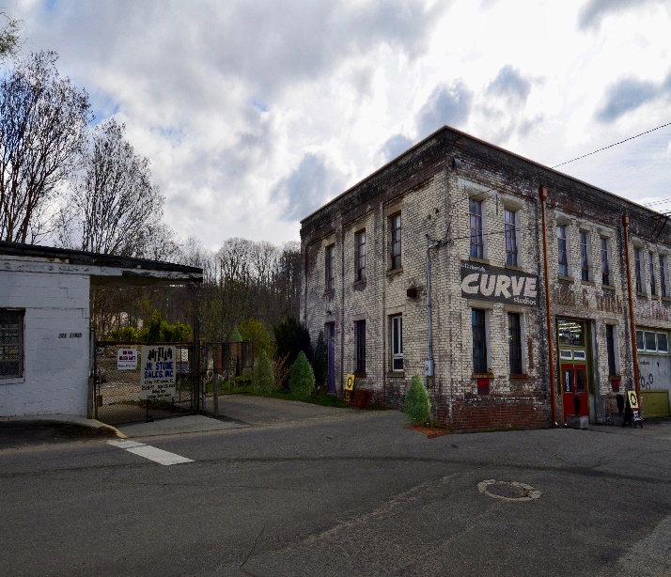
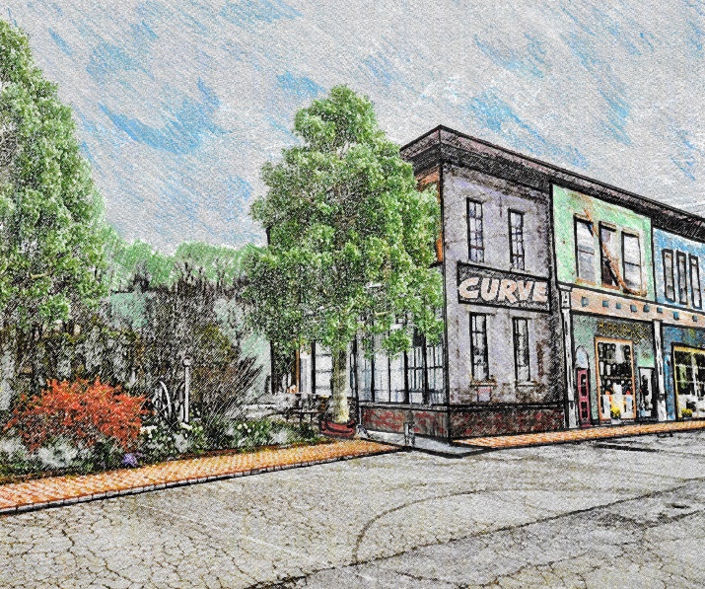
Design Assistance

Slide 19
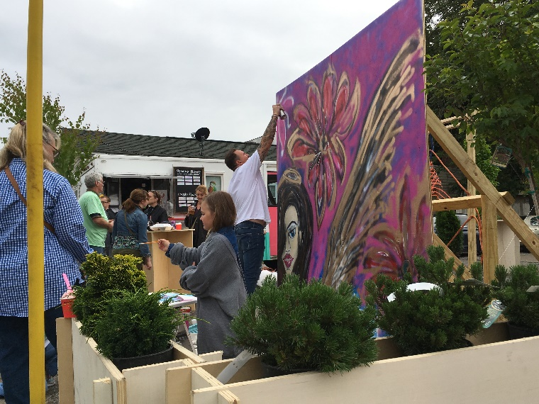
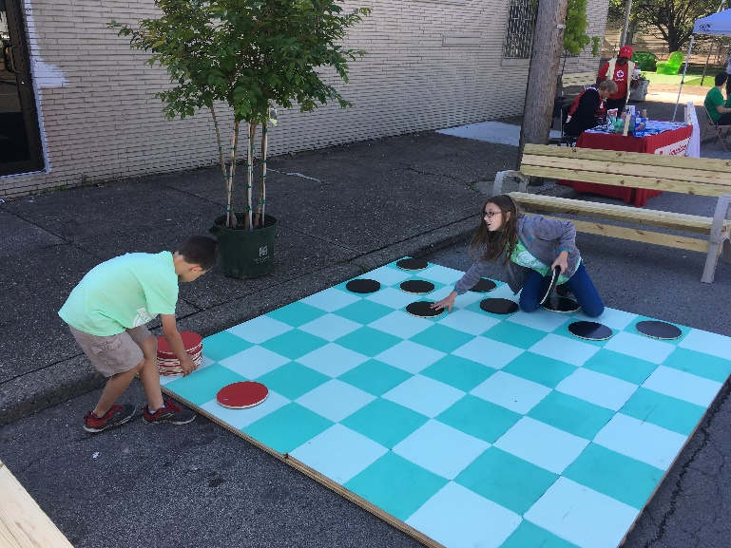
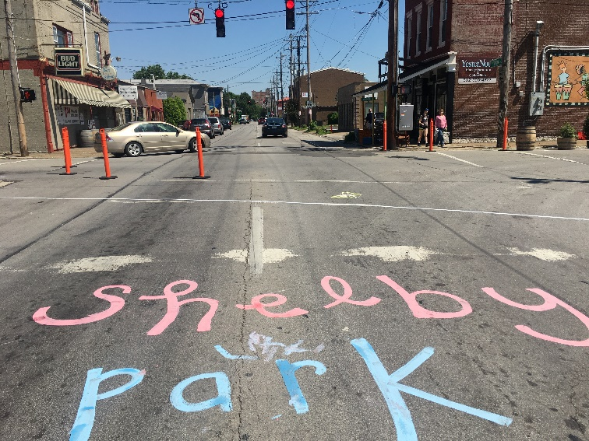
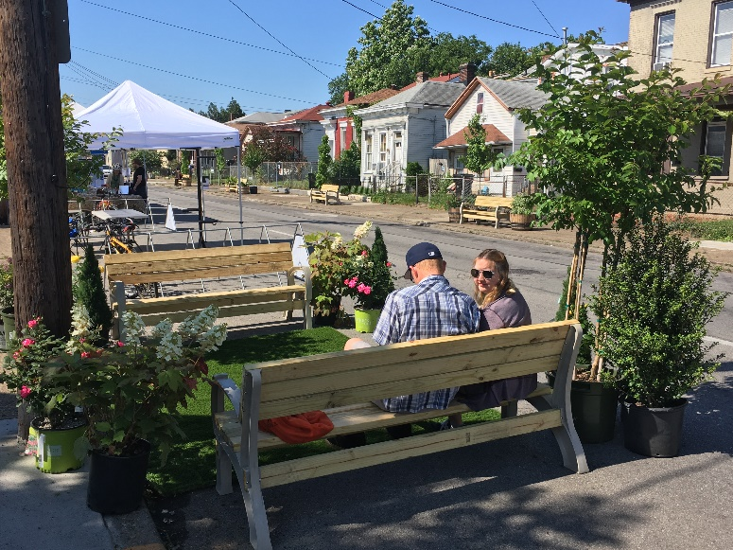
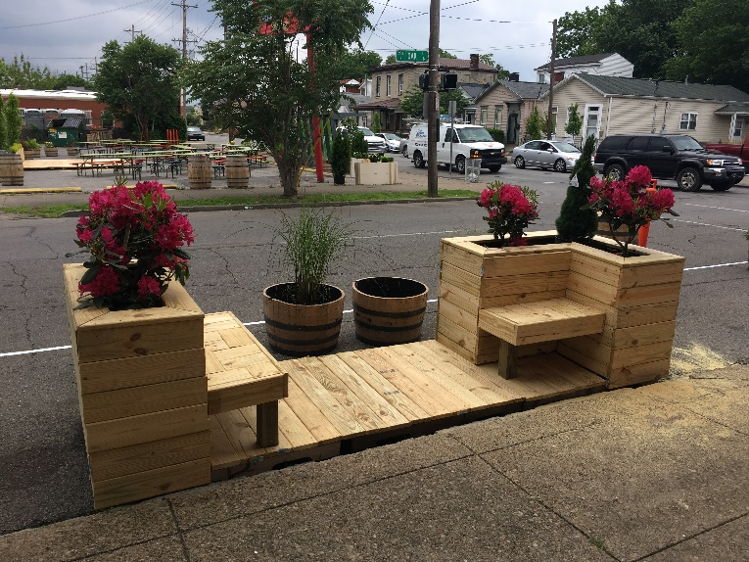
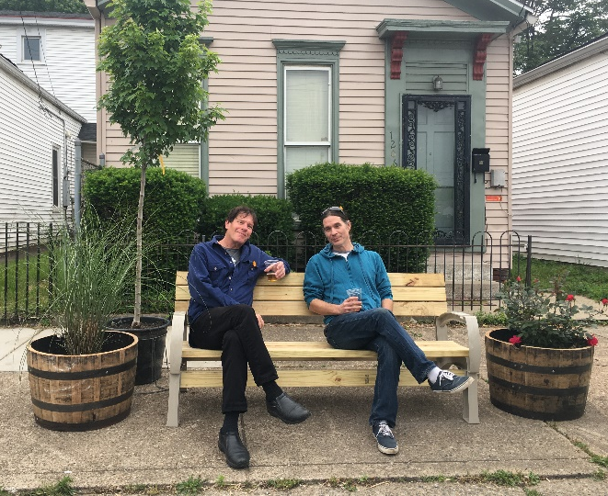
Better Block Louisville
Better Block

Slide 20
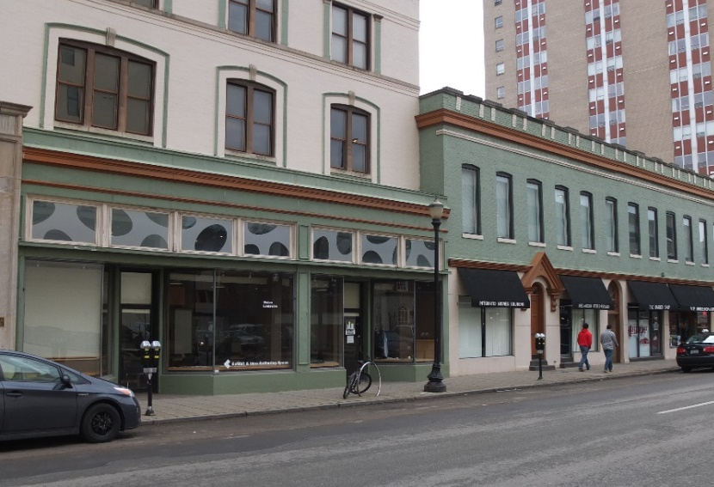
Contact us
1126 Berry Blvd
Phone: 502.589.0343
www.centerforneighborhoods.org
centerforneighborhoods
centerforneighborhoods
Ctr4Nhoods
#louisvilleneighbors

Slide 21
Break

Slide 22
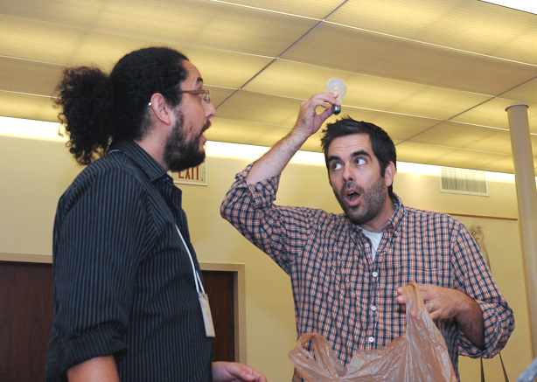
Report Back: What do you want to learn? Who are you?
Tell us:
Name
Neighborhood
What you want to learn?
One thing you are passionate about in your neighborhood

Slide 23
Exercise: What do you want to learn?
… About how to be a good local citizen?
… About other parts of the city?
… About a specific Metro department??
… About bringing people in your
Neighborhood closer together?

Slide 24
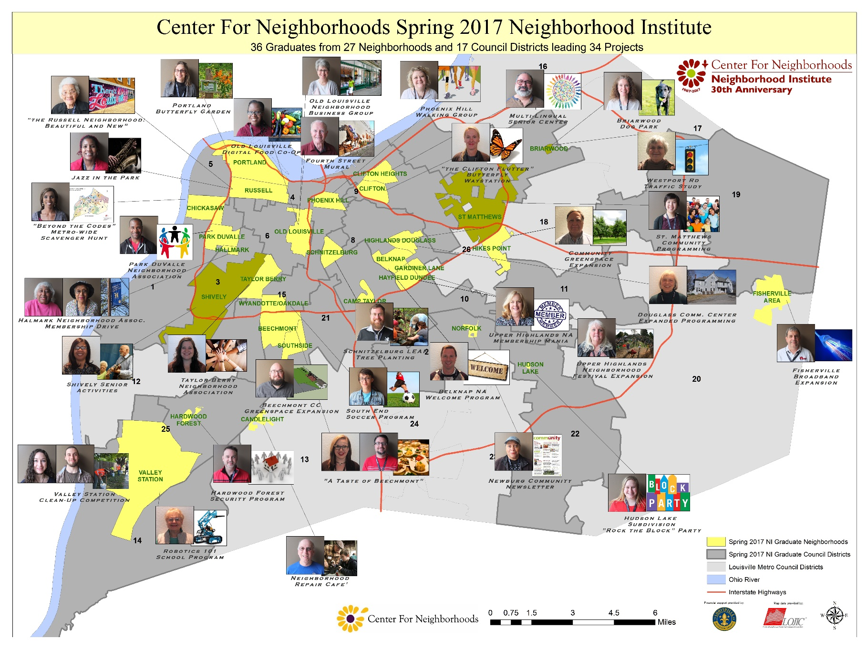
Institute Project Introduction

Slide 25
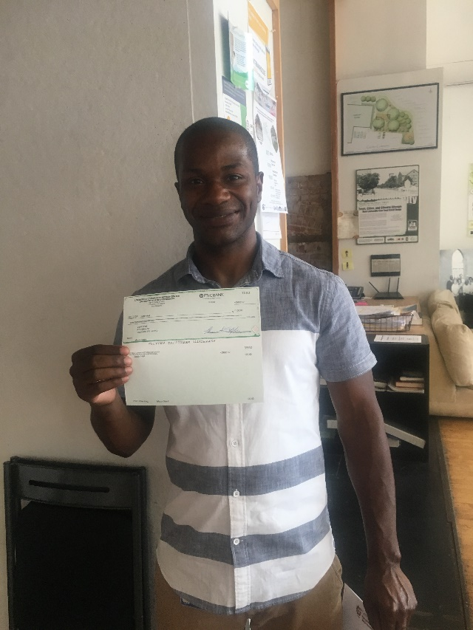
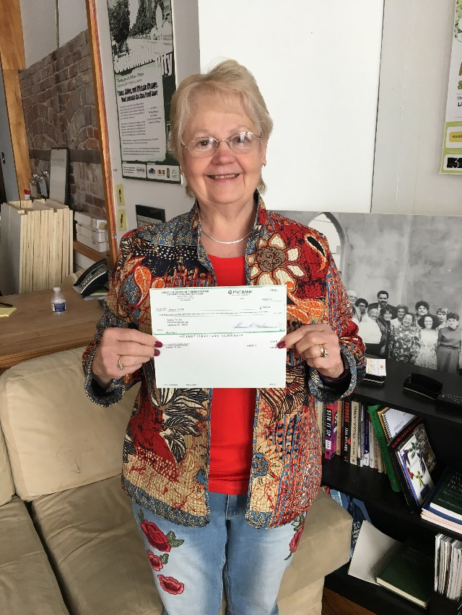
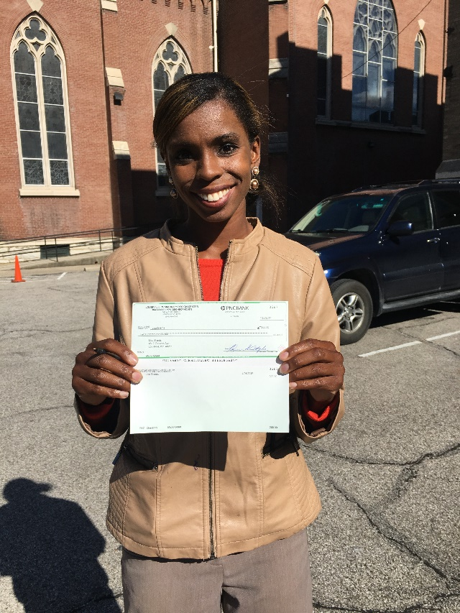
Micro Grant Program

Slide 26
Homework: Three Weekly Challenges
Look up your home address on LOJIC (http://apps.lojic.org/lojiconline)
Share something from “Did You Know…” with a neighbor
Ask neighbors, neighborhood association members or HOA members for project ideas

