Slide 1
Week 4
Neighborhood Institute Spring 2022

Slide 2
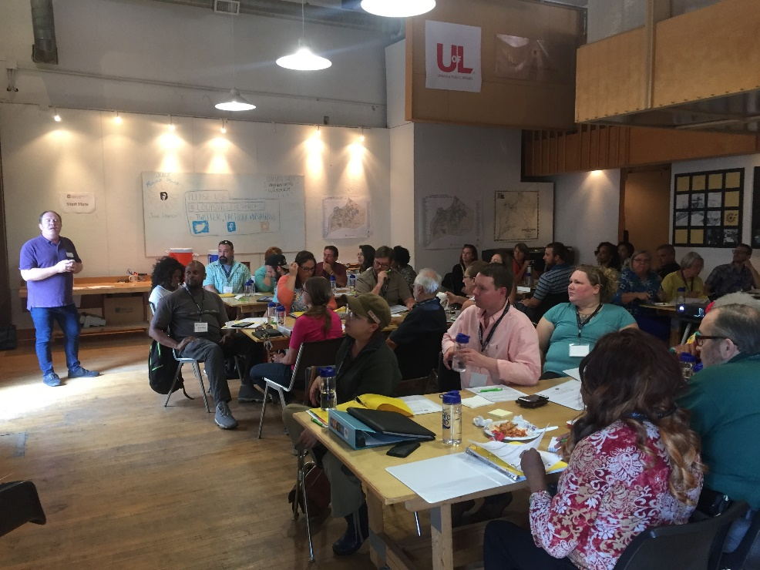
Welcome to Week 4
Housekeeping
Homework
Understanding Your City
Ideal Neighborhood Exercise
Project Introduction
Wrap-Up

Slide 3
Review: Asset Based Community Development (ABCD)

Slide 4
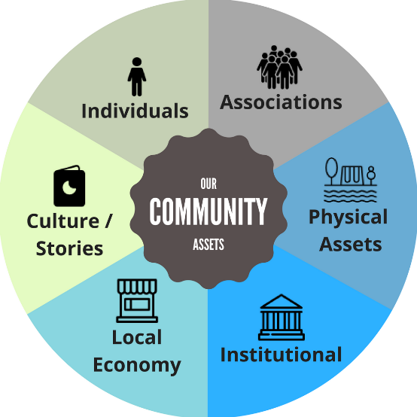
Six Asset Areas

Slide 5
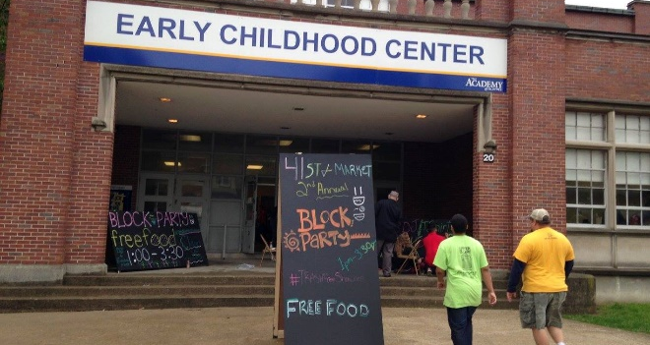
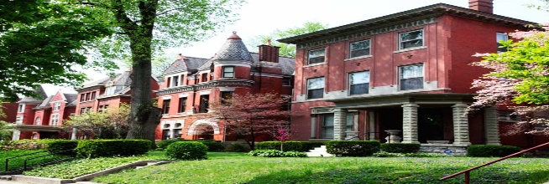
Review: Three Challenges
Interview a neighbor?
Community Toolbox?
What LMPD Division do you live in?

Slide 6
Neighborhood Assessment
Notes:
Question: What is “assessment”? What is it and what is it’s purpose?
Assessments help us to understand something. It’s a process of data collection. At a minimum its point is to help us understand something, to understand a condition or how something is changing. Ideally, assessment is about understanding change, not just to be prepared for that change or condition, but to plan for how we want to lead change to create the condition we want.
This presentation is designed to give you some reference points on how to think about your neighborhood, your city, and a framework for how to assess your community so you can plan to create change.

Slide 7
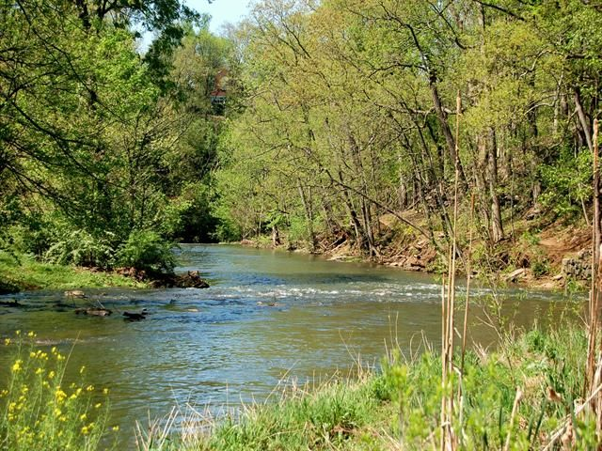
Natural Environment
WFPL

Slide 8
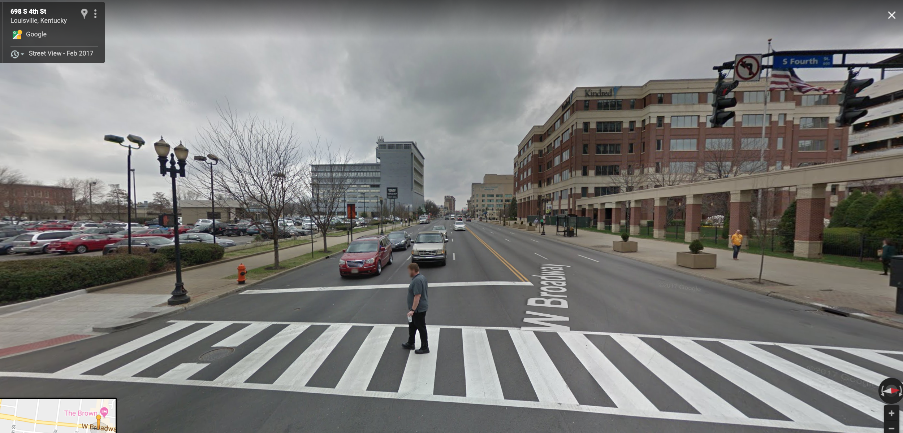
Built Environment
WFPL

Slide 9
Local Regulatory Framework
Comprehensive Plan
Neighborhood/Area Plans
Land Development Code
Development Proposals
Planning Commission
Board of Zoning Adjustment
https://louisvilleky.gov/government/advanced-planning-and-sustainability/completedadopted-neighborhood-plans-and-studies
Notes:
Question: Do any of these elements adequately represent images that stood out in the first location photos?

Slide 10
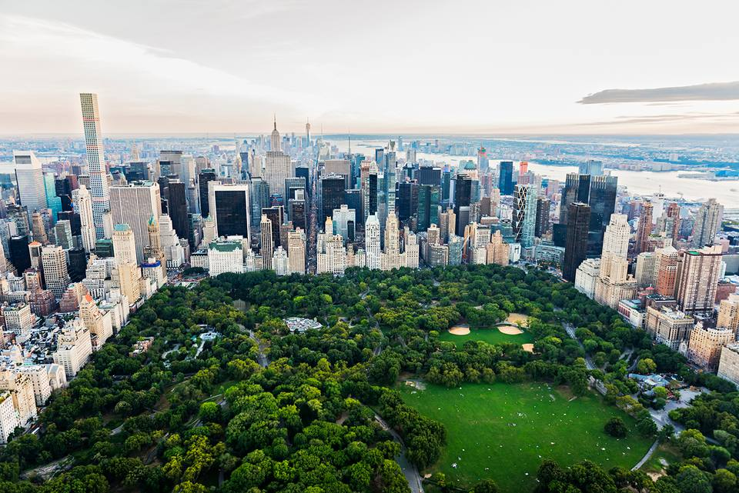
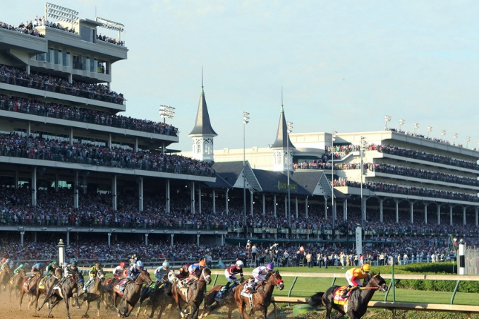
Built Environment Terminology
LANDMARK
EDGE
DISTRICT
NODE
Notes:
Question: Do any of these elements adequately represent images that stood out in the first location photos?

Slide 11
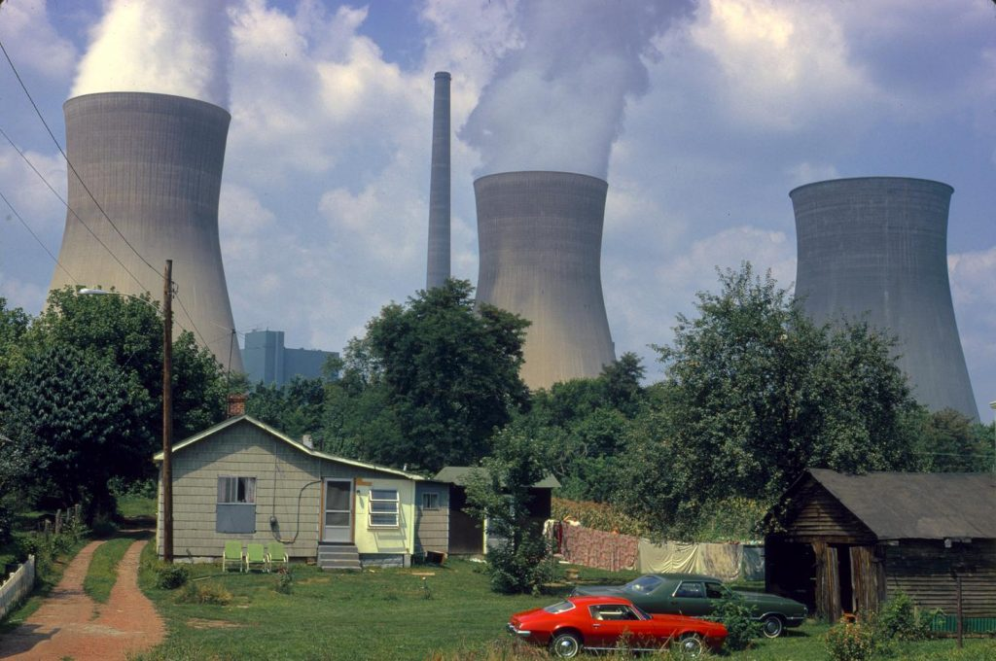
Built Environment Terminology
ZONING
USE
DENSITY
Regulation
What
How much
Notes:
Question: Do any of these elements adequately represent images that stood out in the first location photos?

Slide 12
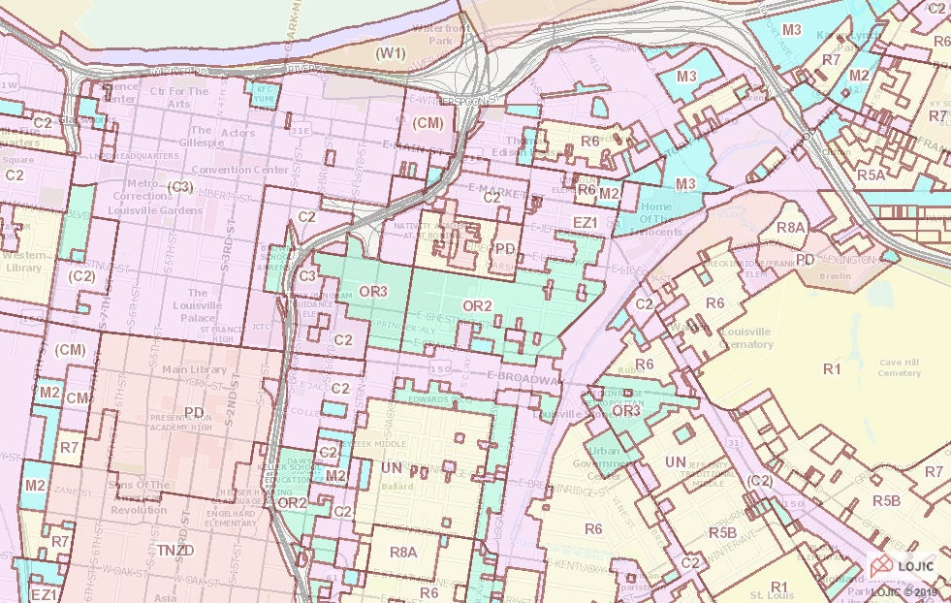
Notes:
Question: Do any of these elements adequately represent images that stood out in the first location photos?

Slide 13
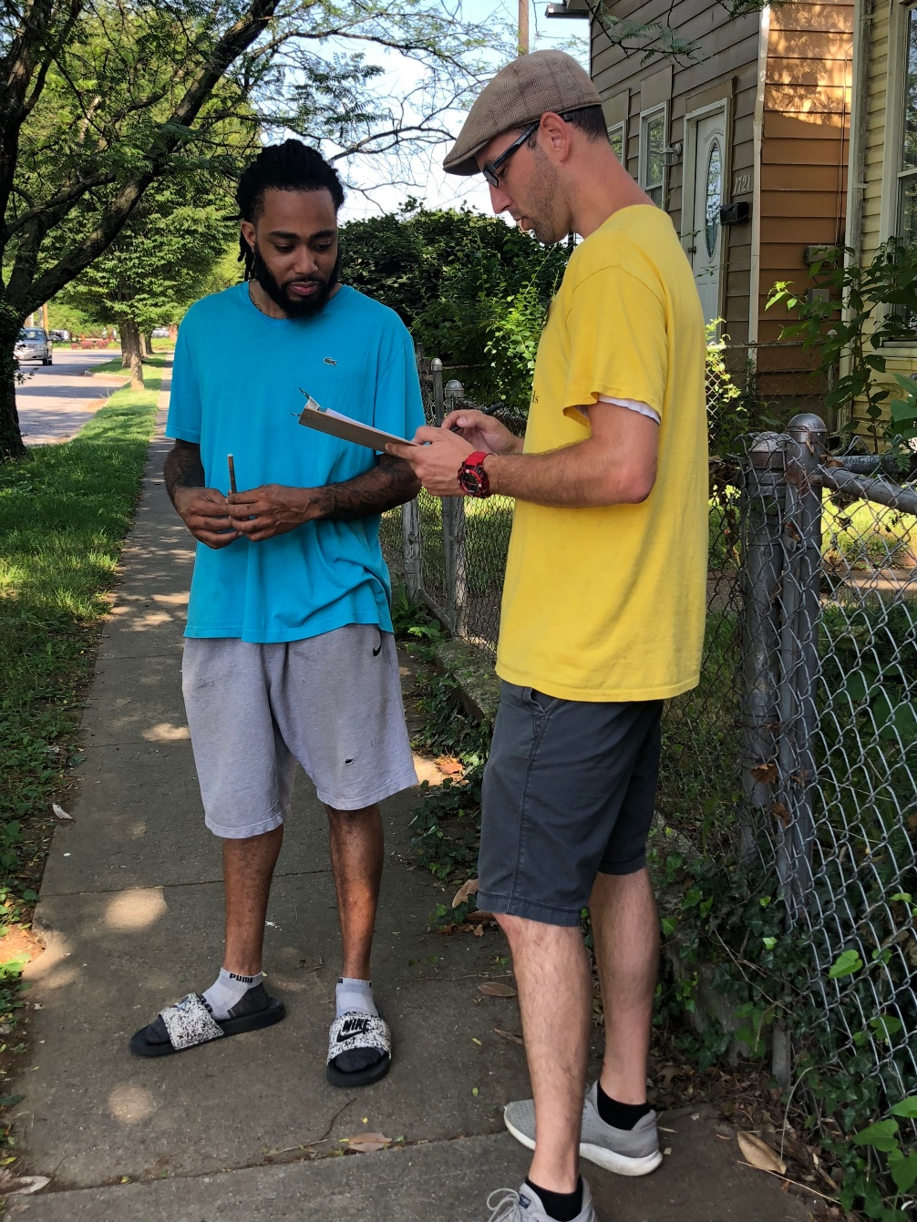
Why Assess
Your Neighborhood?
Understanding Existing Conditions
Engagement Opportunity
Address Concerns
Basis for a plan of action
WFPL

Slide 14
Five Physical Features
Homes & Gardens
Streets
Neighborhood Niches
Institutions
Public Space

Slide 15
Five Organizing Themes
Location
Scale
Mix
Time
Movement

Slide 16
Quality of Life

Slide 17
Study
Observe
Ask
Histories
Walk & Sit
Residents
Maps
Photo/Draw
Visitors
Images
Measure
Business
Data
Visit
Institutions

Slide 18
How do you read the street?

Slide 19
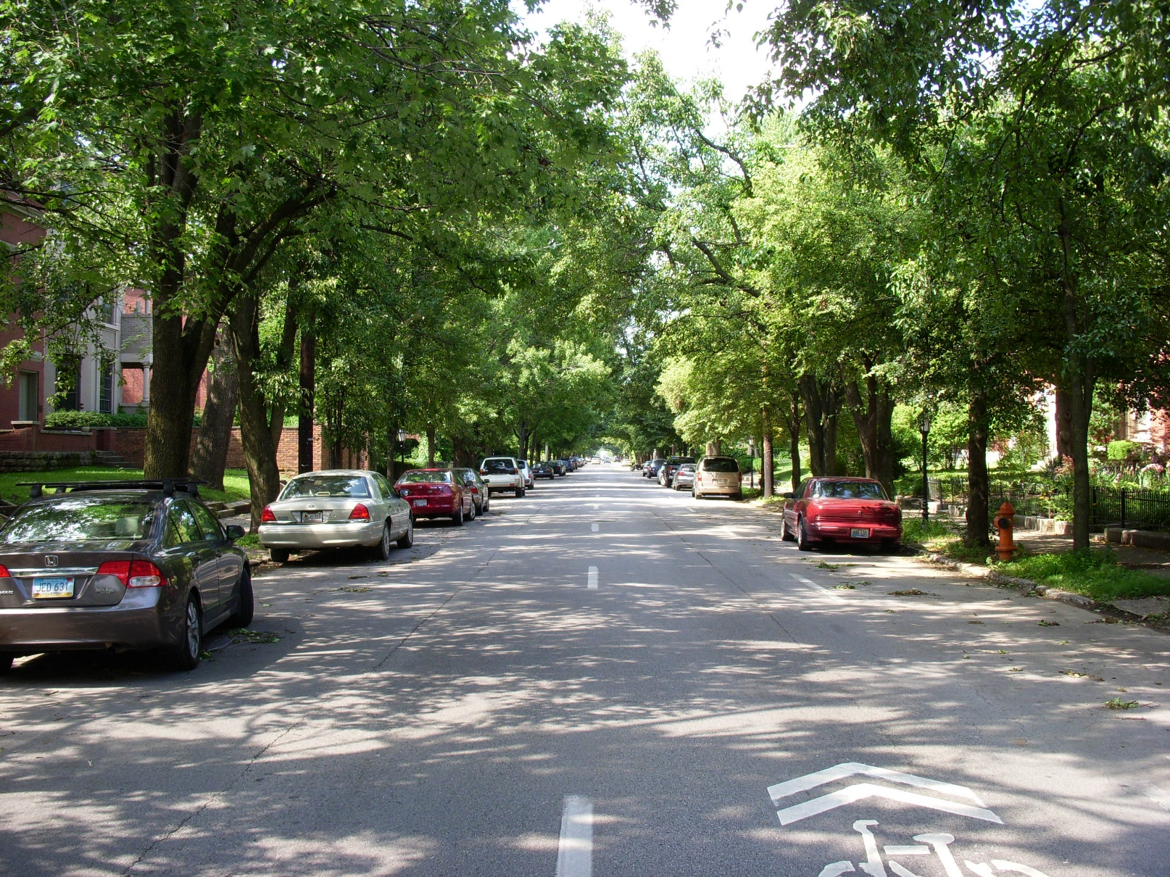
How does perspective change your assessment?
WFPL

Slide 20
Which one is the greater landmark?

Slide 21
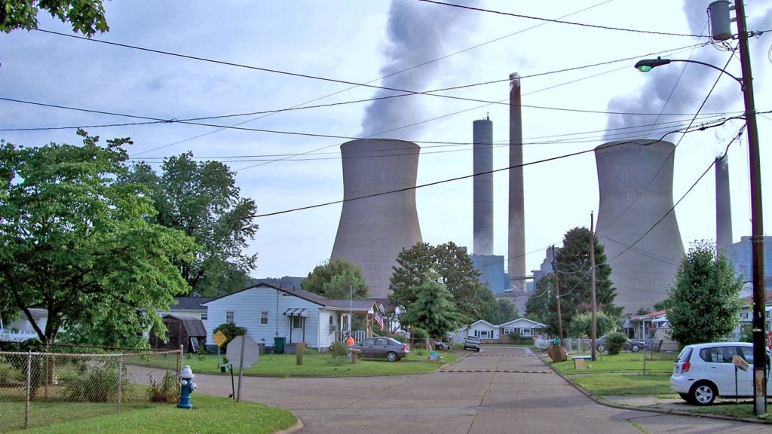
What are the uses? Where’s the edge?
Urban Composition

Slide 22
Where’s the path?
WFPL

Slide 23
Where’s the path?

Slide 24
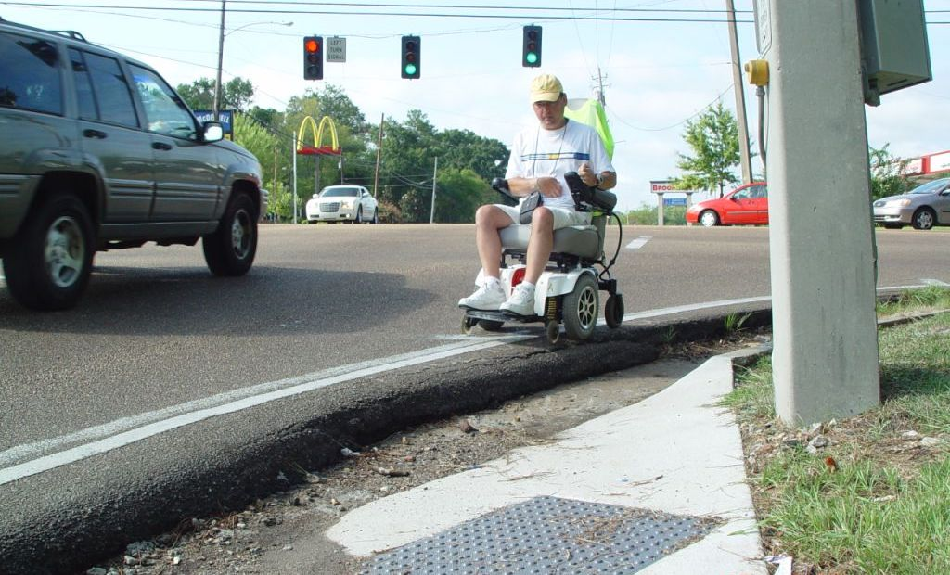
Dangerous by Design
WFPL

Slide 25
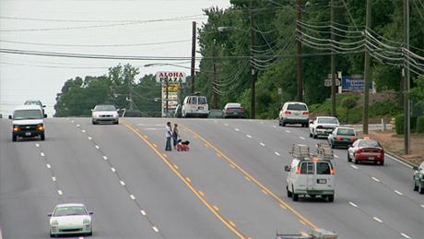
Dangerous by Design
WFPL

Slide 26
How do you use this for understanding your community?
Urban Composition

Slide 27
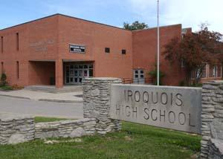
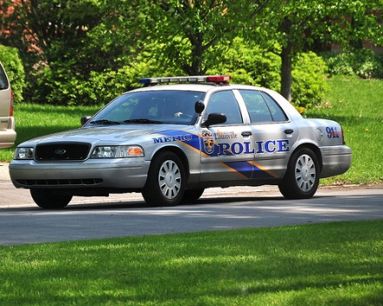
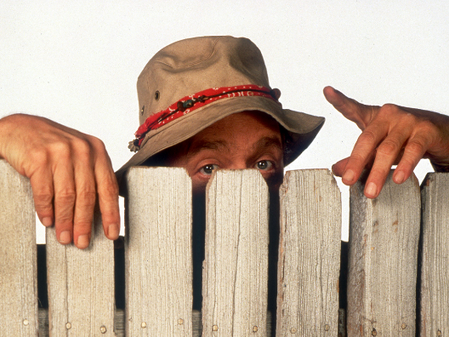
Tools & Tips : ASK & LISTEN
Public School Teachers
Conversations, Surveys
Civic, Faith and Business Leaders
One on Ones, Community Tours
Police Ride Along
Division Resource Officers
Residents . . . your neighbors!
Conversations, Surveys

Slide 28
Tools & Tips: STUDY
Demographic Analysis
US Census, American Community Survey
https://factfinder.census.gov/faces/nav/jsf/pages/index.xhtml
Neighborhood Histories
Encyclopedia of Louisville, UofL Archives, Filson
https://library.louisville.edu/archives/home
Case Studies-Best Practices
American Planning Association – Great Places Designation
https://planning.org/greatplaces/
More coming in Week 4!
LOJIC, PVA, Secretary of State, Open Street Maps and more….

Slide 29
Existing Louisville Reports
Health Equity Report
Center For Health Equity at Louisville Metro Public Health and Wellness
https://louisvilleky.gov/government/center-health-equity/health-equity-report
State of Housing Report
Metropolitan Housing Coalition
http://www.metropolitanhousing.org/resources/mhc-reports/
Neighborhood Profiles
Metro United Way / Kentucky State Data Center
http://ksdc.louisville.edu/research/sponsored_projects/louisville-neighborhood-profiles/

Slide 30
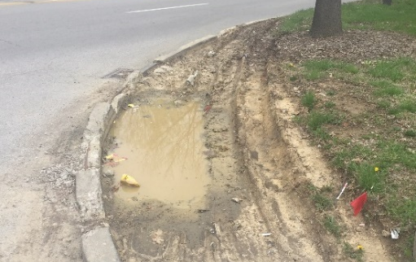
Tools & Tips: OBSERVE
Go on a walk! (Photo Safari)
Walk, snap, gather & report
https://motheringmatters.ch/craft-neighborhood-map/
Windshield/Walking Survey
http://ctb.ku.edu/en/table-of-contents Chapter 3
Walking Audit
http://www.pedbikeinfo.org/planning/tools_audits.cfm
Asset Mapping
Talk to us!
Quality of Life Assessment Tools
Food, Services, Parks, Traffic, etc.

Slide 31
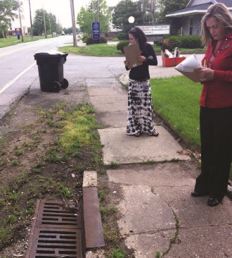
Neighborhood Assessments
https://www.centerforneighborhoods.org/neighborhood-assessments
Walkability Assessments
https://docs.wixstatic.com/ugd/c8c661_4b93d668bd0b47dda85135bf0d79733e.pdf

Slide 32
Additional reading for nerds
The Image of the City - Kevin Lynch
How to Read the American City - Grady Clay
The Death & Life of Great American Cities - Jane Jacobs
Planning To Stay – William Morrish, Catherine Brown
Neighbors and Neighborhoods - Sidney Brower
Movie: “Citizen Jane: Battle for the City”

Slide 33
Break

Slide 34
Ideal Neighborhoods Exercise
Purpose
Timeframe
Group
Report out

Slide 35
Ideal Neighborhoods Exercise
• Give it a Name!
• Public Space
• Public Services
• Infrastructure
• Housing
• Transportation
• Amenities
• Recreation
• Aging and Younger Population

Slide 36
Considering End Goals
What do you want to see/hear/feel at the end?
What are you hoping to achieve?

Slide 37
Examples:

Slide 38
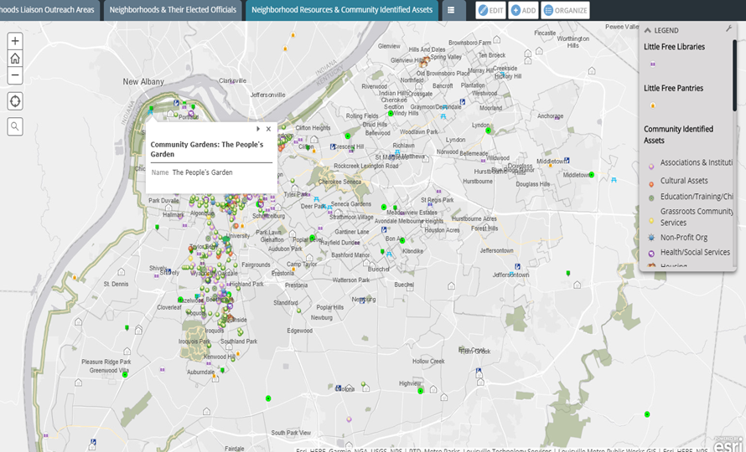
Utilizing Center for Neighborhoods NeighborMap Tools for Neighborhood Assessment
https://www.centerforneighborhoods.org/resources, NeighborMap, Asset Mapper

Slide 39
Next Week:
Community Organizing
Community Engagement
Effective Media & Communication

