Slide 1
Neighborhood Institute Spring 2022
Week 9

Slide 2
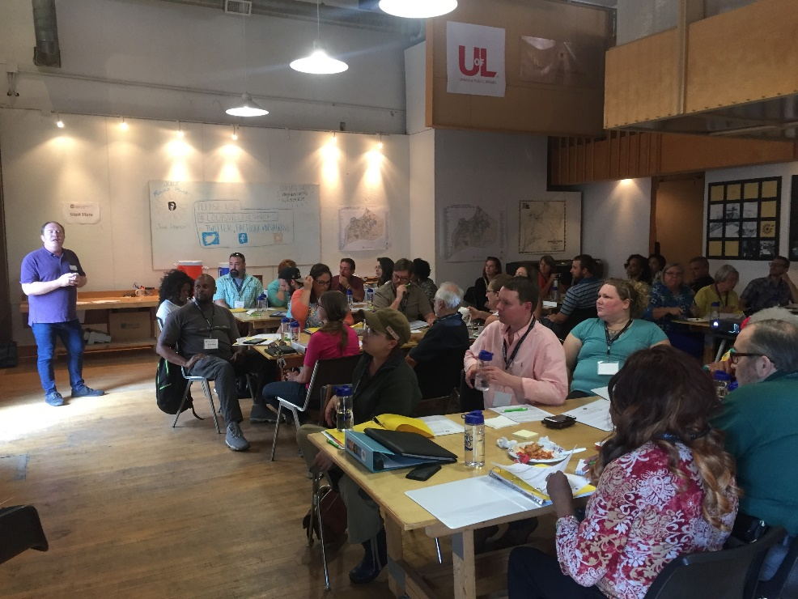
Welcome to Week 9
House Keeping
Project Proposal & Budget
Fundraising/NDF Grants
Fiscal Sponsorship
Project Practice Activity

Slide 3
Fundraising
Neighborhood Development Fund
Fiscal Sponsorship
Crowdfunding

Slide 4
Microgrant Program
Not Mandatory to Apply
Grant Period = 7 months
Final Report required

Slide 5
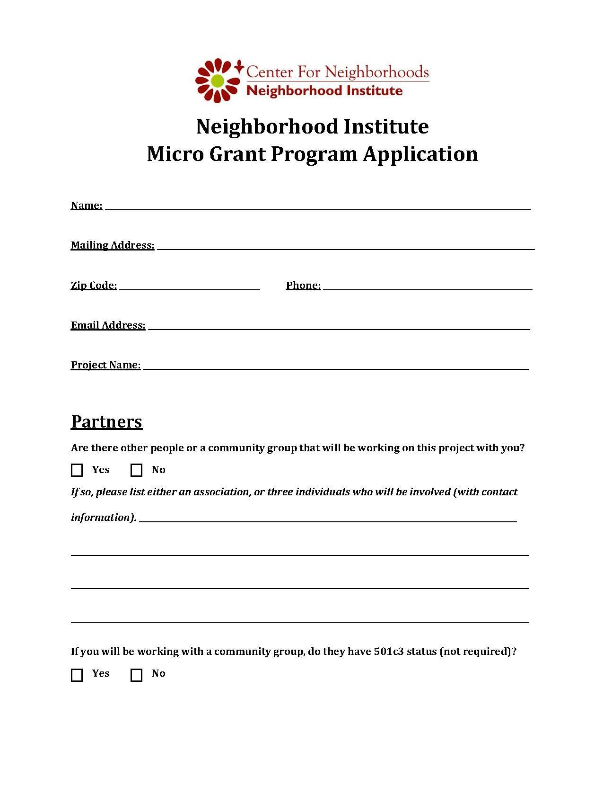
Microgrant Application

Slide 6
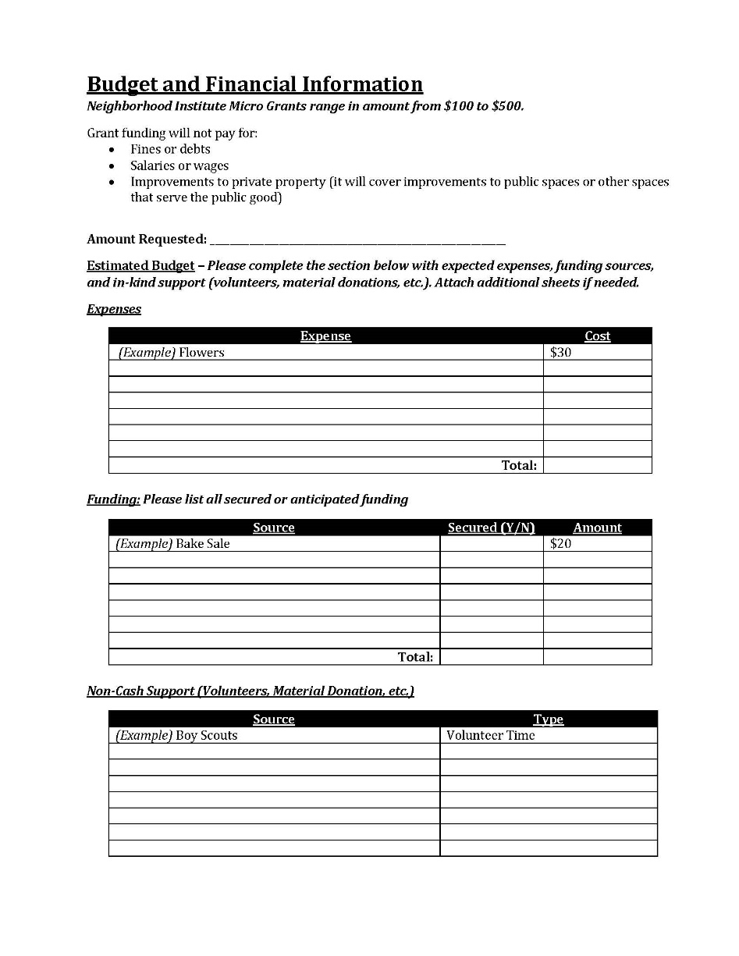
Microgrant Application

Slide 7
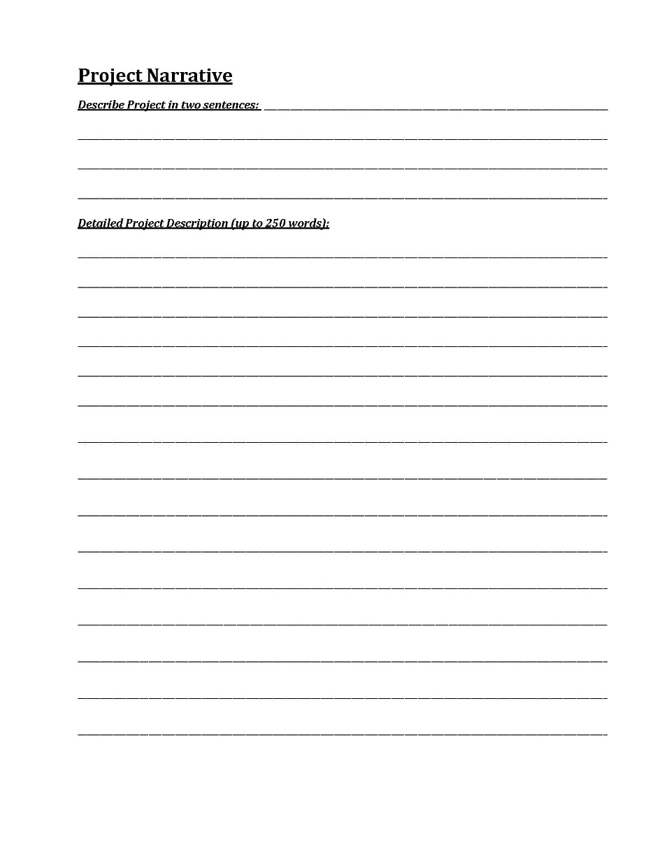
Microgrant Application

Slide 8
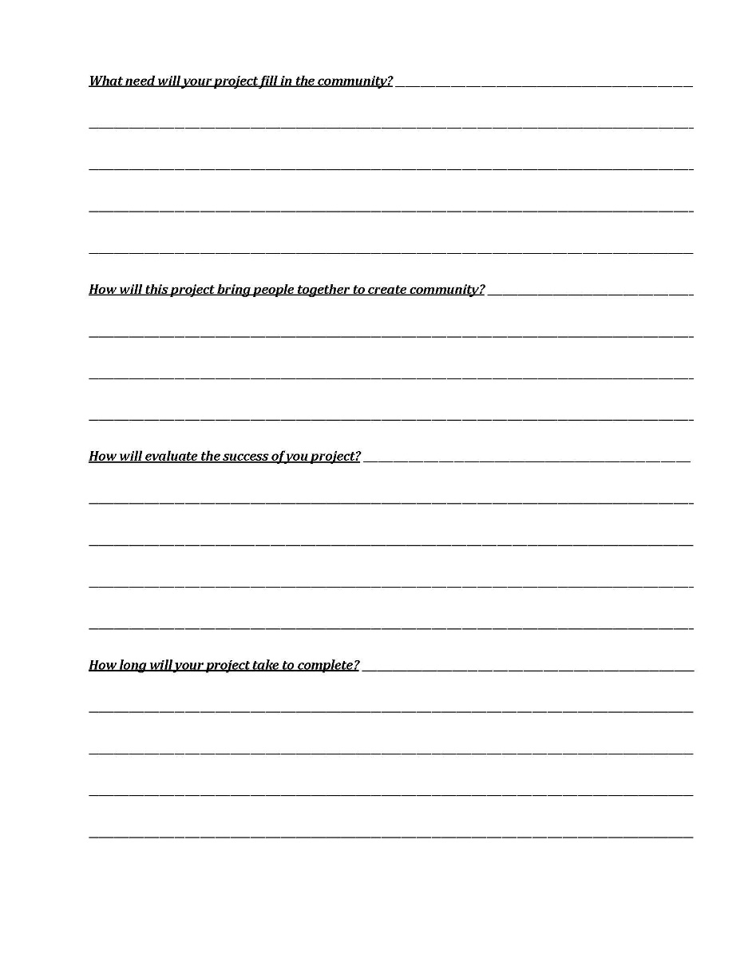
Microgrant Application

Slide 9
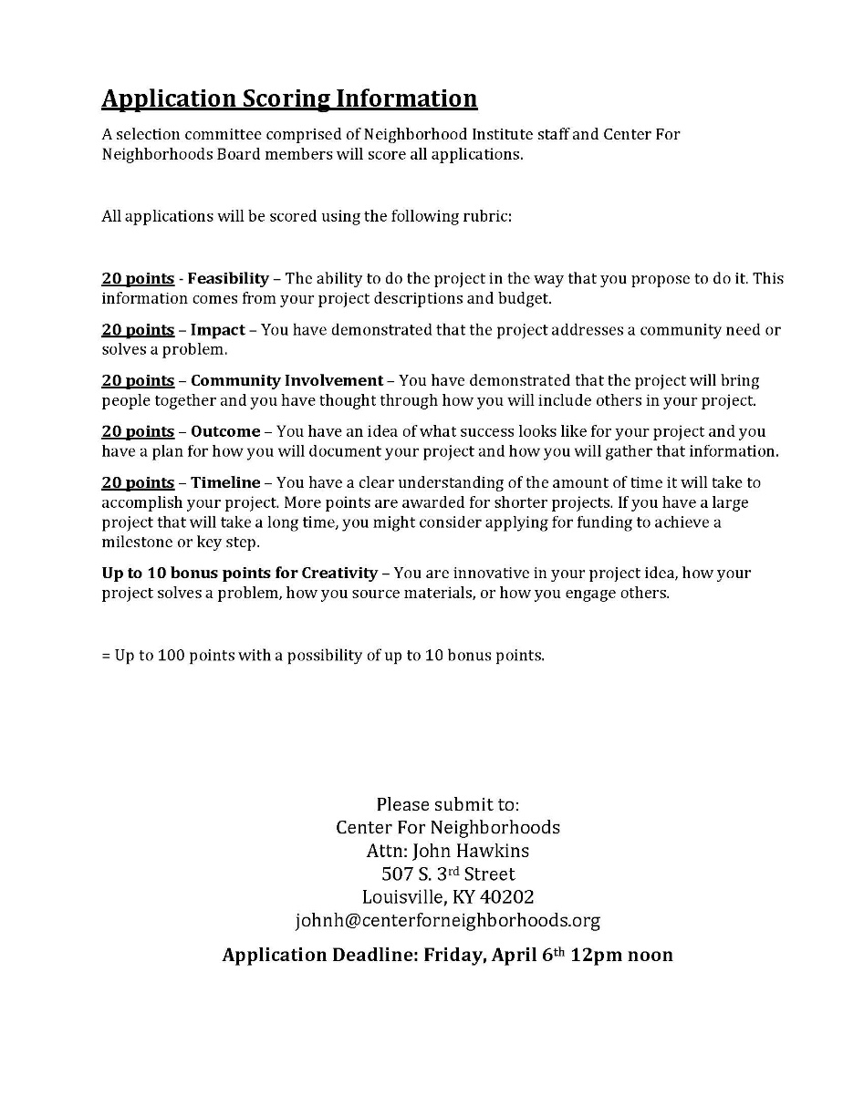
Microgrant Application

Slide 10
Neighborhood Development Fund Grants
All NDF applications require sponsorship from a council member. Speak with your council member / aide about your project before submitting an application.
Each council member is appropriated the same level of funding (reduced this fiscal year)
Project must be for a public purpose.
Grant must be to an non-profit organization, not an individual. Organization must be in good standing.
Unspent funds only carry over to next year if:
Council requests Office of Management and Budget
Approved in overall budget
Under/Over $5,000

Slide 11
Neighborhood Development Fund Grants

Slide 12
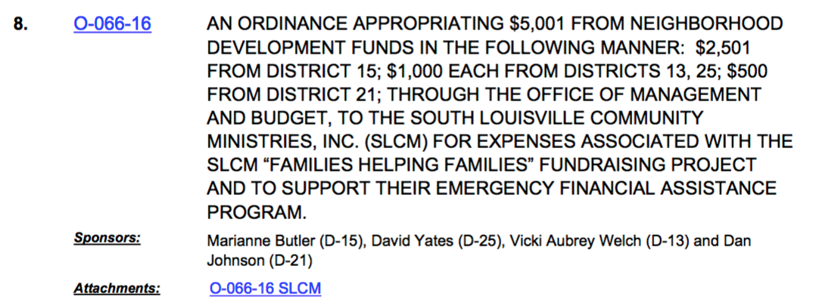
Neighborhood Development Fund Grants

Slide 13
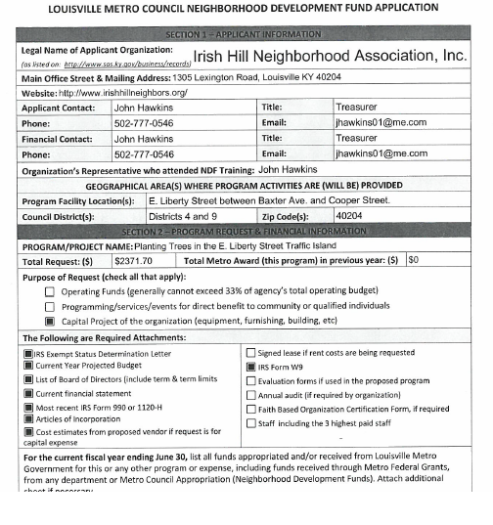
NDF Grant Application

Slide 14
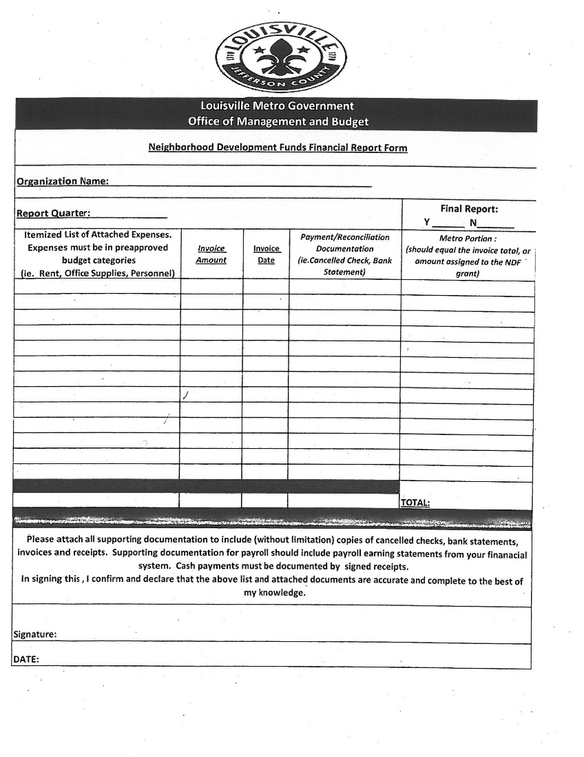
NDF Grant Report

Slide 15
Fiscal Sponsorship
What is fiscal sponsorship?
Fiscal sponsorship is a formal arrangement in which a 501(c)(3) public charity sponsors a project that may lack exempt status. This alternative to starting your own nonprofit allows you to seek grants and solicit tax-deductible donations under your sponsor's exempt status

Slide 16
Fiscal Sponsorship
How do I find a fiscal sponsor?
Look for nonprofits whose missions are similar to yours. You might start with your current affiliations. Make a list of the professional societies, educational associations and institutions, religious organizations, social and recreational clubs, and other groups with which you are already associated, including employers.

Slide 17
Crowdfunding
Some familiar platforms, some new….
Kickstarter
GoFundMe
IndieGoGo
IOBY (In Our Back Yard)
CrowdRise
Anyone know of other platforms/resources?

Slide 18
Office Hours
By appointment
Call or email to schedule

Slide 19
Break!

Slide 20
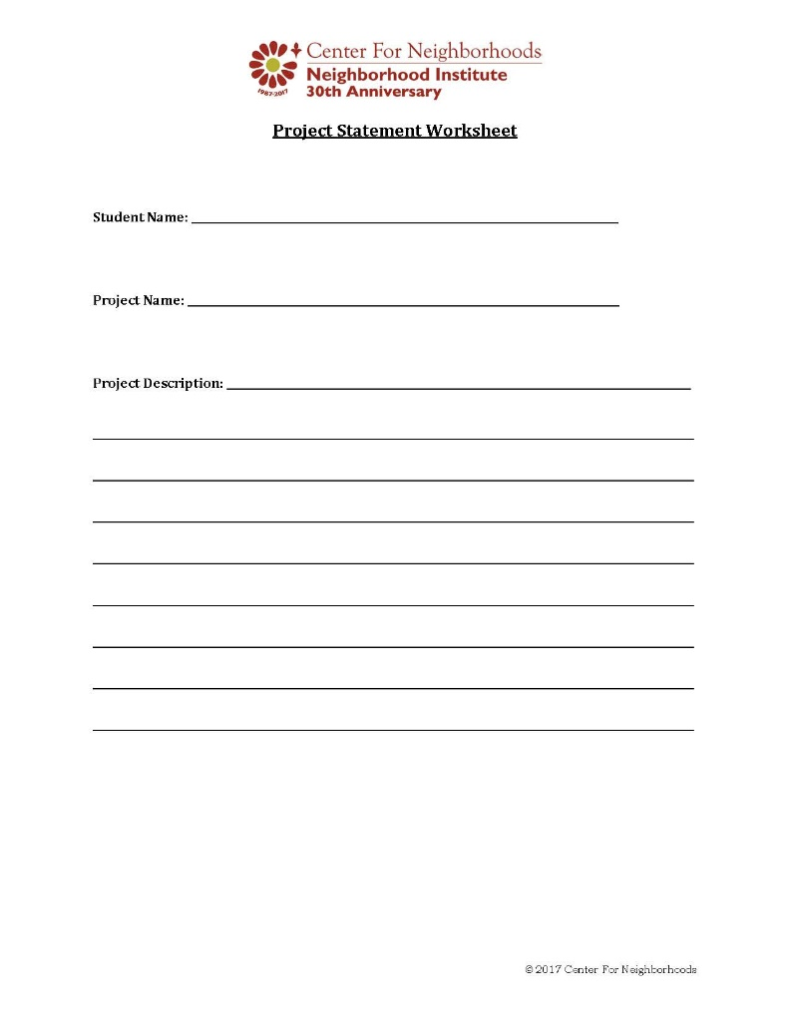
Project Statement

Slide 21
Project Statement
“My project is to increase access to books in 40210 by building and placing 10 Little Free Libraries this year.”

Slide 22
Project Statement
On an index card: Make a list of at least 3 specific things you NEED

Slide 23
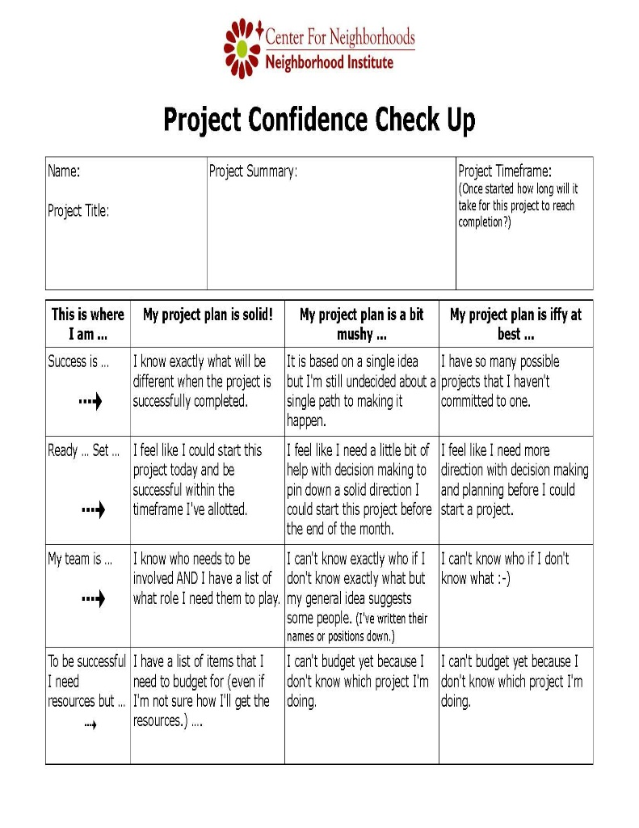
Project Confidence Check Up

Slide 24
Project Confidence Check Up
1
2
3
A
B
C
D

Slide 25
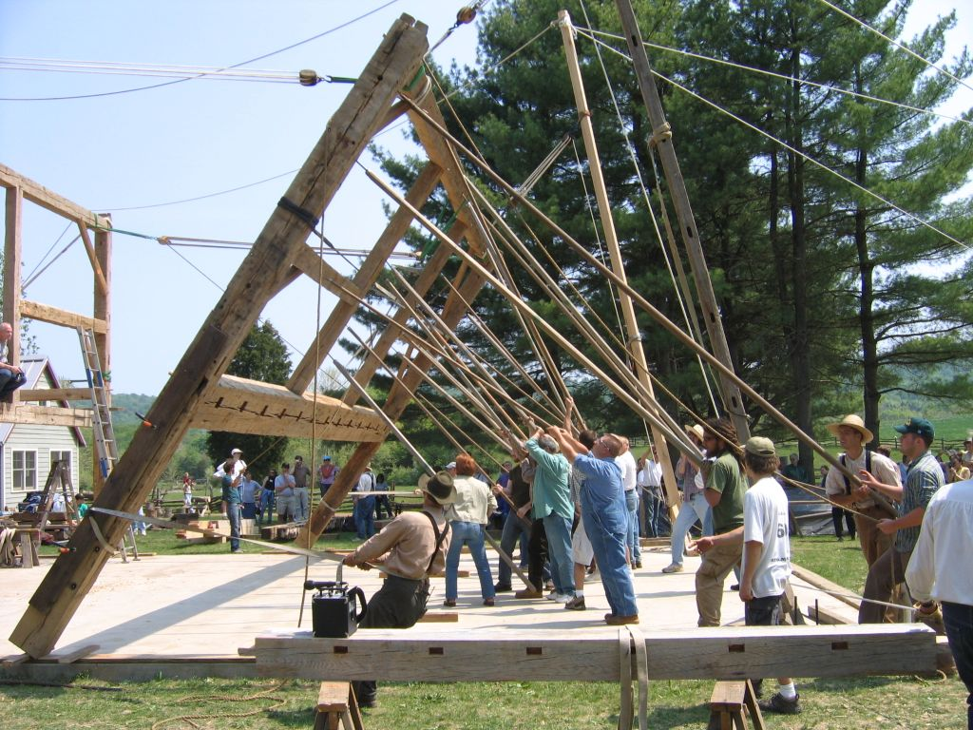
Barn Raising Overview

Slide 26
Barn Raising Prep
Description of the outcome of your project
Remember that list of at least 3 specific things you NEED? Bring it!

Slide 27
Barn Raising
“This is who I am, this is what I'm trying to do, this is what I need help with.”

Slide 28
Barn Raising
Be as specific as you can about what you need.
Do not offer anything you are not truly willing and able to give.
If you can provide what someone else needs, or use what someone has to offer, raise your hand and give your name. Write down each other's information and get together after the formal part of the meeting is over.

Slide 29
Barn Raising
You will be working with those at your table…or close by
Everyone gets a turn!

Slide 30
Homework:
Follow up on resources you discovered during the Barn Raising!

